Slide 1
Adolescent Developmental Stages

Slide 2
Objective
Identify Typical Developmental Stages Including:
Physical Development
Thinking and Learning
Social – Emotional
For youth ages 12 to 18 years old

Slide 3
Developmental Stages: 12 - 14 years Physical Development
Growth of body hair, increase in perspiration, and oil in hair and skin
Tremendous Physical growth: gain in height and weight
Girls tend to be taller and weigh more
Deepening of voice and growth spurts (boys)

Slide 4
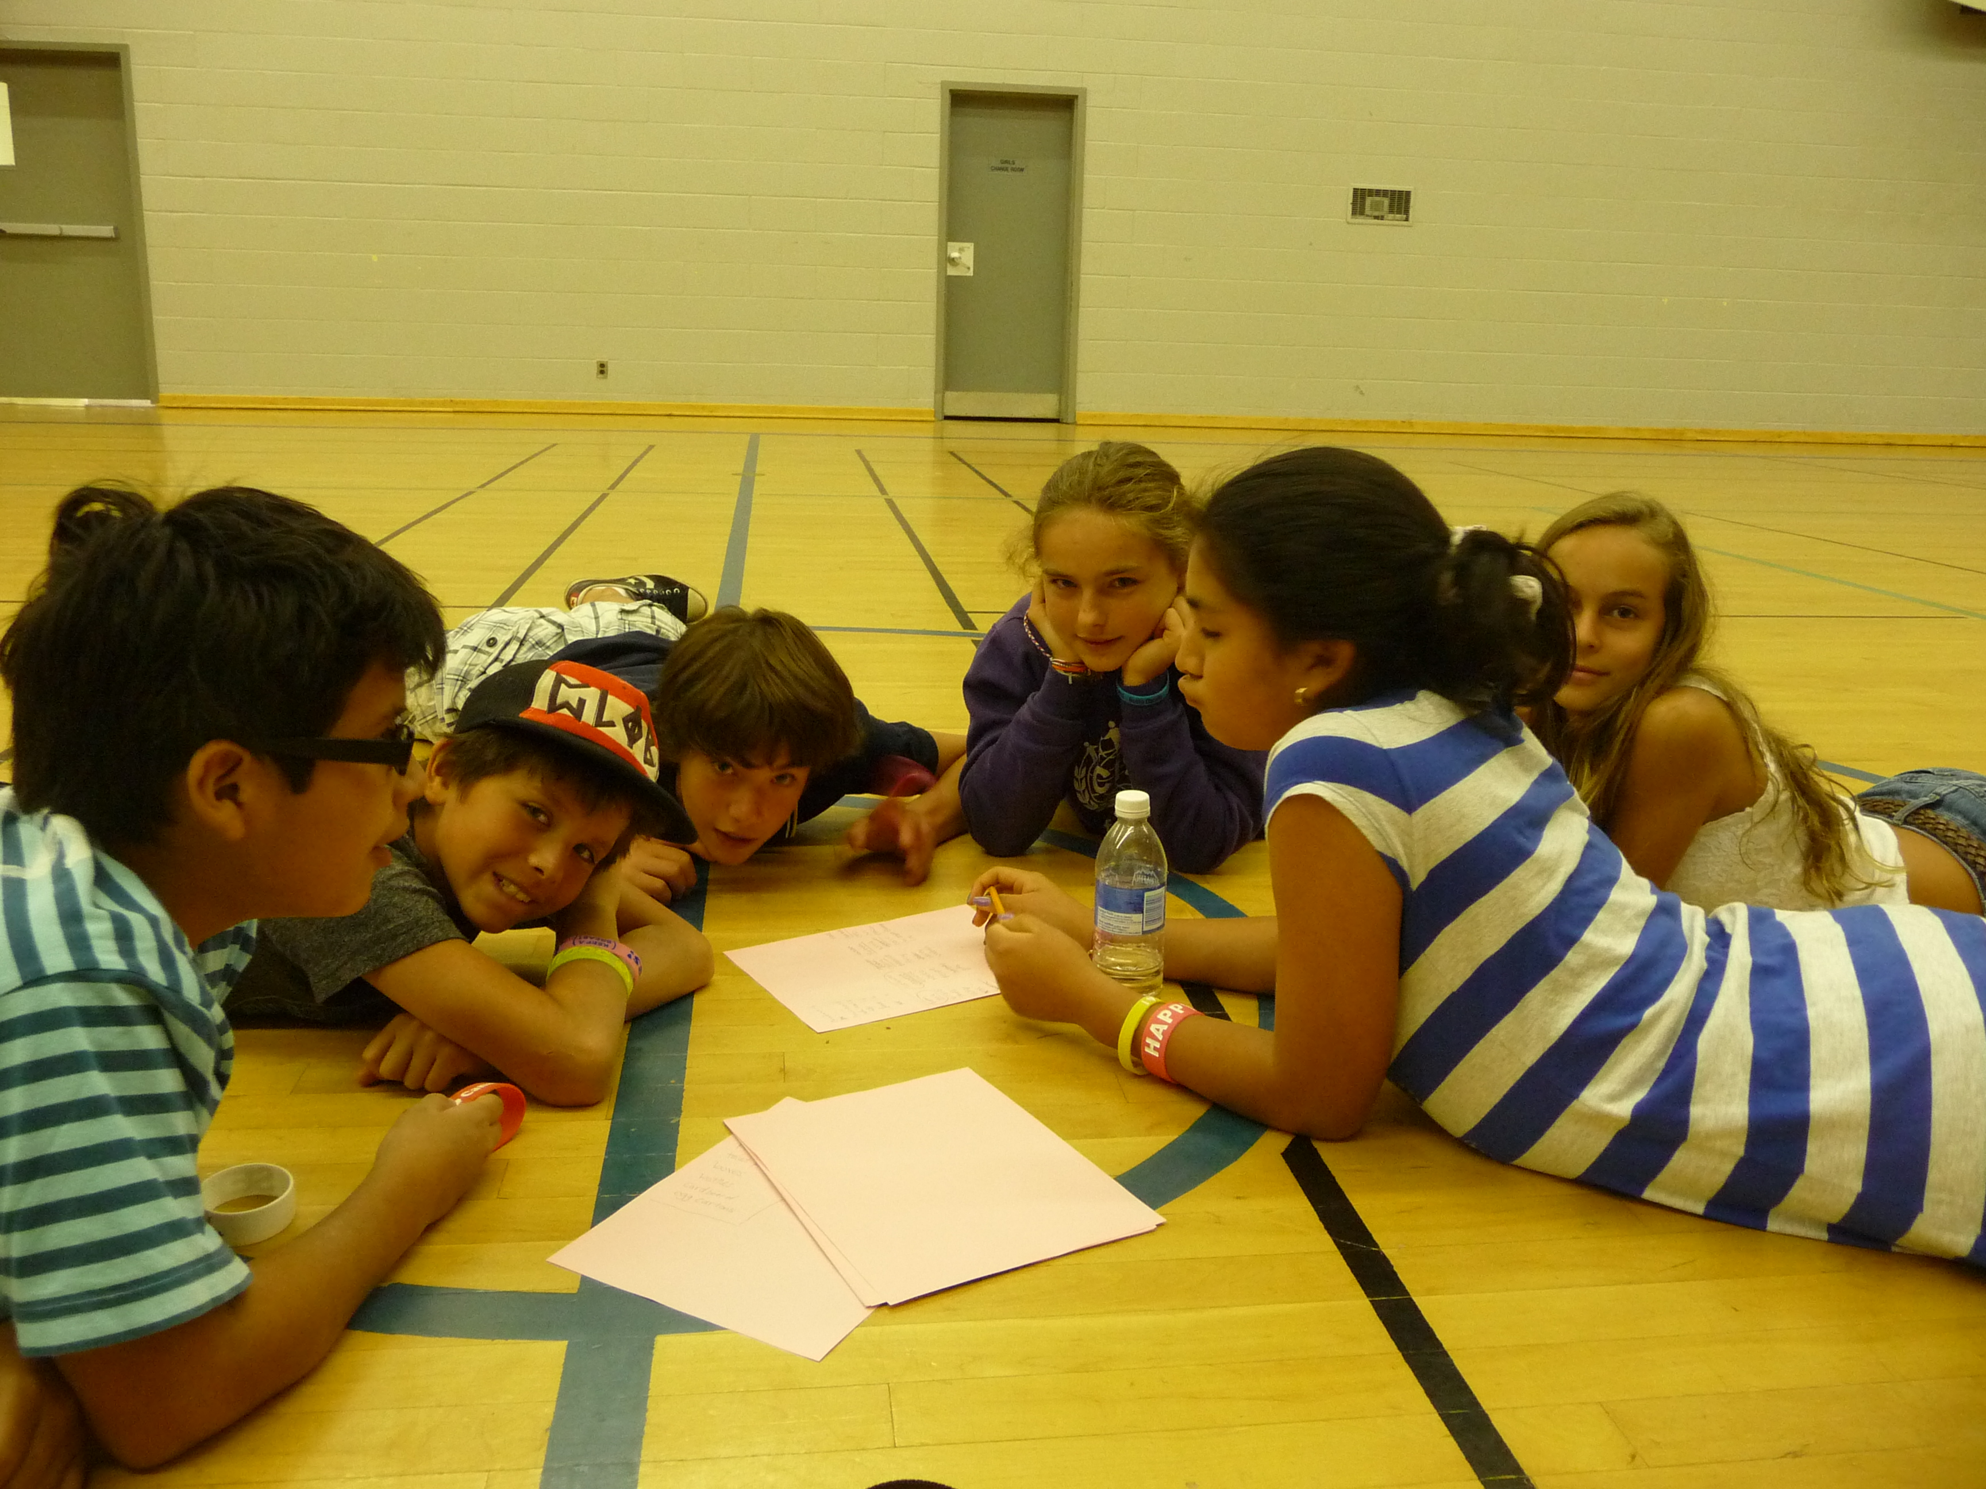
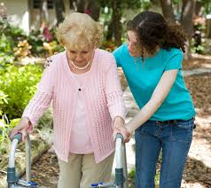
Developmental Stages: 12 - 14 years Thinking and Learning
Developing ability for complex thought
Developing a sense of right and wrong
Better able to talk about feelings

Slide 5
Developmental Stages: 12 - 14 years Social-Emotional
More concern about body image
Back and forth between high expectations and lack of confidence
Experience more moodiness
Realize that parents are not perfect
Returns to childish behaviors when stressed

Slide 6
Developmental Stages: 12 - 14 years Positive Tips
Meet and get to know your teen’s friends and schedule
Be honest and direct when taking about sensitive subjects
In conflicts, be clear about expectations, but allow input on how to reach those goals
Respect your teen’s opinion taking into account thoughts and feelings

Slide 7
Developmental Stages: 15 - 18 years Physical
Rapid physical changes
Often Anxious
Awkward in appearance and physical coordination
Sleeping patterns change
Most girls are physically mature
and will have completed puberty
Most boys will continue to physically mature during this time

Slide 8
Developmental Stages: 15 - 18 years Thinking and Learning
Further development of:
Moral Reasoning
Abstract thought
Skills for goal setting

Slide 9
Developmental Stages: 15 - 18 years Social-Emotional
Less conflict with parents and less time is spent with them
Developing the skills for caring, sharing and developing intimate relationships
Continued challenges with sadness and depression (Can develop into risky behaviors)

Slide 10
Developmental Stages: 14 - 18 years Positive Tips
Encourage them to volunteer and become active in civic activities in the community
Discuss good judgement with media such as games, chat rooms, and instant messaging
Show interest in activities and encourage involvement in sports, music, theater, and art
Spend time with your teen doing things that you both enjoy
Create opportunities for them to use personal judgement and be available for support

Slide 11
Questions
Contact Information:
Sue Ownby
Parent Liaison
Knox County Schools
Sue.ownby@knoxschools.org

Slide 12
References
Content source:
Division of Human Development and Disabilities, National Center on Birth Defects and Developmental Disabilities, Centers for Disease Control and Prevention
Stages of Adolescent Development Chart Adapted from the American Academy of Child and Adolescent’s Facts for Families. © All rights reserved. 2008
U.S. National Library of Medicine 8600 Rockville Pike, Bethesda, MD 20894 U.S. Department of Health and Human Services National Institutes of Health Page last updated: 05 October 2016

