Slide 1


Microsoft Teams
Quick Start Guide for Teachers

Slide 2

What is Microsoft Teams?
Microsoft Teams for Education is the hub for team work. It is an app that lets you pull together a team to work in a secure work space and it brings conversations and collaborations together with video meetings in a secure learning environment.

Slide 3
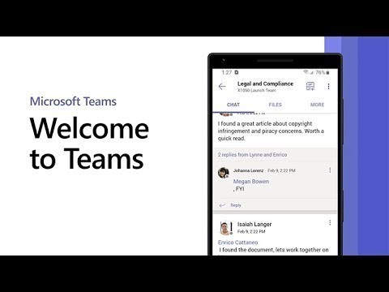
What is Microsoft Teams?

Slide 4
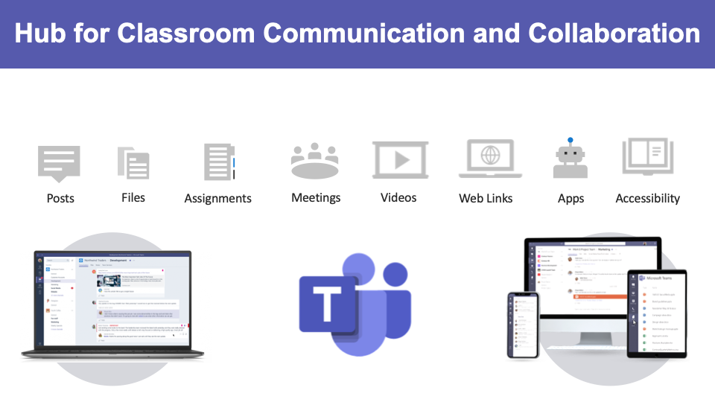

Slide 5
How will I access/download the Teams App?
Access the App
You can access Teams from inside Office 365 Outlook Website through KCS.
  If you use it through the website, you will be able to see the one person speaking and icons for the remainder of the class members.
  You can however download the app to your computer and/or phone which will allow you to see nine people and icons for the remainder of the class members.
To download for a phone, please visit the iOS App Store or Google Play Store. You will need to add your Knox County Schools Credentials. Mobile Device Downloads
To download to a computer:
  For a Mac, please visit KCS Self-Service for installation.
  For a Windows machine, you should be able to download the app directly to your machine.
Once the app is downloaded, we recommend configuring your notifications in the settings section so you are notified as often as you choose. (Note: Two-factor authentication is required to open the Teams application.)

Slide 6
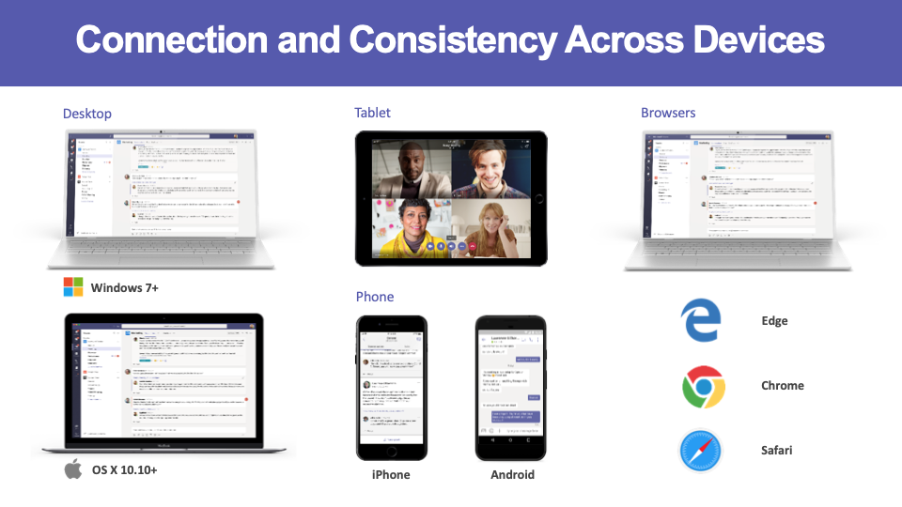

Slide 7
Microsoft Teams
Logging into Teams

Slide 8
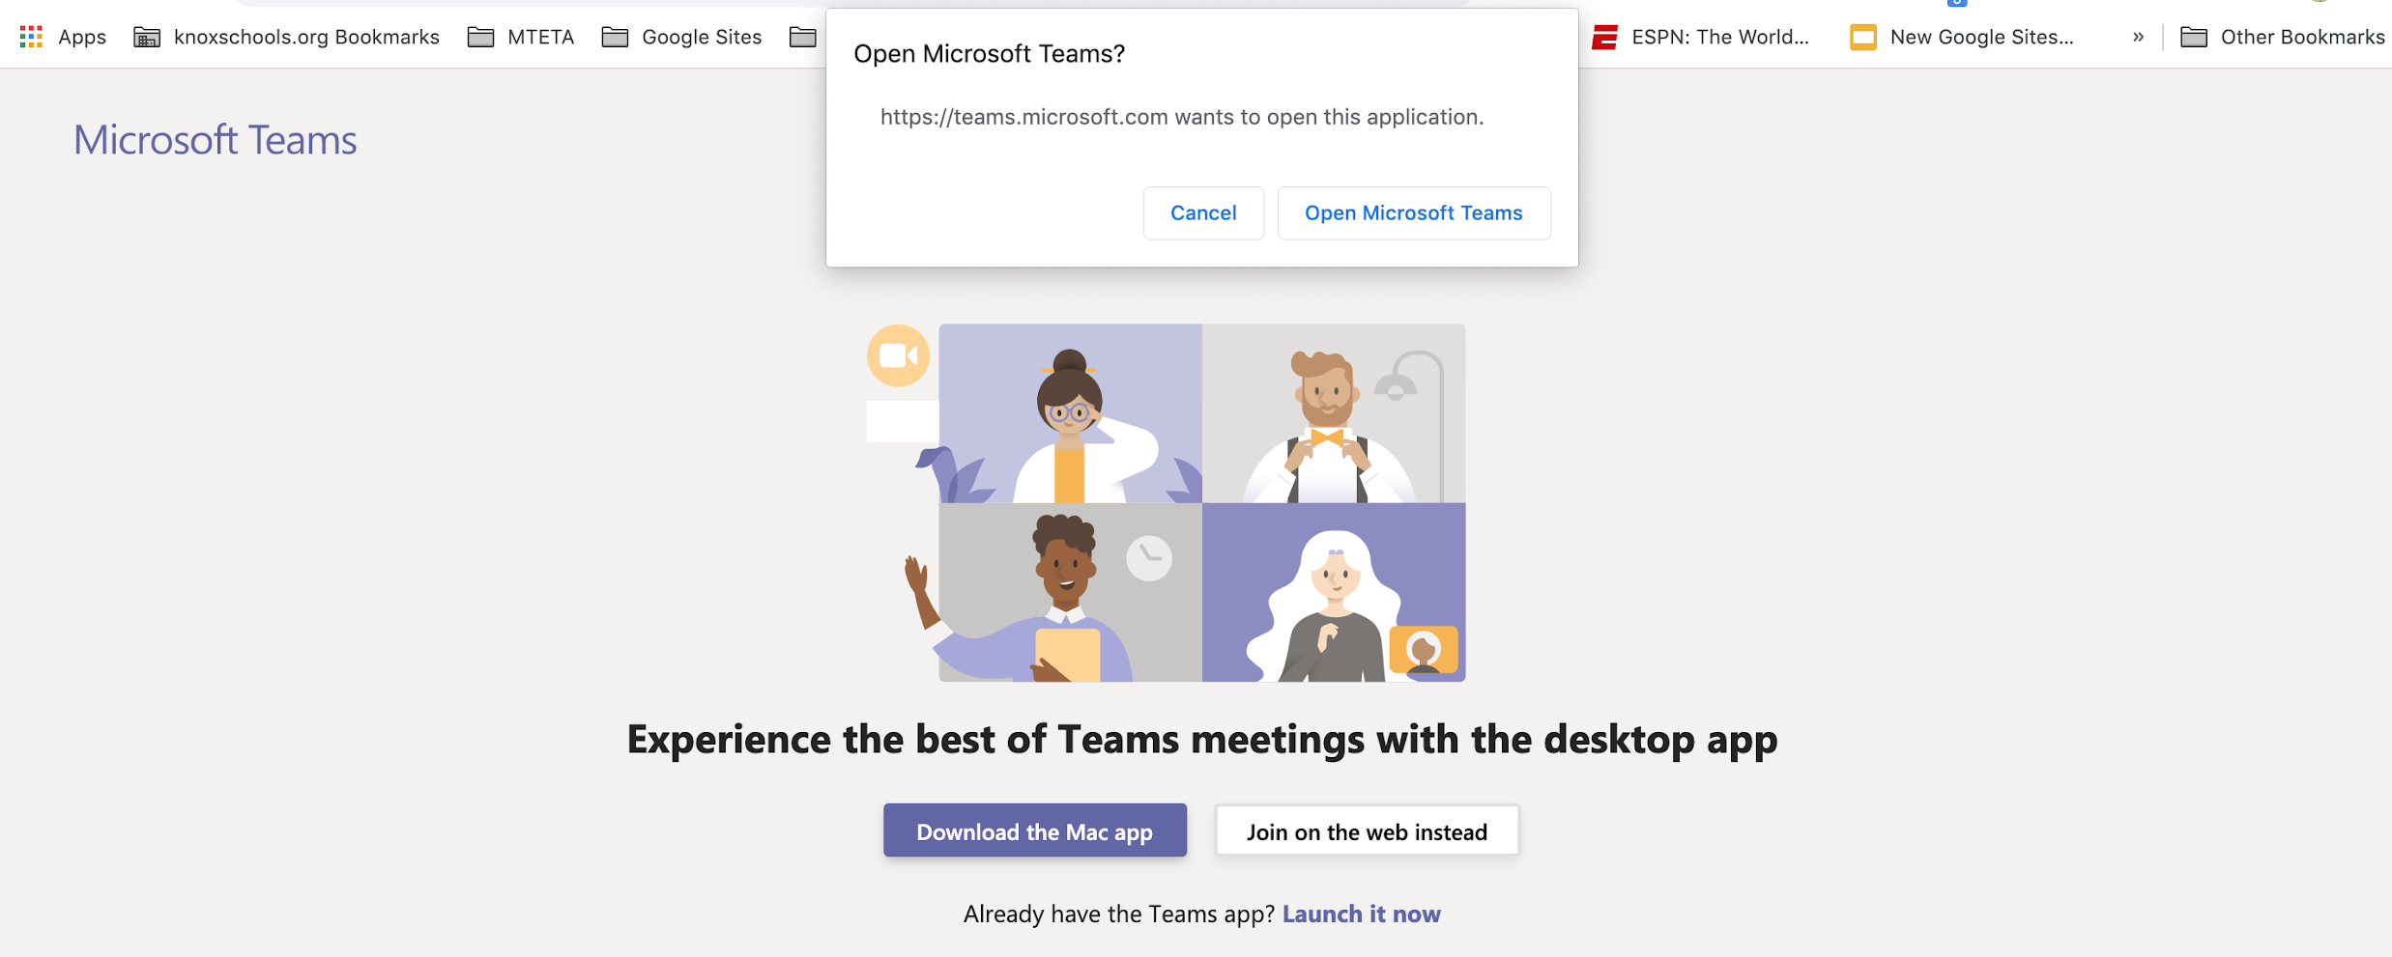
How will I Sign In to Teams?
When you login from the Teams app, you will be prompted to sign in with your KCS email credentials, and authenticate with Two-factor authentication.
If joining from a meeting link you, will given the choice of opening the Teams app or continuing in the Web Browser. The Teams app is most desired, as it has more features than the web version.

Slide 9
Microsoft Teams
Joining a Meeting

Slide 10
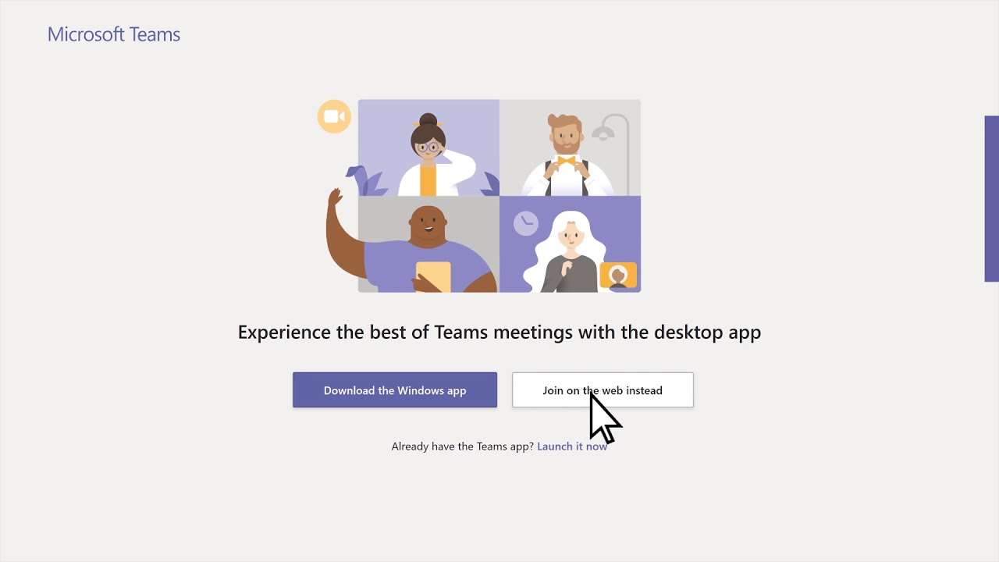
How will I access a Teams Meeting?
Through a Canvas Course, email, or directly in the Teams App
Click on the Join Microsoft Teams Meeting link.
You may be prompted to choose the web-based version or the app. The desktop version app contains more features and is the desired method of participating in a Teams Meeting.

Slide 11
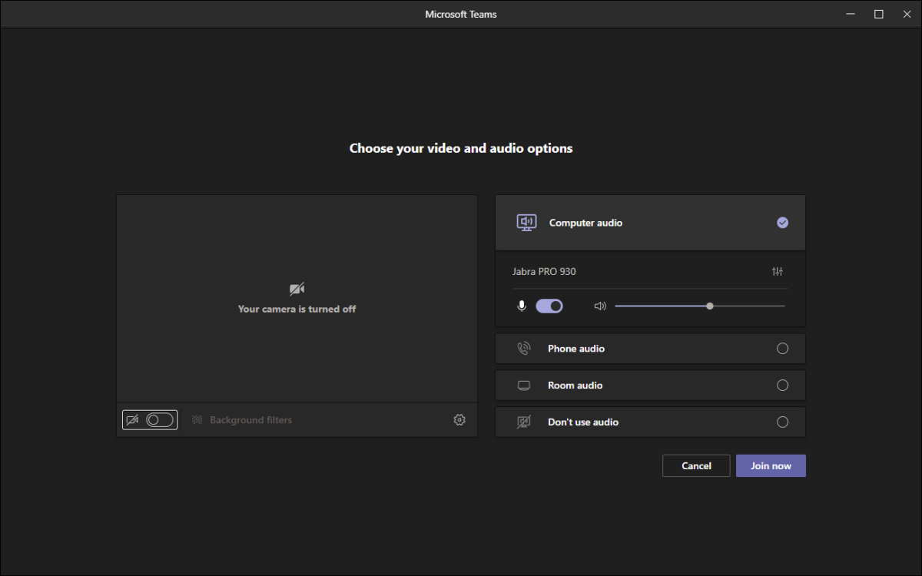
How will I access a Teams Meeting?
Choose whether to join the meeting with your video and audio on or off. Video On is recommended.
Audio Off is recommended
Click the Join Now button.
You should be able to join the meeting. (Note: If the presenter has the lobby turned on, you may have to be admitted to a meeting)

Slide 12
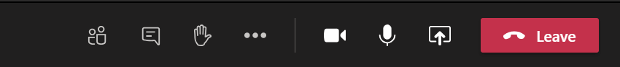
How do I use the Teams Meeting Control Bar?
The control bar helps you to navigate during a meeting. Not every feature may be available. (Controls left to right)
Camera: Turns your camera on and off.
Microphone: Allows you to speak (unmute) or allows you to turn off your microphone (mute).
Screen Sharing - Click the Up arrow to share your screen. Down arrow to unshare.
The three dots (ellipsis) give more options in a meeting - Backgrounds, close captions, etc...
Raise Hand: Allows the teacher to know you have a question or comment.
Meeting Chat: Allows you to write comments and questions. The teacher may use this area to share files with you as well.
Participants: Lists individuals in the meeting.
Leave: Click the red button to end the call.
How to use the Control Bar - https://bit.ly/kcsteamscontrolbar

Slide 13
Sharing Your Screen/Content in a Teams Meetings
To share your screen in a meeting, select Share in your meeting controls. Available sharing options include:
  Present you entire desktop
  Present just the current open window
  Present a PowerPoint presentation
  Use the Whiteboard
When you're done sharing, go to your meeting controls and select Stop sharing
How to Share your Screen in Teams - https://bit.ly/kcsteamsscreenshare

Slide 14
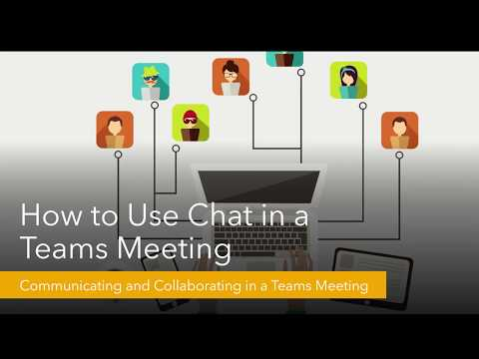
Meeting Options - Using Chat
The in-meeting Chat is a great feature for collaboration, questions, sharing files etc.
The Chat from the meeting will live in the Chat area on the left rail of Teams in the “Me” space and can be revisited or added to after the meeting has ended.

Slide 15
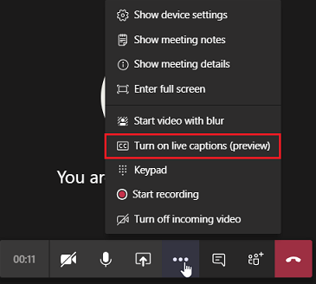
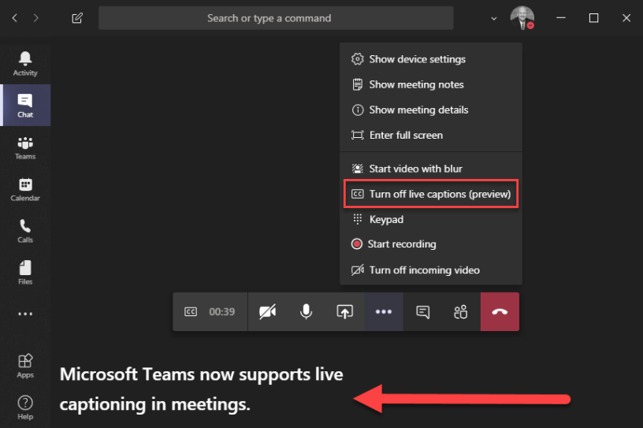
More Meeting Options - Closed Captioning (Live Captions)
The owner of the meeting has to Click on the Ellipsis (3 dots) to turn captions either on or off

Slide 16
Ending a Teams Meetings vs. Hanging Up
Meeting organizers have the option to end the meeting for all participants. If you're a teacher, for example, this is a great way to make sure your students don't hang around in your virtual classroom after you've left.
To end an in-progress meeting, go to your meeting controls and click the arrow next to Leave > End meeting.
You'll be asked to confirm. When you do, the meeting will end for everyone right away.
How to End a Teams Meeting - https://bit.ly/kcsendteamsmeeting

Slide 17
Microsoft Teams
Scheduling a Meeting

Slide 18
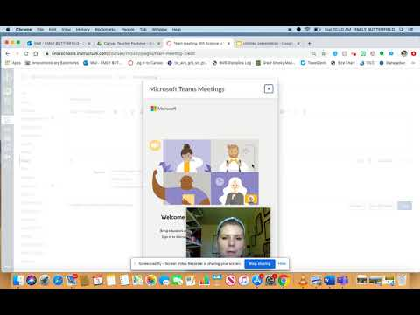
Scheduling a Teams Meeting with Students
Microsoft Teams Meetings can be scheduled for students through Canvas.
The meeting(s) can be a recurring Office Hours or can be as needed during the school year within a course.
Check out the video for step-by-step directions on scheduling a Teams meeting through Canvas.

Slide 19
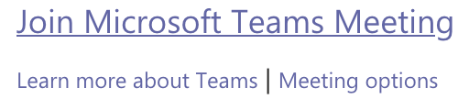
Scheduling a Teams Meeting with Colleagues
To schedule a meeting using the Teams Calendar, follow these steps.
Go to Calendar on the left side of the app and select New meeting in the top right corner.
A scheduling form will pop open.The scheduling form is where you'll give your meeting a title, invite people, and add meeting details and select a range of time in the calendar.
Once you're done filling out the details, select Save. This will close the scheduling form and send an invite to everyone's email inbox.
If you did not include participants by name in scheduling the meeting, share the Join Microsoft Teams Meeting link that has been created. Click back on the meeting in the calendar to get the link.

Slide 20
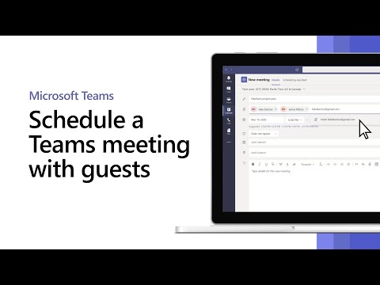
Scheduling a Teams Meeting with Parents or Guests
Teams meetings can be scheduled with parents or others who are not a part of the KCS group.
Use the email of the guest or parent to invite them to a meeting.
The join the meeting link can also be emailed to a parent or guest.

Slide 21
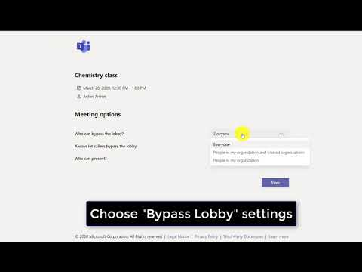
Setting Meeting Options - Everyone
To set meeting options for a Teams Meeting:
Click on the desired meeting in either the Teams or Office 365 calendar.
Click on Meeting Options
Select who to allow to Bypass the lobby. It will default to Everyone and can be changed as desired. Note: Guests in a meeting will have to be admitted, as they are outside the KCS organization.
Who can present? will allow you to pick only yourself or people you specify to share their screens in a Teams Meeting. This prevents others from inadvertently sharing their screens and can be changed during the meeting.

Slide 22
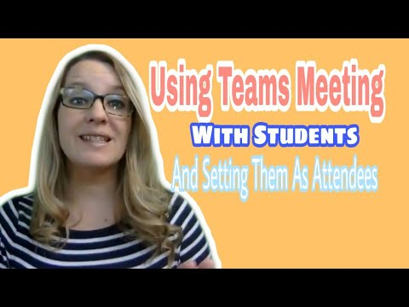
Setting Meeting Options - Student Meetings
1 - Changing roles within
a meeting. (Making Attendees)
2 - Use meeting options on
the calendar meeting link.
3 - Click on Who can Present and
select Only Me.
Due to the policies enabled by IT, some of the student features will not be options (for example, we can set the policy that only adults can record meetings). Stay tuned for more details about what is set for KCS. You can also set these roles for adults as well.

Slide 23
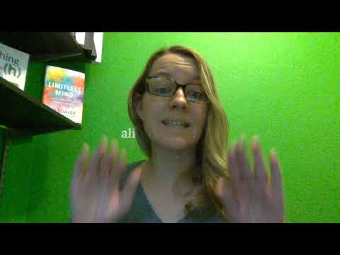
Attendee View for Teams Student Meetings

Slide 24
What are some Teams Meeting Expectations?
Be appropriate and respectful in your actions
KCS approved dress
Choose a well-lit room for your meeting.
Avoid sitting with a window behind you.
Be conscious of background noise.
Mute your microphone when you are not speaking.
Use the chat feature when you have a question or comment and do not want to interrupt the speaker.
Test system setting, audio and video, prior to conducting a meeting

Slide 25
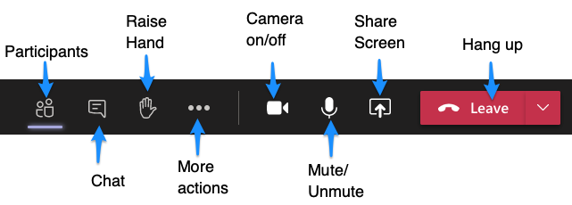
Recording a Teams Meeting
Recording a meeting can be a valuable resource for students and parents and help facilitate students' understanding and retention of the material presented. When you record a meeting, a searchable transcript and closed captions are automatically created.
To record a meeting, once the meeting has started, go to More options > Start recording. You can stop the recording using More options as well.

Slide 26
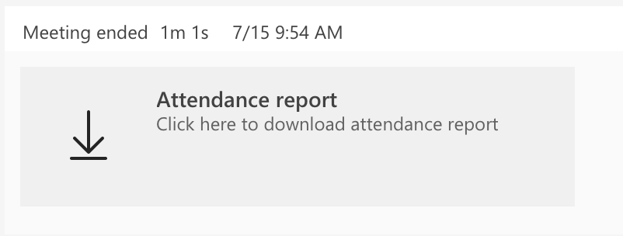
Attendance Report in a Teams Meeting
The attendance report for a meeting is located in the meeting chat for each individual meeting and can be downloaded or opened from that link.
To download:
Click the download arrow
Check your downloads for a .csv file called MeetingAttendance List.
This file can be opened with Excel, Numbers, or Sheets.

Slide 27
What happens if I have technical difficulties during a Meeting?
What happens if I am disconnected from the meeting?
Rejoin the meeting by clicking on the original link you were sent.
What happens if I am signed in as a guest in a meeting?
Hang up and, sign into your KCS account, and rejoin the meeting.
What do I do if I cannot hear the person speaking?
Most likely, the person has his/her microphone muted. You may wish to make a comment in the chat or you may unmute your microphone and let the speaker know. You may need to adjust the volume on your computer or phone.

Slide 28
Teacher Resources
Tips for Teachers In Microsoft Teams - https://bit.ly/kcsteamteacher
Tips for Meetings In Microsoft Teams - https://bit.ly/kcsteamteachermeeting

