Slide 1

Getting Started with Canvas for Teachers

Slide 2
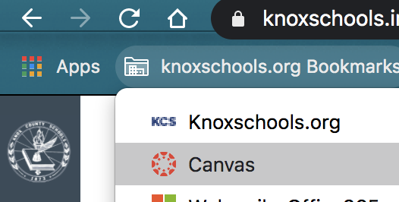
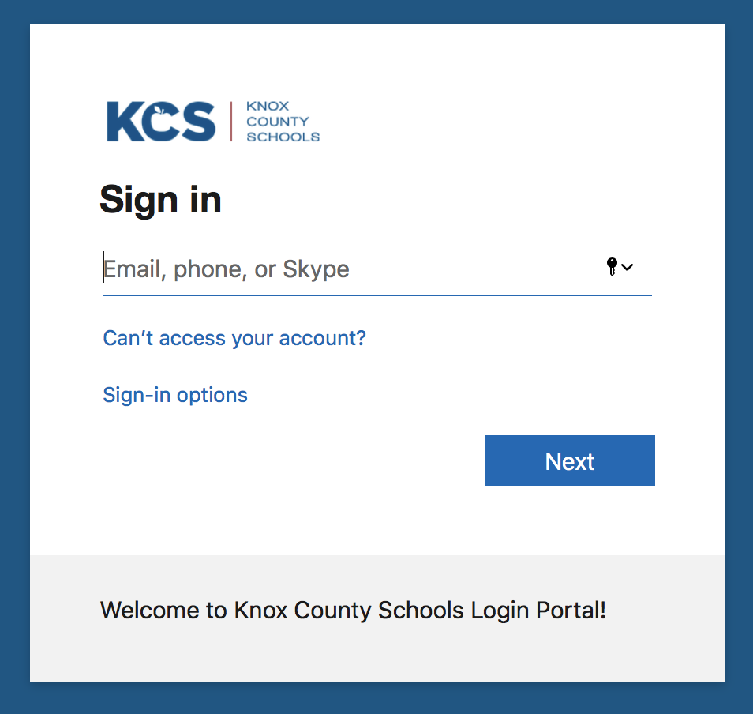
Logging In
Bookmark toolbar>Canvas
https://knoxschools.instructure.com/
Use your district email and password to login.

Slide 3
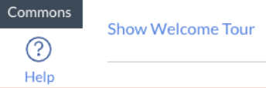
Welcome Tour
Click on the help menu icon in the global navigation to find the tour.

Slide 4
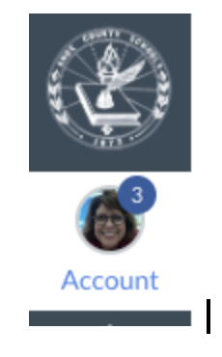
Notifications
Notification settings:
Found under Account
Set up how you wish to be notified of Canvas events.
Add your cell phone and/or personal email as preferred for Canvas notifications.

Slide 5
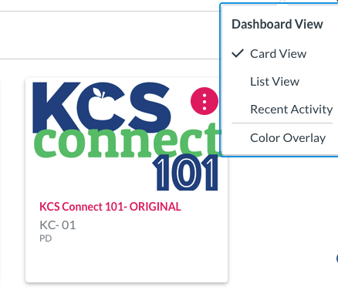
Your Dashboard
Find the correct Course Card on your dashboard to get into your course.
Note that under the three ellipsis, you can choose the view you want on your dashboard.
TIP: Control the Cards you see on your dashboard. Select Course icon >View all courses. Click the star next to any course cards you want to appear on your dashboard. Deselect the star to remove from your dashboard.

Slide 6
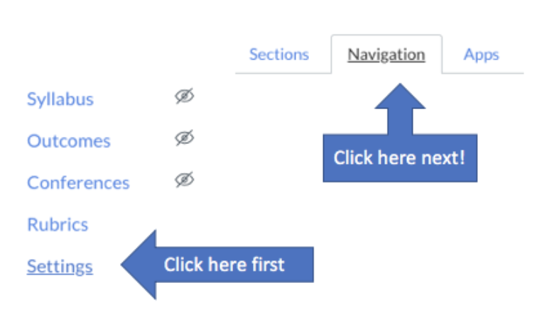
Course Navigation
Click Settings > Navigation
Found on the left of your page as you enter a Canvas course.
This area can easily be personalized for each course to help students find their way.
Drag any of the items found in the navigation to the bottom to hide them from students.

Slide 7

People
To Add people:
Choose People > +People
Use email address & choose role
Select Next
Click to Add User
You can add people in various roles like student, teacher, or TA.
Canvas syncs nightly with Aspen so student enrollment will remain current.

Slide 8


Google Drive
Authorize Google Drive to allow it to connect to Canvas.
Select Google Drive from Course Navigation
Enter your credentials.
Authorize.

Slide 9
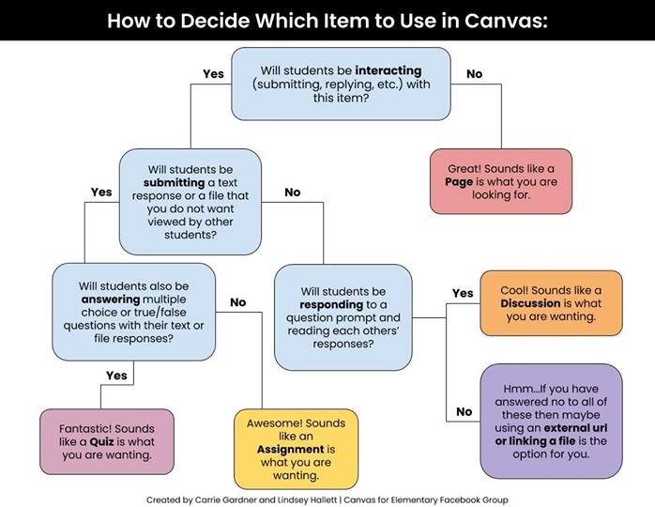

Slide 10

Pages
Content pages allow you to create materials for your class.
Create a homepage for your course.
Pages are essentially one-way communication.

Slide 11
Rich Content Editor
The editor is available any time you are adding text or content to a page, assignment, quiz, or discussion.
Check under the plug (far right) to see more options such as Google Drive, Microsoft Teams, etc.
Find the plugin icon to see YouTube, Google Drive and other Plugins.
Tip: Use tables to allow text to sit beside images!

Slide 12
Rich Content Editor
2
3
4
5
6
Anytime you type in Canvas, you will get this toolbar.
You can make change the font size or make the text bold (B), italicized (I), or Underlined (U).
You can change the color, highlight words, or super/subscript.
Align (center, left or right) your text or create bullets
Add hyperlinks, images, media, or documents. For media, you can upload or record here.
Insert table, math equations, and other connected items (under the plug like Google Drive).

Slide 13
Building Your Course
Modules
Pages
Assignment
Quizzes
Discussions
Feedback
Grades

Slide 14
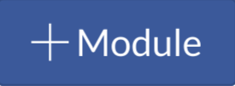
Modules
Modules organize content into units, weeks, or other chosen organizational methods.
  Provides linear direction for how course content should be completed.
  Houses assignments, discussions, quizzes, and pages.

Slide 15



Building Your Course
Assignments
Allow for students to submit work using various file types. Feedback and grades can be given.
Quizzes
Quizzes allow for student assessment of course content. Quizzes can be graded or set up as surveys or practice.
Discussions
Allow for student feedback and collaboration. Teacher settings can allow for customization of student replies. Can be set to graded or ungraded.

Slide 16
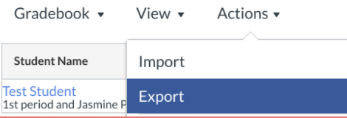
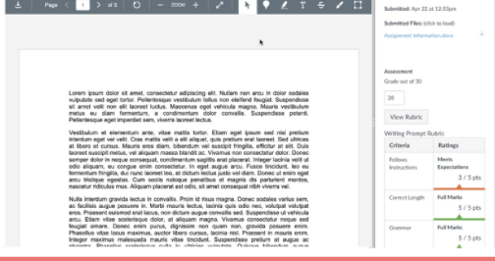
Grades and Feedback
SpeedGrader
Allows for teacher annotations and feedback directly on a student submission.
Grades>Select Student & Assignment>SpeedGrader
Exporting Grades
This will generate a .csv file that you can use to input your grades into Aspen.
Grades>Actions>Export

Slide 17
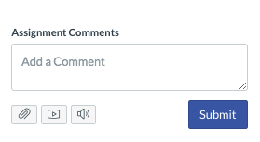
Feedback in SpeedGrader
Feedback
You can type comments.
Attach files with feedback.
Create an audio or video recording.
Use speech to text.
Then Submit
1
2
3
4
Rubrics are another great feature to be used within Speedgrader so students have high quality feedback.

Slide 18
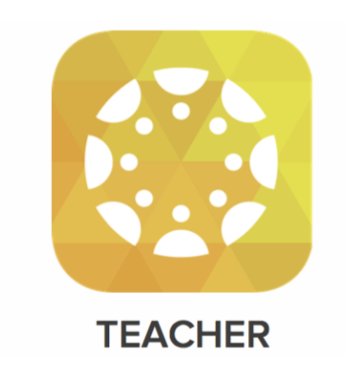
THE CANVAS TEACHER APP
Can be downloaded from the Apple or Android Store.
The app will allow access to your courses.
You can grade, communicate, and update through Announcements, Assignments, Discussions, and Quizzes.

Slide 19
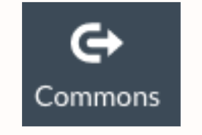
Commons
Share your work with yourself or others in the Commons.
You can also find work from others that you can import to your course.

Slide 20
Crosslisting
Do you teach multiple blocks of the same course?
Try crosslisting! This will allow you to upload ONCE and then all classes will have access to the information.
How to Crosslist courses

Slide 21
Have Questions or Need Support??
Email: edtechliaisons@knoxschools.org
Visit the Canvas Help Guides
https://community.canvaslms.com/community/answers/guides

