Slide 1
Getting Started with Canvas for Students

Slide 2
Logging In
-Logins are now a single sign-on (SSO).
-Use your Microsoft login and your password to login.
-Memorize your username and password.

Slide 3
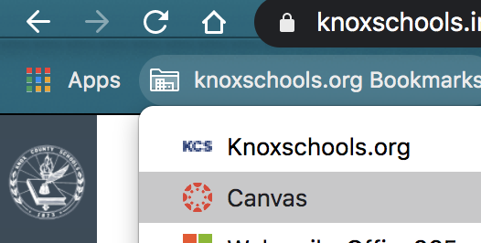
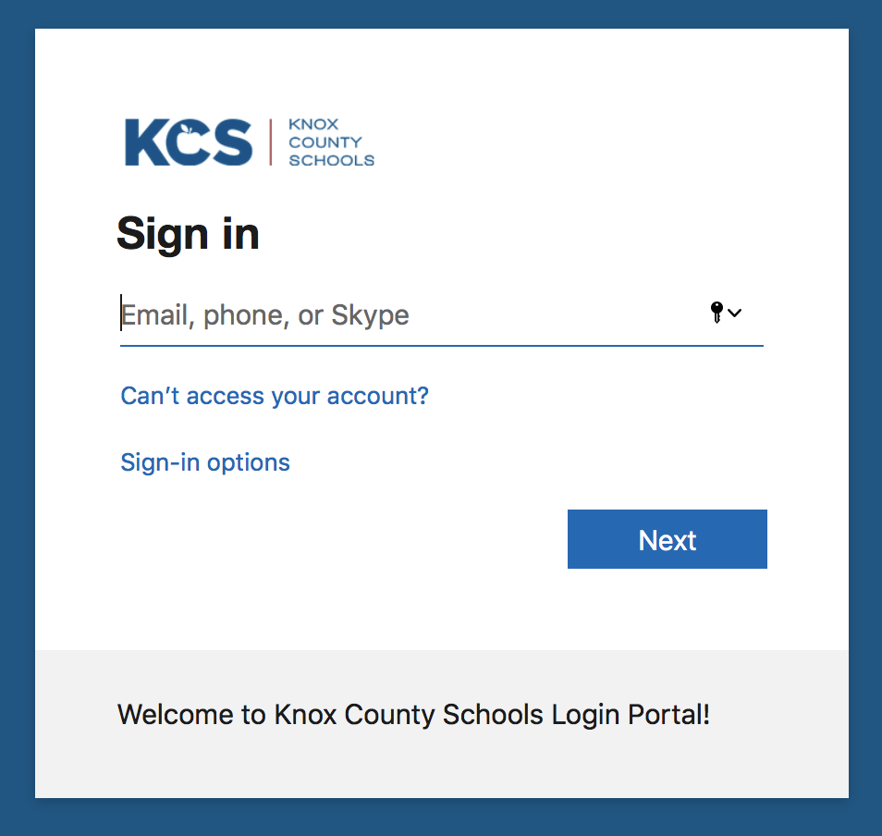
Logging In
https://knoxschools.instructure.com/
Bookmark toolbar>Canvas
Use your district email and password to login.

Slide 4
FIRST TIME LOGGING IN?

Slide 5
Forgot your password?
If you need your password reset,
contact your teacher!
Teachers can change student passwords in ARS

Slide 6
Welcome Tour
Click on the help menu icon in the global navigation to find the tour.

Slide 7
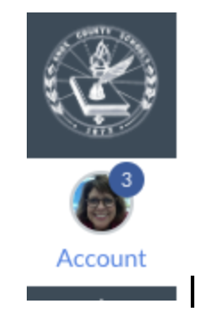
Notifications
Notification settings:
Found under Account
Set up how you wish to be notified of Canvas events.
Add your cell phone and/or personal email as preferred for Canvas notifications.

Slide 8
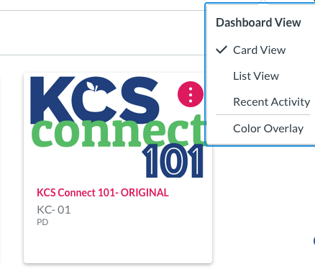
Your Dashboard
-Find the correct Course Card on your dashboard to get into your course.
-Note that under the three ellipsis, you can choose the view you want on your dashboard.
TIP: Control the Cards you see on your dashboard. Click Course icon >> View all courses. Click the star next to any course cards you want to appear on your dashboard. Deselect the star to remove from your dashboard.

Slide 9
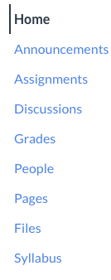
Course Navigation
Course Navigation is found on the left of your page as you enter a Canvas course.
This column allows for you to navigate through your course resources. (Your teacher controls which items you might see).
Note:
Global Canvas navigation -> Far left in gray

Slide 10
Course Navigation Language
Students can only see what the teacher has chosen for you to see.
If you don’t see these items, that is okay.
Modules
Modules organize content into units, weeks, or other chosen organizational methods. They house assignments, discussions, quizzes, and pages.
Quizzes
Quizzes can be graded or set up as surveys or practice. Be sure to read the quiz directions to find out how many attempts are possible and other possible quiz features.
Assignments
These are assigned to students for graded or ungraded submissions. Various file types can be submitted for teacher feedback.
Discussions
Discussions allow for student feedback and collaboration. Teacher settings can allow for customization of student replies. They can be set to graded or ungraded.
Announcements
Announcements are messages from your teacher to you. Watch for announcements for important dates and scheduled events.
To Do
On the right side of your homepage, will be an updated to do list of upcoming work that needs to be completed.

Slide 11
How do I Navigate a Module?
Once you get started in a Module, you will be able to select the Next or Previous buttons at the bottom of the page.

Slide 12
Rich Content Editor
2
3
4
5
6
Anytime you type in Canvas, you will get this toolbar.
You can make change the font size or make the text bold (B), italicized (I), or Underlined (U).
You can change the color, highlight words, or super/subscript.
Align (center, left or right) your text or create bullets
Add hyperlinks, images, media, or documents.
Insert table, math equations, and other connected items (under the plug like Google Drive).

Slide 13
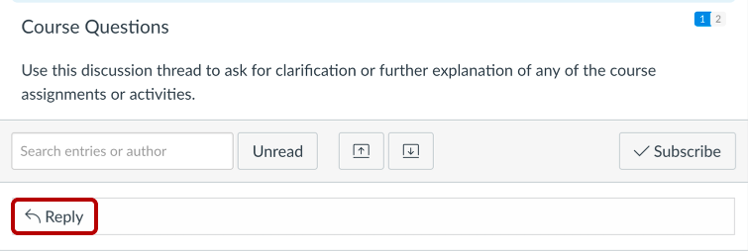
How do I reply to a discussion?
Your teacher will give you specific instructions based on how they set-up the discussion.
Select the reply button under the topic.

Slide 14
How do I reply to a discussion(2)?
Just type in the text box using the Rich Content Editor. You can attach a file too.
Post Reply.

Slide 15
How Do I Take a Quiz?
Your teacher might use Quiz or New Quizzes.
If they use a traditional quiz, you will select Take the Quiz to begin.
Then you should Submit Quiz.
Seek guidance from your teacher about various quiz types.

Slide 16
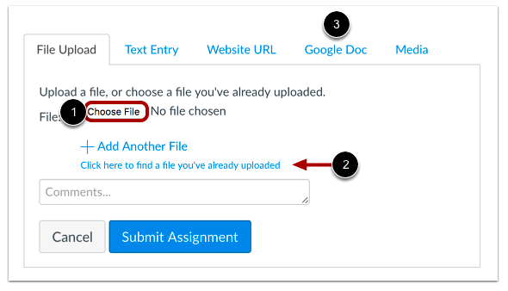
How Do I Submit an Assignment?
Once you have completed your assignment, then select submit assignment.
You will be able to choose a file, submit a text entry, website URL, or Google Doc.

Slide 17
Grades
Official Student grades are found in Aspen.
Aspen.knoxschools.or
Viewing Assignment Feedback
Canvas teacher feedback and grades can be found under “Grades” in the left navigation (if the teacher has chosen for it to be viewed).
Students can reply to teacher feedback by submitting a comment (written, audio, or video)

Slide 18
Google Drive
In order to have access to all your Google Files in Canvas, be sure to authorize and allow your Google Drive to connect to your Canvas.
You should only have to do this one time.

Slide 19
Ask Your Teacher
Canvas is organized by your teacher and they will have various features they will share with you.
If you need help, just ask your teacher.

Slide 20
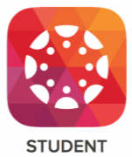
THE CANVAS STUDENT APP
This app can be downloaded from the Apple or Android Store.
The app will allow you to:
Access your courses and groups
Submit assignments
Participate in discussions
View grades and course materials
Access course calendars, to do items, notifications, and messages.

Slide 21
Need Help?
Contact the teacher for your course.
Use Help icon to access...
Canvas Help Guides & Welcome Tour

