Slide 1
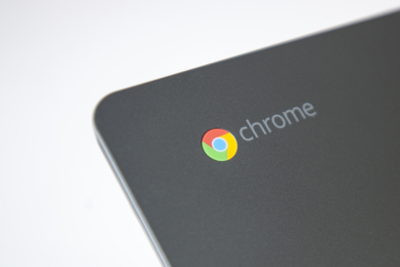
Chromebook Basics-
Students &
Families

Slide 2

Chromebook Session
Agenda
-What is a chromebook?
-Chromebook management
-Apps and uses

Slide 3

What is a chromebook?
Chromebooks are laptops that use Google's Chrome operating system (unlike a MAC OS or Windows). It's primarily used to navigate in the Chrome web browser and to work from web-based applications through Google Drive like Google Docs, Slides, and Sheets. Its storage is in the cloud rather than on the machine itself.

Slide 4

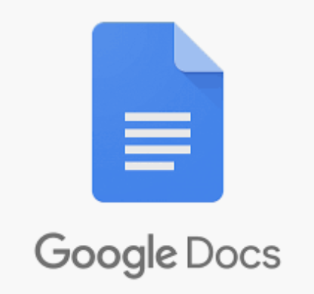
Google Workspace -
A Web-based set of productivity applications from Google.
Google Drive - Google Drive is a file storage and synchronization service developed by Google. Google Drive allows users to store files on their servers, synchronize files across devices, and share files.
Google Docs - Google Docs is a word processor included as part of a free, web-based software office suite offered by Google within its Google Drive service.

Slide 5

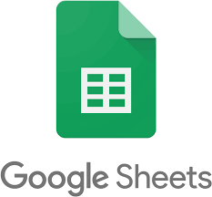
Google Workspace -
A Web-based set of productivity applications from Google.
Google Slides - Google Slides is a presentation program included as part of a free, web-based software office suite offered by Google within its Google Drive service.
Google Sheets - Google Sheets is a spreadsheet included as part of a free, web-based software office suite offered by Google within its Google Drive service.

Slide 6
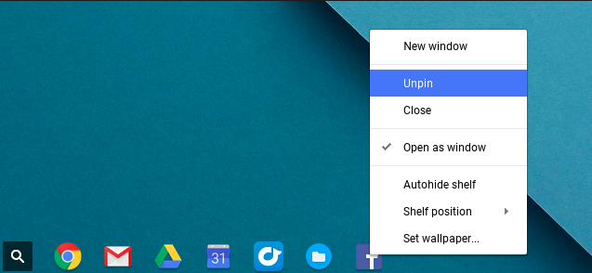
The Shelf
Notes:
Pin things that you use often
Unpin things that you do not want students to use

Slide 7
The Shelf
Notes:
Pin things that you use often
Unpin things that you do not want students to use

Slide 8
Management...
Sample Student
Student Passwords
John Smith
Student ID #1234567
Username: S1234567@student.knoxschools.org
Password: JS4567kcs
If a student password needs reset, please contact the student’s teacher.

Slide 9
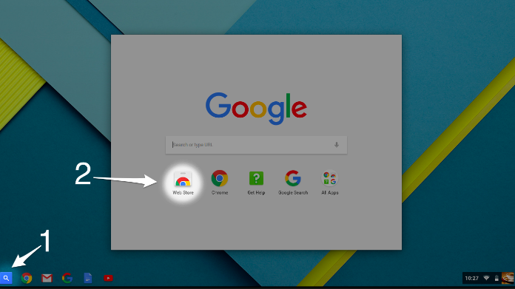
The Web Store

Slide 10
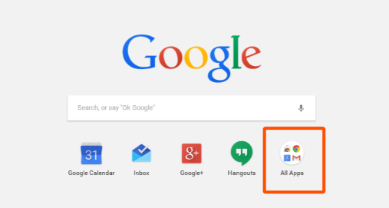
Finding Apps
Talk to your teacher about which apps to download. Too many apps may cause your device to slow.

Slide 11

HELP?
Restart the device
Contact the teacher

Slide 12



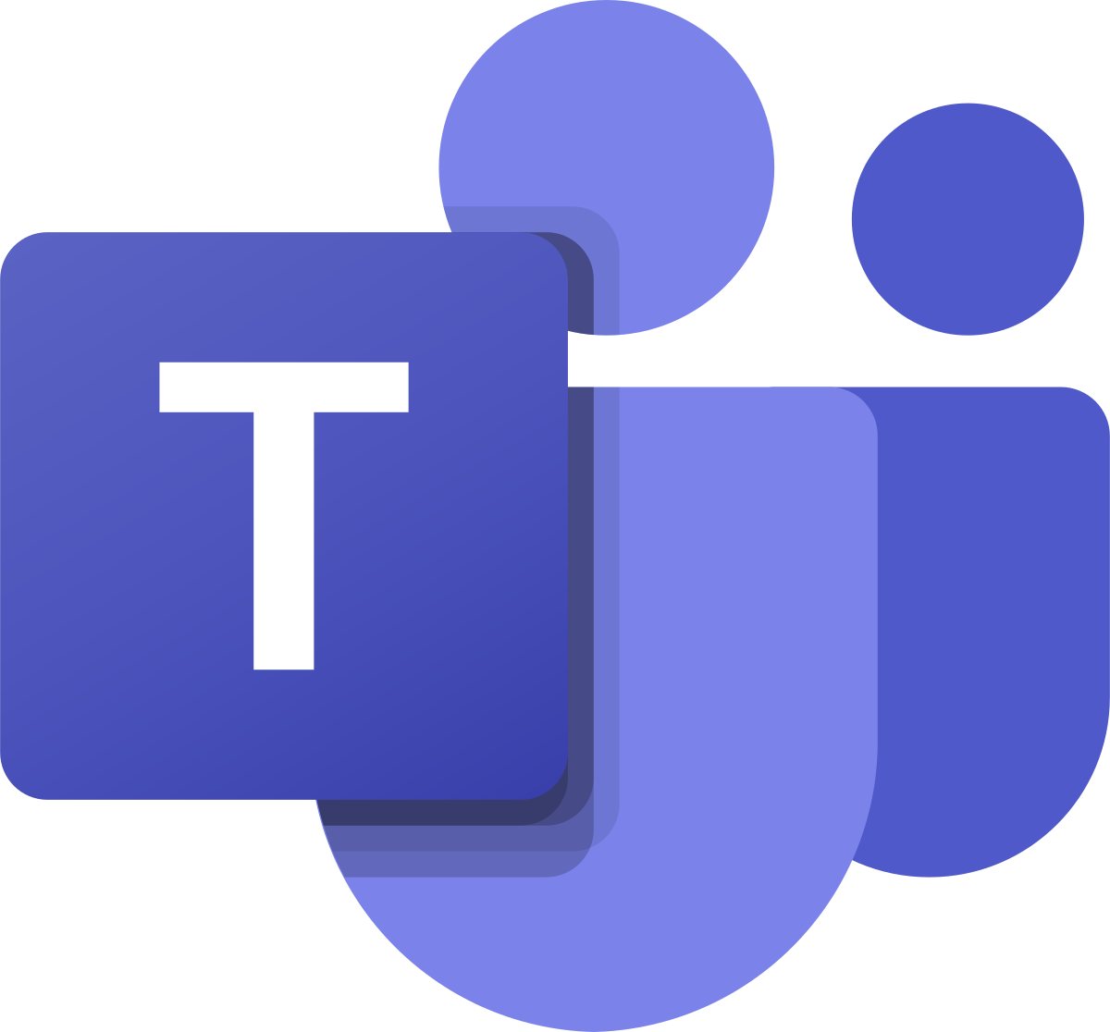
Technology Systems to Support our Students
Aspen is the system for grades, attendance, and communication. Aspen Family Portal allows for communication concerning student progress. | Canvas is the learning management system. Student content, tasks, and feedback will all be housed here. This is a student’s digital backpack. | Google Drive allows students to store various work products as documents, spreadsheets, or presentations. Connects with Canvas. | Microsoft Teams is the system used to video chat. Connects with Canvas.

