Slide 1
Getting Started with Canvas for Families

Slide 2
Technology Systems to Support our Students
Aspen is the system for grades, attendance, and communication. Aspen Family Portal allows for communication concerning student progress. | Canvas is the learning management system. Student content, tasks, and feedback will all be housed here. This is a student’s digital backpack. | Google Drive allows students to store various work products as documents, spreadsheets, or presentations. Connects with Canvas. | Microsoft Teams is the system used to video chat. Connects with Canvas.

Slide 3
This Session Focuses on Canvas
Aspen is the system for grades, attendance, and communication. Aspen Family Portal allows for communication concerning student progress. | Canvas is the learning management system. Student content, tasks, and feedback will all be housed here. This is a student’s digital backpack. | Google Drive allows students to store various work products as documents, spreadsheets, or presentations. Connects with Canvas. | Microsoft Teams is the system used to video chat. Connects with Canvas.

Slide 4
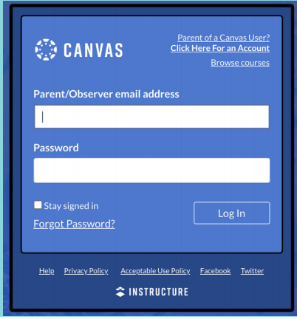
CREATE AN OBSERVER ACCOUNT
https://knoxschools.instructure.com/
An observer account will allow you to view your child's courses.
Create an account and use your student's pairing code to link them to your account.

Slide 5
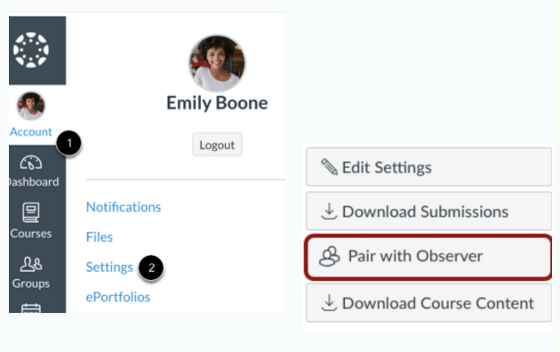
How to Generate a Pairing Code
Student will login to his/her account to generate a pairing code that can be used to link the Canvas account to an Observer.
Login to student’s Canvas account.
Select Account>Settings>Pair with Observer
Use this code to link account to parent/guardian account.

Slide 6
FIRST TIME YOUR STUDENT IS LOGGING IN?

Slide 7
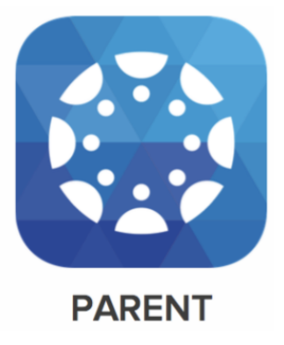
CANVAS MOBILE APP
The Canvas Parent App can be downloaded from the Apple or Android store.
The app will allow you to:
access to view student courses
review upcoming and past assignments
check on grades
receive alerts about student activity.

Slide 8
UNDERSTANDING COURSE NAVIGATION
Modules
Modules organize content into units, weeks, or other chose organization methods.
They house assignments, discussions, quizzes, and pages.
A teacher may/or may not allowing students to view this item.

Slide 9
Assignments
Tasks that are assigned to students for graded or ungraded submissions.
Teachers can request various file types from students to offer feedback.

Slide 10
Quizzes
Quizzes can be graded or set up as surveys or practice.

Slide 11
Discussions
Discussions allow for student feedback and collaboration.
Replies can be written, audio, or video.
Teacher settings can allow for customization of student replies.
These may be graded or ungraded.

Slide 12
Grades
OFFICIAL STUDENT GRADES ARE FOUND IN ASPEN- via Aspen Family Portal
ASPEN.KNOXSCHOOLS.ORG

Slide 13
Grades
In Canvas
The Grades section in Canvas shares Teacher Feedback and Assignment Grades.
Students can reply to teacher feedback by submitting a written, audio, or video comment.
Remember Canvas is the student’s digital backpack and only has the work of the student and not the final average.

Slide 14
Keep in Mind
How to actively participate in the Canvas Course can be found in the student resources.
Canvas is customizable and some features may not be visible for students. Contact your child’s teacher for more details for how to navigate their course.

Slide 15
HAVE MORE QUESTIONS?
Contact your Child’s Teacher
The Help Icon in Canvas can give more resources.

