Slide 1
Community Budget Meeting
April 13, 2023

Slide 2

Agenda
Introduction – Superintendent Dr. Rysewyk
    KCS Four Priorities
Budget Development
    Stakeholder Input
    Projected Revenue & TISA Overview
FY24 Proposed Budget
Questions
Notes:
Jon

Slide 3
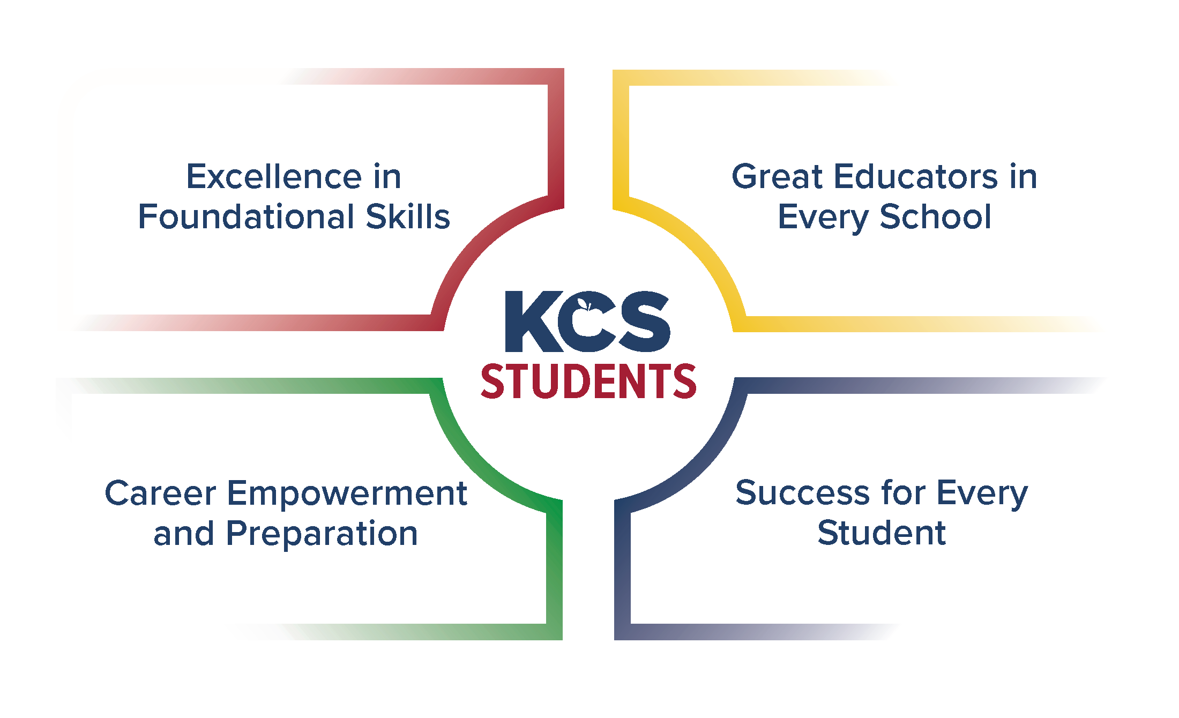
Four Priorities
Notes:
Jon

Slide 4
Superintendent’s Highlights
Investments in Staff
$16.8m for 4% base salary increases for all certified and classified staff
$3.5m for additional 8% (total 12%) base salary increases for all custodians, school clerical, educational assistants, and food service**
Investments in Students
20 new FTE interventionists (10 behavioral, 10 academic) for staffing pilot - 2 schools per region*
6 new FTEs: Richard Yoakley, KAEC, and Ridgedale (2 new FTEs each)
18 new Pre-K positions
Investments in Schools
555% increase in playground investments, from $90k (FY23) to $590k (FY24)
3 Population Growth Solutions:
  Farragut - $4m | Mechanicsville/Lonsdale/Beaumont - $3.4m | South Knoxville - $4.1m, FY25
$3m in School Security Investments:
Locks | Video Systems | Emergency Communication | Perimeter Security
Notes:
Jon

Slide 5
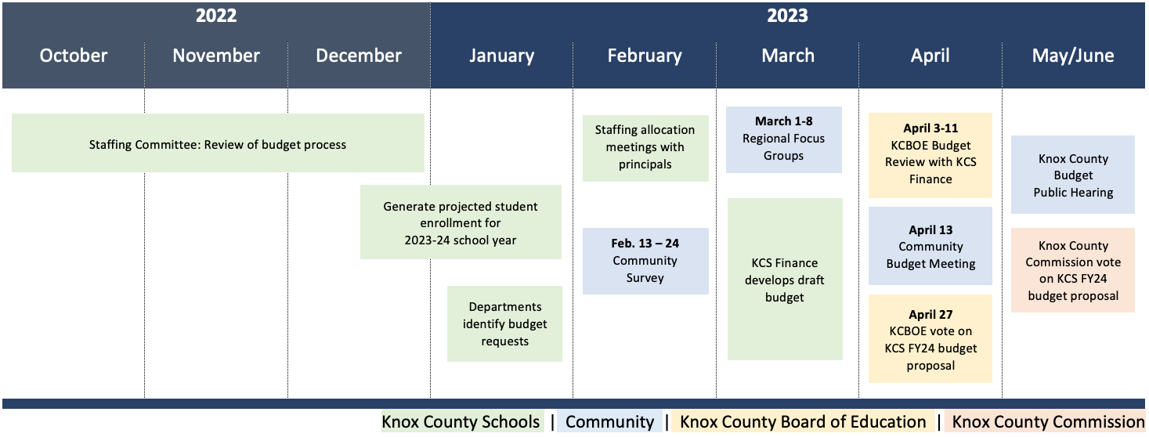
Identifying Expenditures:
Stakeholder Engagement Process
Notes:
Joe

Slide 6
Stakeholders
 | KCS Families | KCS Staff | Community Members | Total
Staffing Committee | -- | 26 | -- | 26
Community Survey English and Spanish | Parents/ Guardians: 1,224 Students: 7 | 671 | 237 | 2,139
Regional Budget Focus Groups One per region | Parents/ Guardians: 16 | 22 | -- | 38
TOTAL: |  |  |  | 2,203
Notes:
Joe

Slide 7


Budget Development: General Purpose (GP)
Revenue
Expenditures
State funds
Local funds
Other revenue
Investments in Instruction
Investments in Staff
Investments in the Future
Investments in Students
Fixed Expenses
Notes:
Joe

Slide 8
FY24 Projected Revenue: $655.5 million
STATE …………………….…...... $302.7m
TISA: $298.6m
Other: $4.2m
LOCAL ……………..………….… $340.5m
Sales Tax: $225.7m
Property Taxes: $113.1m
Other: $1.7m
OTHER SOURCES ……………... $12.3m
Notes:
Joe

Slide 9













TISA – New State Funding Formula
BEP: prior to FY24
flat rate per-pupil funding
TISA: FY24 onward
student-centered funding
Student Centered Budgeting
Student A: $7,973*
Student A: $6,860*
Transportation
School Staff
School Utilities
& Maintenance
Student B: $7,973*
Economically
Disadvantaged (ED)
4th Grade Tutoring
Student B: $9,075*
Economically
Disadvantaged (ED)
4th Grade Tutoring
A
C
B
Student C: $7,973*
Economically
Disadvantaged (ED)
4th Grade Tutoring
Unique Learning Need
Student C: $13,827*
Economically
Disadvantaged (ED)
4th Grade Tutoring
Unique Learning Need
Instructional
Materials
Special Education
Services
Tutoring
District
Support
*FY23
*estimate
Notes:
Joe / Joni

Slide 10
FY24 Proposed Expenditures: $64 million ( )
Priority-Based Initiatives ………….…… $36m
Staffing Allocations ………………….….. $5.4m
Capital Improvements ………….……. $11.3m
Maintenance, IT, Transportation …. $6.7m
Other ……………………………….……….... $4.7m
92% School Based | 8% Districtwide
Notes:
Joni

Slide 11
FY24 Priority-Based Expenditures: $36 million
Excellence in Foundational Skills | Invest in Instruction High-quality instructional materials | Tutors and Interventionists | $647.9k*
Great Educators in Every School | Invest in Staff Salary and benefits | Recruitment and retention efforts | $31m
Career Empowerment & Preparation | Invest in the Future College and career exposure opportunities | Advanced Academics | $167.5k*
Success for Every Student | Invest in Students Expanded Pre-K opportunities | Increased behavioral and mental health supports | $4.2m
Capital Improvements | Invest in Schools Improvements to existing facilities | Expansion to address population growth | $11.3m**
*Significant investments from ESSER 3.0 and other grants
**Additional funding requested in FY24 Capital Improvement Plan
Notes:
Joni

Slide 12
FY24 Investments in Staff & Students
Great Educators in Every School | Invest in Staff -- Salary and benefits | Recruitment and retention efforts
 | $16.8m for 4% base salary increases for all certified and classified staff
 | $3.5m for additional 8% (total 12%) base salary increases for all custodians, school clerical, educational assistants, and food service**
 | $3.5m to cover inflationary increases to medical insurance premiums
 | $1.3m to provide targeted staff support for Region 5 schools
Success for Every Student | Invest in Students -- Expanded Pre-K opportunities | Increased behavioral and mental health supports
 | 6 new FTEs: Richard Yoakley, KAEC, and Ridgedale (2 new FTEs each)
 | 18 new Pre-K positions
 | 20 new FTE interventionists (10 behavioral, 10 academic) for staffing pilot - 2 schools per region*
 | 9.5 new school-based support positions (i.e., elementary counselors, psychologists, etc.)
 | 1.0 new ELL Family & Community Liaison
*Funds in staffing allocation
**Funds in Child Nutrition Program budget
Notes:
Joni

Slide 13
FY24 Investments in Schools
Other General Purpose Initiatives
555% increase in playground investments, from $90k (FY23) to $590k (FY24)
$11.3m to Capital Improvement Fund
FY24 Capital Improvement Plan Proposal: $51.35 million
Highlights
3 Population Growth Solutions:
  Farragut - $4m | Mechanicsville/Lonsdale/Beaumont - $3.4m | South Knoxville - $4.1m, FY25
Significant Investments in School Maintenance:
HVAC - $8m | Paving - $3.15m | Roofing- $3m
$3m in School Security Investments:
Locks | Video Systems | Emergency Communication | Perimeter Security
Notes:
Ron

Slide 14

FY24 General Purpose Budget Proposal
Revenue
$655,500,000
Expenditures
$655,500,000
Notes:
Ron

Slide 15
Questions
Notes:
All

