Slide 1



Slide 2

What is YOUR plan after high school?

Slide 3
Today you will learn about:
Choosing a Career
Getting into College
Going to College
Paying for School

Slide 4
Choosing a Career

Slide 5

Learn More About Yourself
Take a look at:
Your interests
Your skills
Your career goals
Focus on information that
Pertains to your personality
Represents the lifestyle you want
Reflects the goals you have set for yourself
Assure yourself
Volunteer in a related field
Work part time
Take part in a job shadowing program
Participate in an internship once you are in school

Slide 6

Begin Your Career Portfolio
Tennessee College & Career Planning System
Career Interest Assessment
Skills Confidence Assessment
Work Values Inventory
www.planningyourdreams.org

Slide 7
Going to College

Slide 8
Top 10 Reasons NOT to Choose a College
Your boyfriend/girlfriend is going there
It has a good football team
¹
⁶
Your best friend is
going there
Make the best choice for you!
Your school counselor told you to pick it
2
7
3
It’s a party school
The school is prestigious
8
You decided in the 7th grade
The tuition is low
4
9
Your mom and dad are alumni
It looks good in the guidebook
5
¹⁰

Slide 9
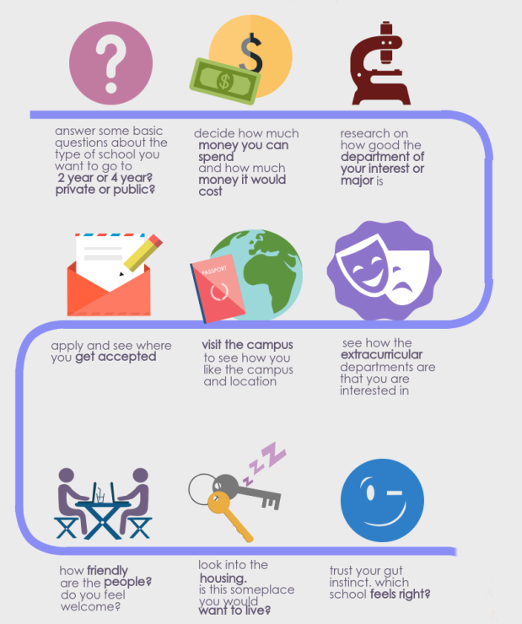
How to Choose Your College
in 9 Simple Steps

Slide 10



What can you do now?
Meet with reps
scholarships
Research colleges
- College fairs
- Private visits at your school
- Search engines
- Employer
- Banks
- Churches/civic groups/social organizations
- Internet
- Campus visits

Slide 11
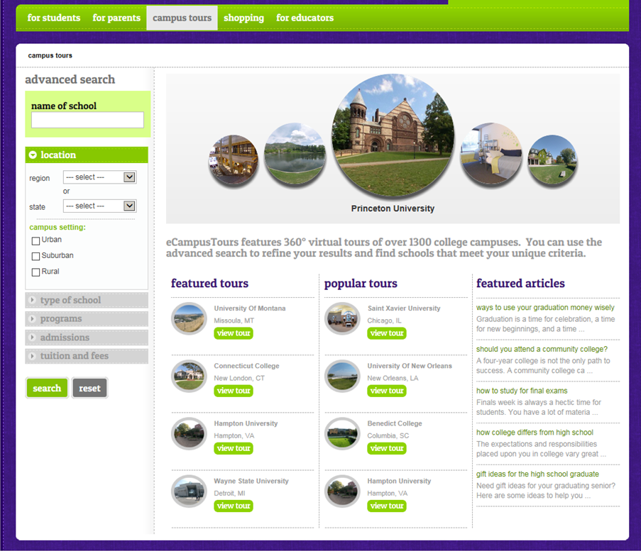

Begin your college search at
360 degree tours of over 1,300 college campuses
$1,000 Scholarship Giveaway
FREE Scholarship Search
College Planning Newsletter
www.ecampustours.com

Slide 12

Make the Most of Your Campus Visit
Call ahead.
Take notes.
Visit residence halls.
Talk to current students.
Meet with the faculty.
Sit in on a class.
Ask questions.
- Cost of attendance?
- Housing policy?
- Scholarships & financial aid?
- Activities & social groups?
- Meal plan?

Slide 13
Getting into College

Slide 14
Letters of recommendation
Extracurricular activities
Rigor of secondary school record
Particular talent/ability
What do colleges look for in an applicant?
Character & personal qualities
essay
Act/sat
Class rank
Academic gpa
Social media

Slide 15

College Admissions & Social Media
Use the “about” section to your advantage
Display appropriate photos/videos
Post content carefully
Choose your “likes” and “follows” wisely

Slide 16
Entrance Exams: ACT & SAT
ask
01
the Admissions Office about details (which test to take, what score you need, etc.)
STEP
retake
during senior year
www.act.org
www.collegeboard.org
03
02
check
with the school counseling office for registration packets and dates
STEP
STEP

Slide 17

The Application
Deadlines as early as November 1
Varies depending on school
Available online
May include:
- Resume
- Essay
- Recommendation
- Test scores
- Transcript

Slide 18

Other Applications
Housing
Scholarships
Special programs
Don’t forget:
- Application fee or fee waiver
- Additional transcripts
- Deadlines

Slide 19
Don’t Wait
Apply Early
Meet All Deadlines
From crafting a creative essay to lining up stellar recommendations, you will have to put a lot of work into your applications. Avoid procrastination in order to submit impressive applications.
Don’t wait until the last minute to submit your applications. Rushing to meet the deadlines displays to college admissions officers that you possess poor time management skills or that you may be unmotivated.
After you have researched and made a list of your deadlines, you should organize them by date so you will know which ones take priority. Use a planner or a calendar for easy management of your deadlines.

Slide 20
Paying for School

Slide 21

$
How to Get Money for College
$$
Financial Aid = Money that assists students and families in funding their college education

Slide 22
Definition of Terms
FAFSA: Free Application for Federal Student Aid
FSA ID: Federal Student Aid ID
The user name and password created to complete the FAFSA
COA: Cost of Attendance
The total amount it will cost to go to college each year (including tuition, fees, room and board, books, etc.)
EFC: Expected Family Contribution
Estimate of a family’s ability to contribute to a year of college expenses; used to determine eligibility for financial aid
SAR: Student Aid Report
Document that gives basic information about your eligibility for financial aid

Slide 23

Apply Early for Your FSA ID
Parent and student both need FSA IDs to submit the FAFSA
Apply for FSA ID 1-3 days prior to FAFSA filing, which is available beginning October 1

Slide 24

Important Tips About Your FSA ID
- Email address – Must know login info (your parents need a separate email as well)
- Create a username and password
- SSN and date of birth as shown on SS card
- Mailing address
- 4 challenge questions
- Register your mobile phone number for account recovery using text messages

Slide 25


Slide 26
Scholarships & Grants
Federal
State
Institutional
Private
Gift Aid: Scholarships & Grants

Slide 27

Tennessee Hope Scholarship (Lottery)
Apply by completing the FAFSA
www.tn.gov/collegepays
4 year (Freshman & Sophomore) –
$3,500/year or $1,750/semester
4 year (Junior & Senior) –
$4,500/year or $2,250/semester
2 year – $3,000/year or $1,500/semester
Award amounts are available for summer
enrollment
21 ACT (980 SAT) OR 3.0 weighted overall GPA

Slide 28

General Assembly Merit Scholarship
3.75 GPA weighted
29 ACT (1350 SAT)
Up to $1500 supplement to the Hope Scholarship

Slide 29

Tennessee Promise
TCAT, 2-year, 4-year (pursuing an Associate’s degree
Promise application completed by November 1
FAFSA application completed by January 16
8 hours of community service prior to fall enrollment and during year
1 mandatory Promise meeting
Mentor

Slide 30

Ned McWherter Scholars Program
3.5 unweighted GPA
29 ACT (concordant equivalent SAT)
$6,000 per year ($3,000 from the state of Tennessee and $3,000 from the college or university attended)
Eligible Tennessee college or university

Slide 31

Tennessee Student Assistance Award
Assistance to financially-needy TN residents
FAFSA deadline: ASAP after October 1
Families with EFC $2,100 or less
Prior-year recipients will be awarded first and then new students who meet all requirements
Four-year/two-year private: $4,000
Four-year public: $2,000
Two-year public: $1,300
Career Schools: $2,000
TCAT: $1,000

Slide 32

Wilder-Naifeh Technical Skills Grant
TN College of Applied Technology
FAFSA application
$2,000 per year
No ACT or GPA requirement

Slide 33
Self-Help Aid: Employment & Loans
Employment
Federal Work Study
Campus Employment
Loans
Stafford Loan
Parent (PLUS) Loan
Alternative Loans

Slide 34
How do I apply?
Pell grant
Stafford Loan
State Aid Programs
FAFSA – Free Application for Federal Student Aid
College or University – Institutional Aid
Other sources of aid – Outside scholarships and loans
Work study
SEOG

Slide 35

FAFSA: Free Application for Federal Student Aid
When?
FAFSA will be available to seniors beginning October 1
How?
Register for an FSA ID and complete the FAFSA at www.fafsa.gov
Remember…
Must reapply
Priority deadlines
Keep copies of everything

Slide 36

The Financial Aid Award Notification
Based on the FAFSA and college aid applications
Details all of the aid you are receiving
Must individually accept/deny all parts of the award
Must return to the college by the deadline
May be other institutional applications to complete
Check your student portal often, as most approvals will be done electronically. Read all information carefully!

Slide 37

How does the FAFSA work?
After completing and submitting the FAFSA, students will receive the Student Aid Report (SAR) via email within 3-5 days OR in the mail within 7-10 days with their Expected Family Contribution (EFC).

Slide 38
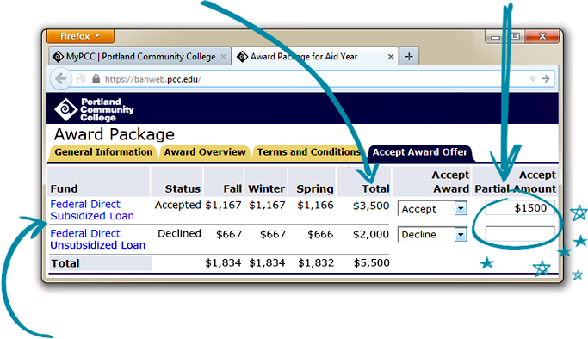
Sample Student Portal

Slide 39

Additional Costs to Think About
Start up costs:
- Gas to and from school
- Comforter, bedding, curtains
- Microwave
- Mini fridge
- Computer, etc.
Consider saving your graduation money or having a trunk party to assist you in obtaining many of the items you’ll need.

Slide 40
Start early
Request information from schools
Visit campuses
Request applications
Retake ACT or SAT
Search for scholarships
Meet all deadlines
Ask questions
Complete applications
FILE FAFSA October 1
Fall of Your Senior Year

Slide 41



Spring of Your Senior Year
Complete any scholarship paperwork and community service requirements
Complete remaining paperwork with your college(s), including award notification
Return your Intent to Enroll to your school of choice (usually by May 1)

Slide 42



Summer Before You Enroll
Attend New Student Orientation
Get Ready!!
Finish any last minute details with your school

Slide 43

Top 5 Things to Learn Before You Go Off to College
Live on a fixed budget
Laundry
Balance a checkbook
Cook basic meals
Time management

Slide 44

After You Enroll
Career Services
Internships
Practical experiences
Get involved
Ask for help

Slide 45






Follow Us
@Edsouthsos
@ecampustours
@Edsouthsos
@ecampustours
@Edsouthsos
@ecampustours
@studentoutreachservices
@ecampustours
@ecampustours
Student outreach services from edsouth

