Slide 1
aimswebPlus Reports
Welcome to today’s session!
Notes:
Tammy will do slides 1-15.
Welcome to our session. We appreciate your attendance. This session is being recorded. The chat will be monitored, so if you have questions please post them there. Let’s get started!

Slide 2
Today’s Agenda
Review available reports in aimswebPlus.
Discuss what the data tells us.
How can we explain this data to parents?
Notes:
Today we will look at the available reports in aimswebPlus, discuss what the data in the reports can tell us, and how we can communicate this information to parents and other stakeholders.

Slide 3
Benchmark Comparison Screen
Notes:
When you log in to aimswebPlus, the benchmark screen is the first thing you will see. This screen includes interactive parts, rank percentiles high to low with the center being the composite score and the individual measures out to the right.
The two icons to the left of the student name allow you to quickly navigate to individual reports and tasks.
You notice lexile levels on the far right for each student
The goal icon indicates that a student has a progress monitoring goal set and the progress toward that goal

Slide 4
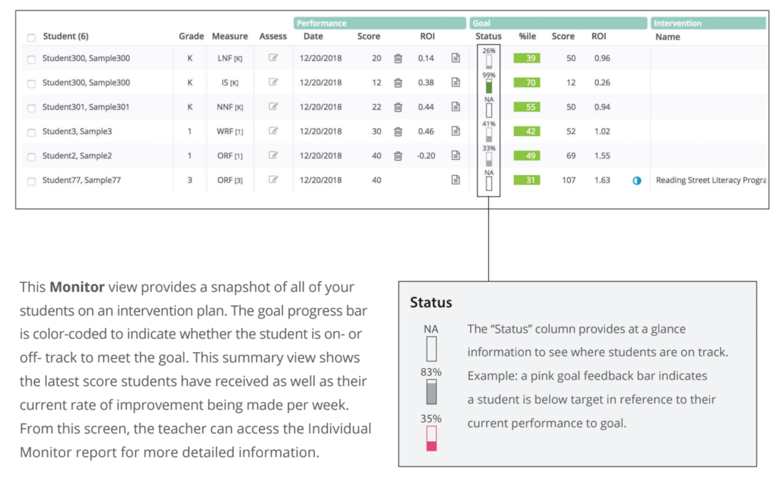
Individual Monitoring
Notes:
The status of the goal is represented graphically and provides at a glance information about progress toward the goal. If it is empty, there is not enough data, shaded shows progress, red indicates that progress is not adequate. You can see the individual progress monitoring report by clicking on the status bar as well. We will look closer at individual monitoring a little later.

Slide 5
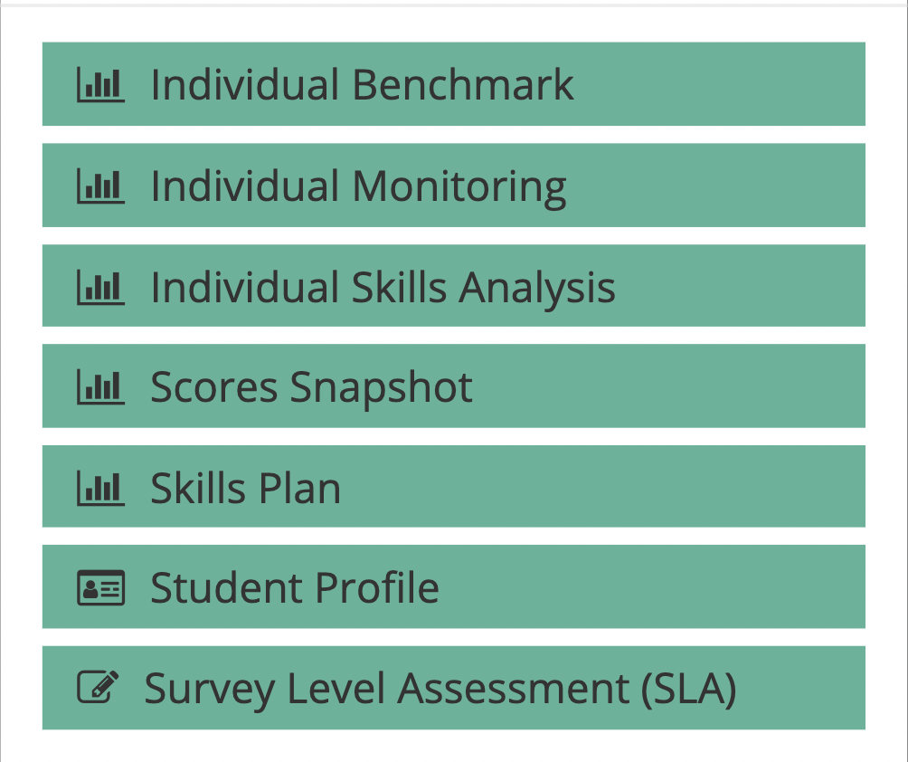
Report Options
Notes:
When you click on the page icon beside the student name, this screen appears. This allows you to quickly navigate to various reports or tasks for that particular student.

Slide 6
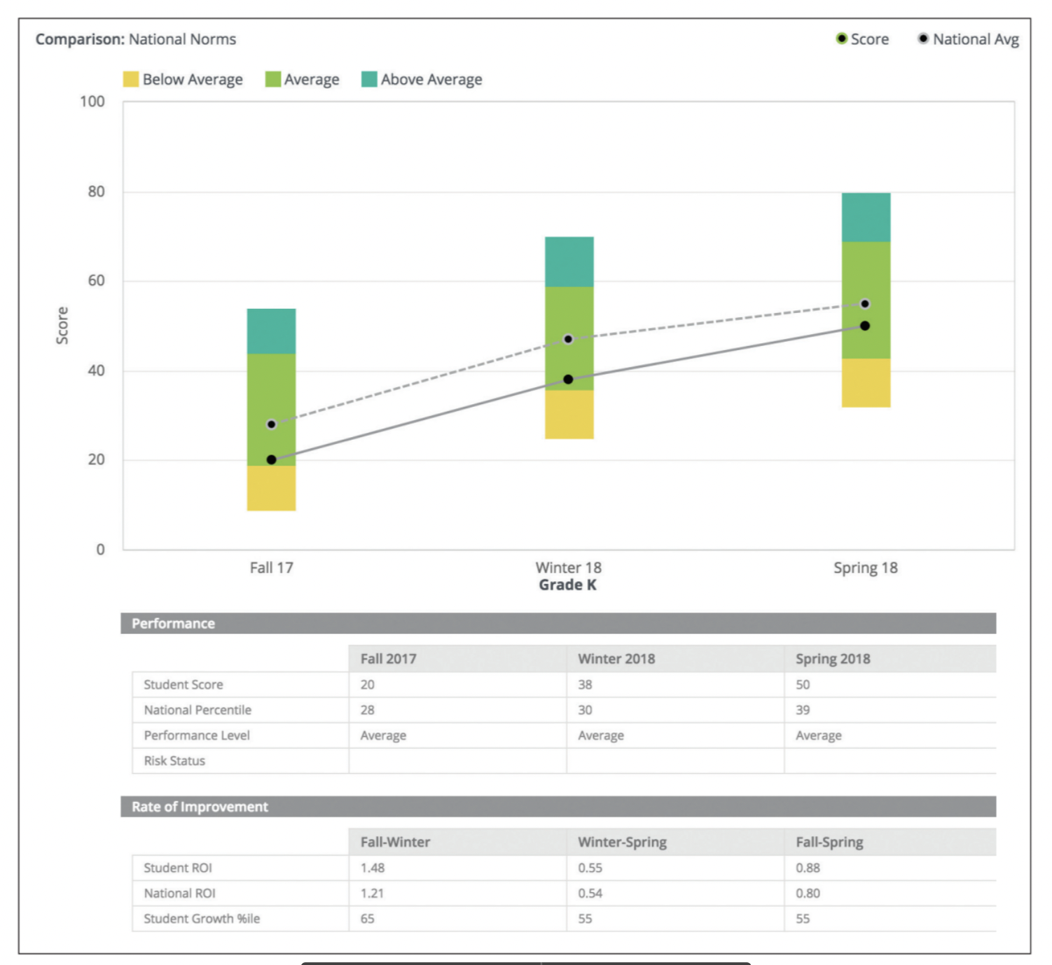
Individual Benchmark Report
Notes:
The Individual Benchmark report shows performance relative to norms (national or local) and seasons or years. It
displays the student’s rate of improvement (ROI) and Student Growth Percentile (SGP), and includes a Lexile® score
based on the Oral Reading Fluency (ORF) measure as well. The lines in the graph allow comparison of the student
growth summary to the national average growth.

Slide 7
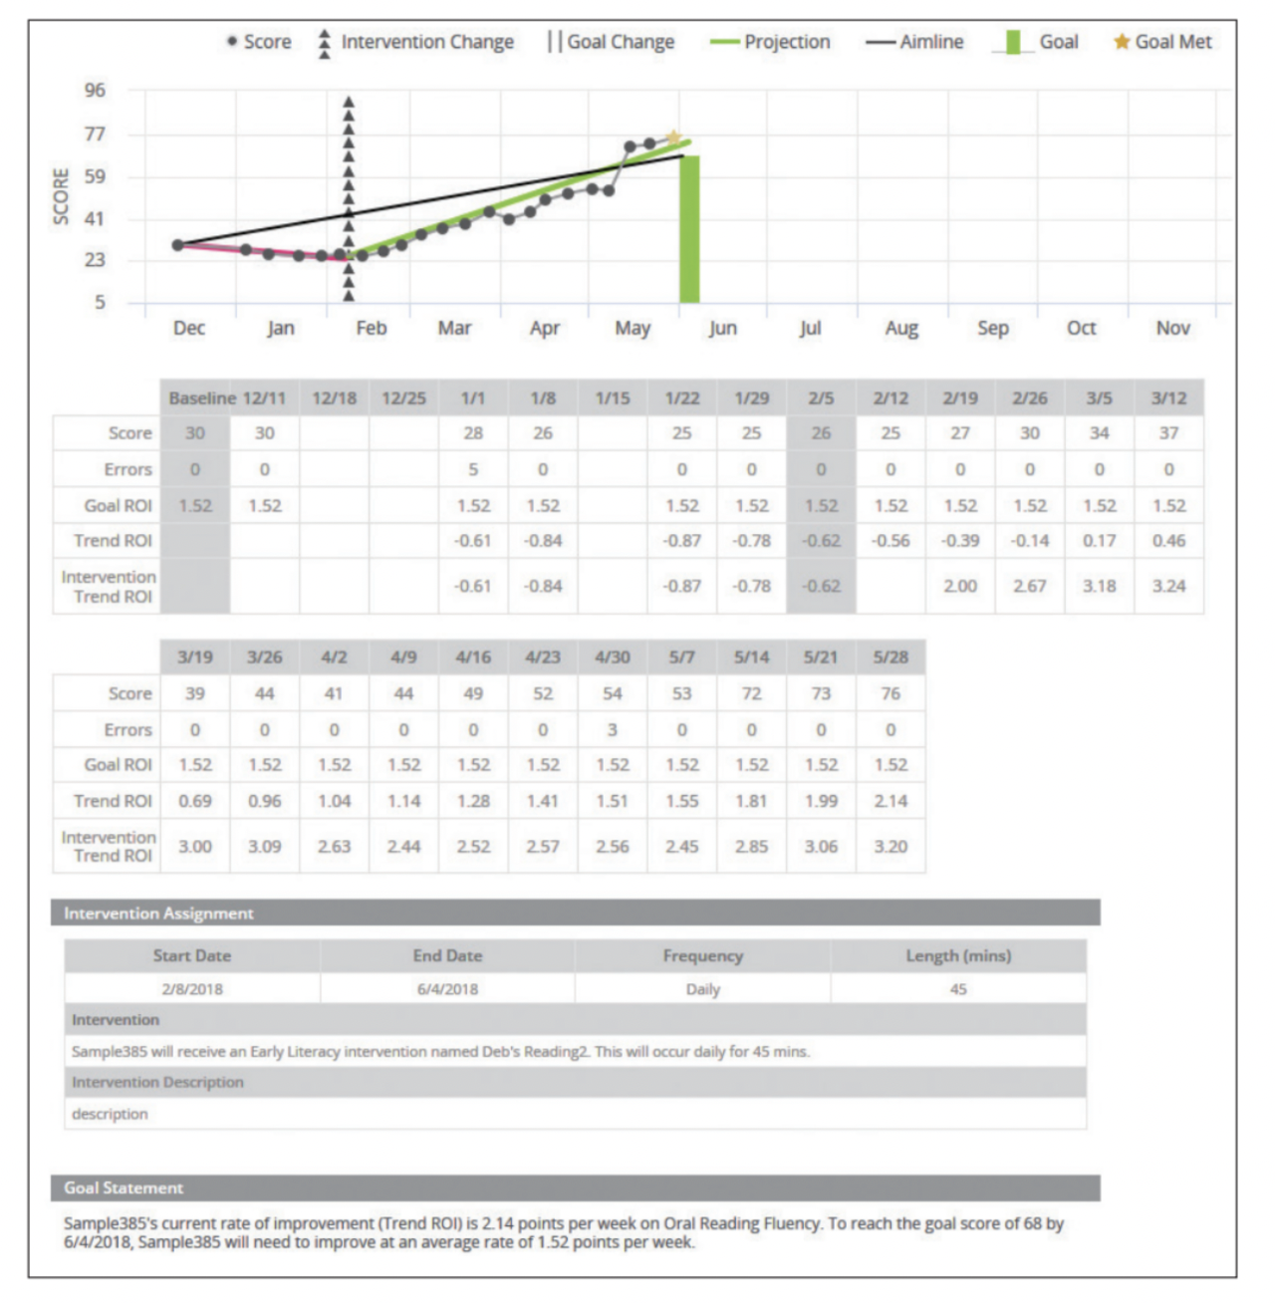
Individual Monitoring Report
Notes:
The Individual Monitoring report shows the goal score, number of errors, a line connecting the baseline score
to the goal score (the aimline), the weekly progress monitoring scores, and a best-fitting linear regression line (the
trendline) projected out to the goal date.
The aimswebPlus system uses the trendline and the spread of scores around the line to analyze the student’s
likelihood of meeting the performance goal by the goal date. The report also includes a table that lists individual
scores, the rate of improvement (updated with each new score), the Goal Statement, and other graphical elements
indicating when an intervention or goal change was made.

Slide 8
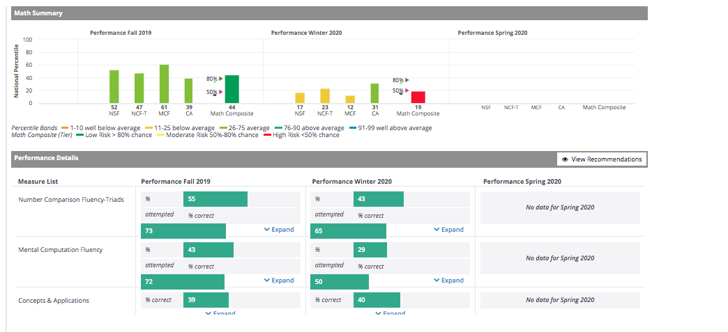
Individual Skills Analysis 2nd grade & up~ Math ONLY
Notes:
The Individual Skills Analysis report provides a summary of skill and item levels for the math measures. The
summary portion of the report shows percent of items completed and accuracy of items completed within each
skills area. It also compares the student to the national norm on overall measure results. When a skill area is selected,
you may also review items that the student scored correct or incorrect, as well as comparisons to national averages.

Slide 9
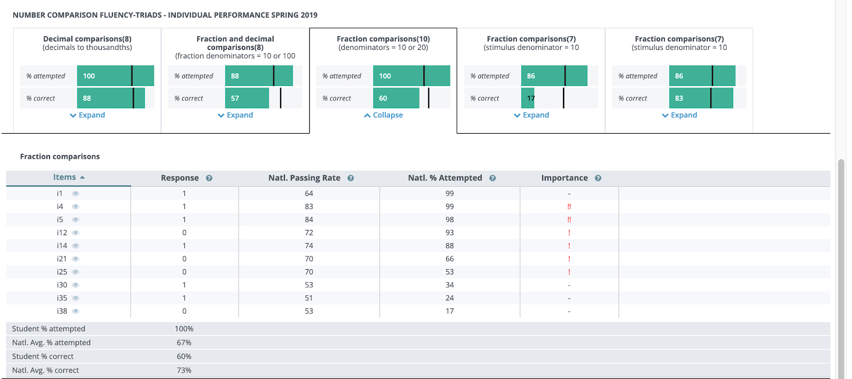
Individual Skills Analysis
2nd grade & up~ Math ONLY
Notes:
The Individual Skills Analysis report provides a summary of skill and item levels for the math measures. The
summary portion of the report shows percent of items completed and accuracy of items completed within each
skills area. It also compares the student to the national norm on overall measure results. When a skill area is selected,
you may also review items that the student scored correct or incorrect, as well as comparisons to national averages.

Slide 10
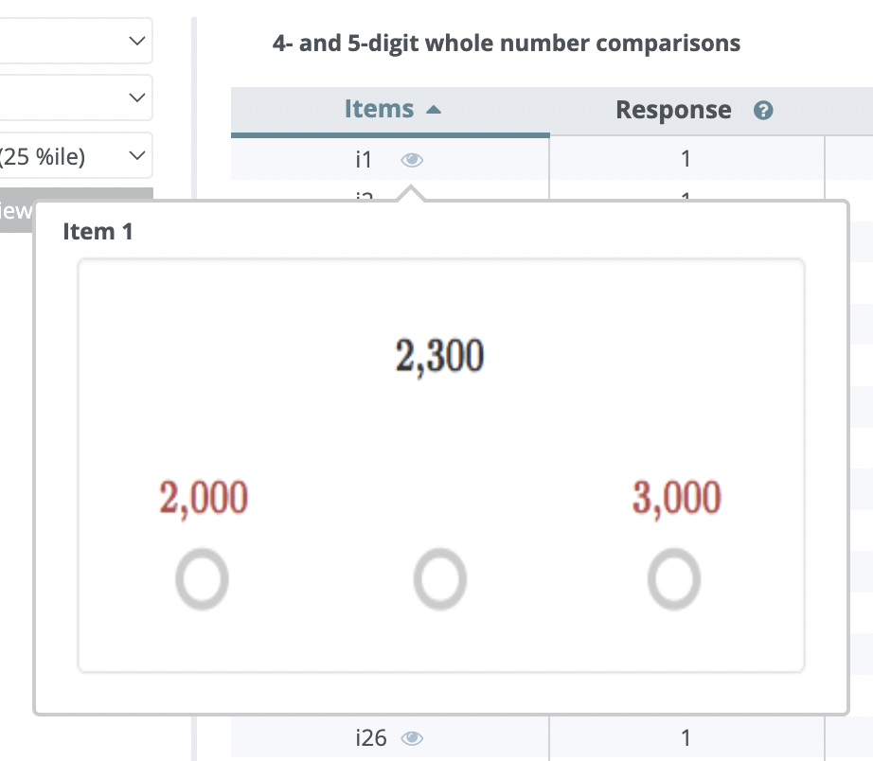
Sample Test Question (2nd grade & up~ Math ONLY)
Notes:
The Individual Skills Analysis report provides a summary of skill and item levels for the math measures. The
summary portion of the report shows percent of items completed and accuracy of items completed within each
skills area. It also compares the student to the national norm on overall measure results. When a skill area is selected,
you may also review items that the student scored correct or incorrect, as well as comparisons to national averages.

Slide 11
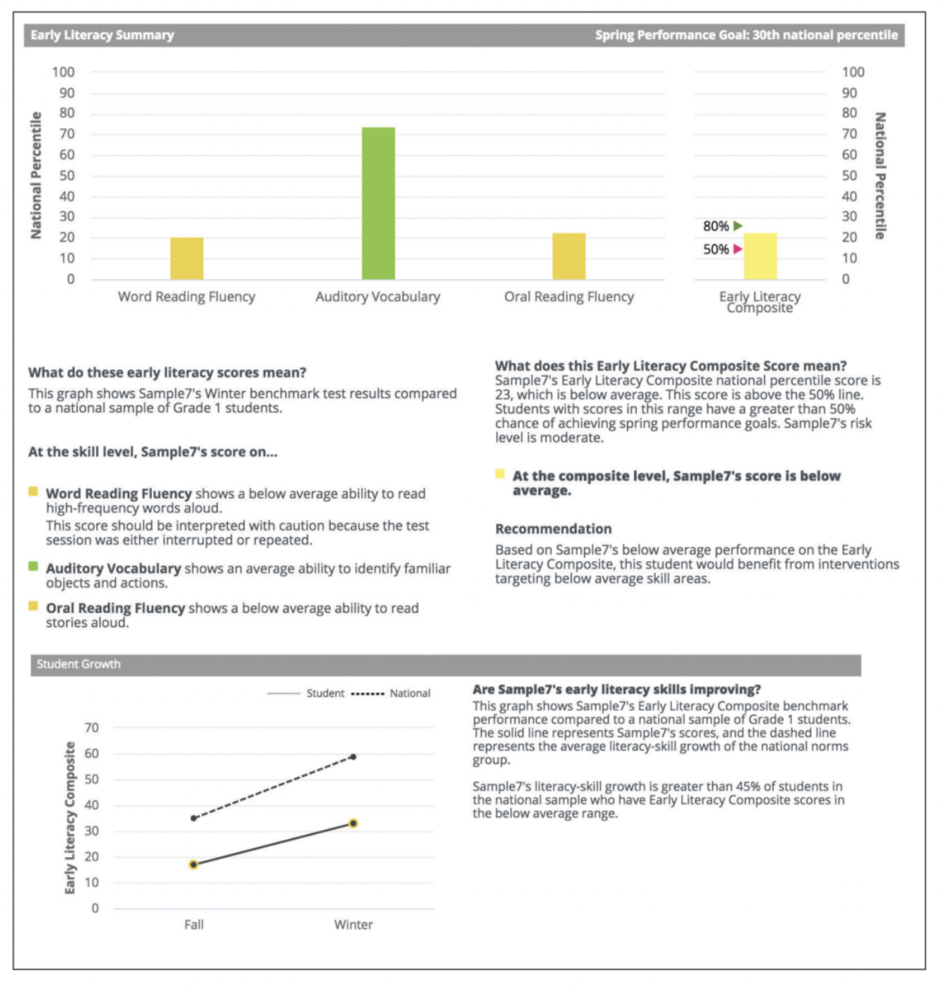
Student Scores Snapshot
Notes:
This is the report that we send home for Reading and Math!
The Scores Snapshot report allows teachers to see at-a-glance student performance by individual measure as well
as the composite, and is often shared to communicate student performance during parent/teacher conferences.
The report provides a brief narrative description of performance by measure and includes a recommendation
regarding the intensity of instructional need. This report also charts the fall, winter, and spring benchmark
composite scores and describes student’s growth relative to the national average.

Slide 12
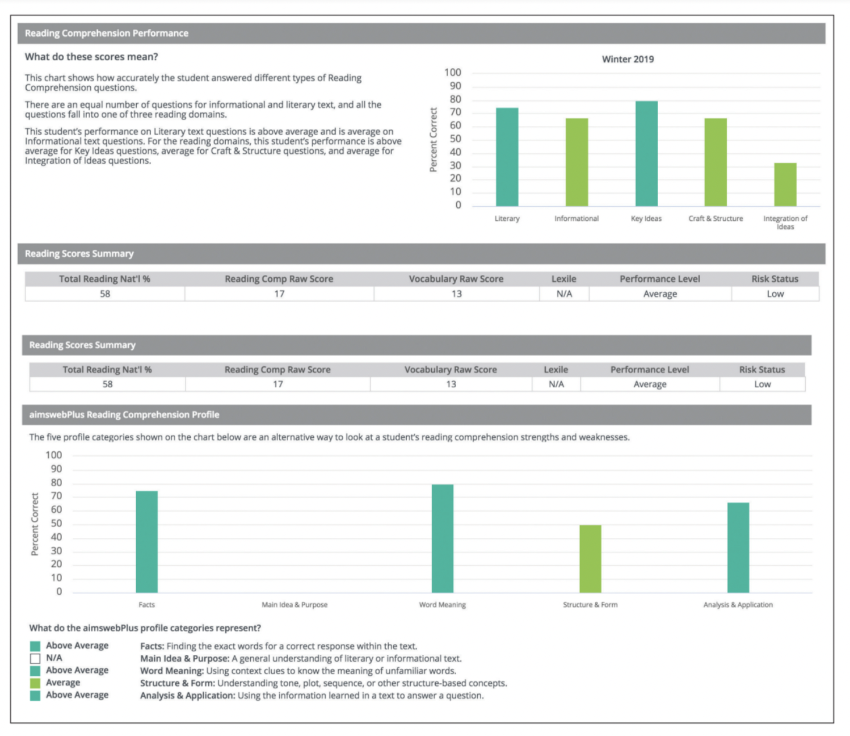
Skills Plan~ Reading (2nd grade & up)
Notes:
The Skills Plan – Reading report provides further
analysis of the student’s reading performance. This is a good report to share at parent conferences since it is more details than the Student Skills Snapshot. The report charts the percentage correct
by Reading Comprehension domain and passage type
(Literary and Informational) and indicates whether
performance is below, above, or average, relative to the
national sample of students at the same grade level.
A brief narrative describes the results reported in
the graph.
The next section of the report is a score summary
including the student’s national percentile, Lexile reading
level, performance level on the Reading Comprehension
measure, and her/his level of risk.
The third section of the Skills Plan report charts percentage
correct by type of Reading Comprehension question.
Following the chart on this page is an interpretive
table that can be used to isolate causes of low Reading
Comprehension scores. The report examines several
factors that may contribute to poor comprehension
including: vocabulary knowledge, oral and silent reading
rate, and the ability to derive meaning from very brief
passages. It also contrasts the student’s performance
on an increasingly complex inferential analysis of text
from the lowest level of literal comprehension to a
deeper understanding of main idea and analysis and
application. This report contrasts performance by type
of text: Literary, Informational, and the brief literary
passages used in the Silent Reading Fluency measure.

Slide 13
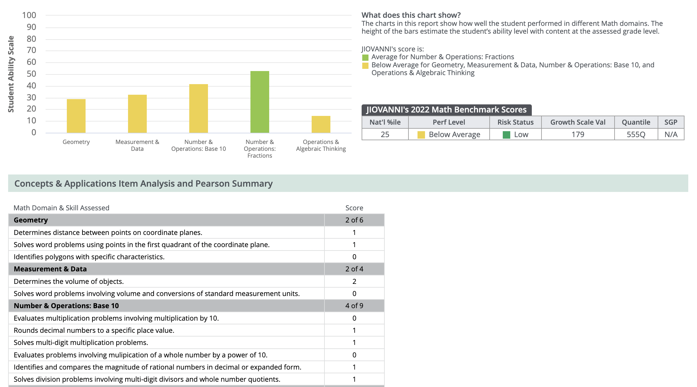
Skills Plan~ Math (2nd grade & up)
Notes:
The Skills Plan - Math report provides further analysis
of the student’s math performance. It shows how the
student performed in each of the major math domains,
and indicates whether performance is below, above,
or average, relative to the national sample of students
at the same grade level. A brief narrative describes the
results reported in the graph.
A score summary table provides the student’s national
percentile, performance level, Quantile, and Growth
Scale Value (vertical scale score) on the Concepts &
Applications measure. The report also shows item-level
performance, organized by math domain, and provides
a brief description of the behavioral objective for each
item. Teachers can use this table to identify very specific
skills that need further instruction.

Slide 14
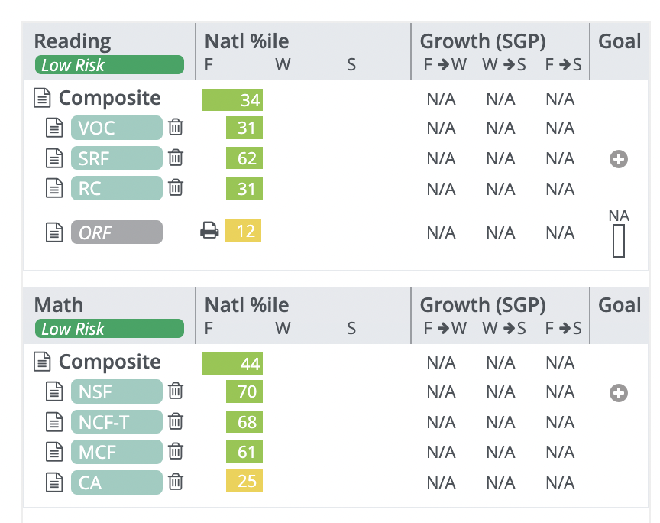
Student Profile

Slide 15
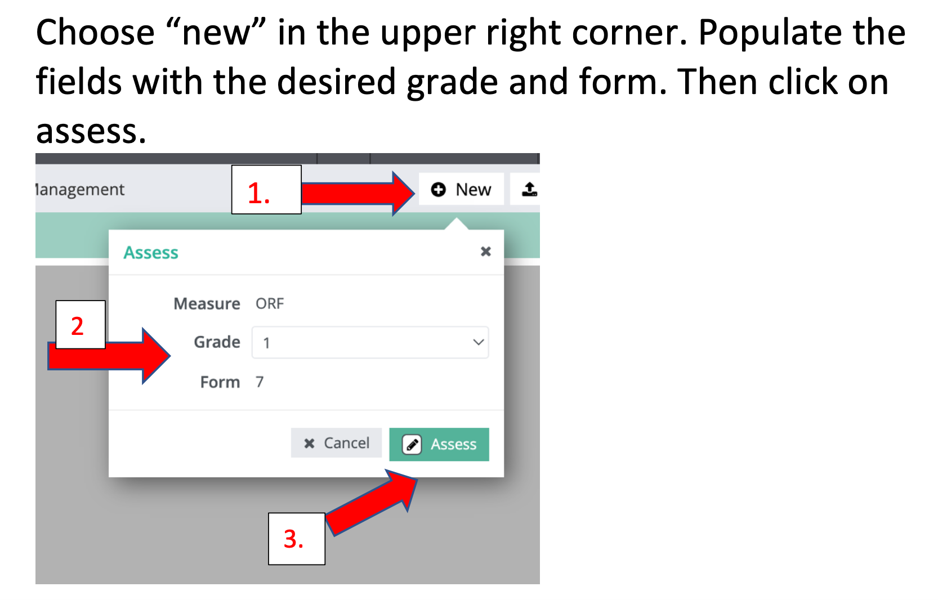
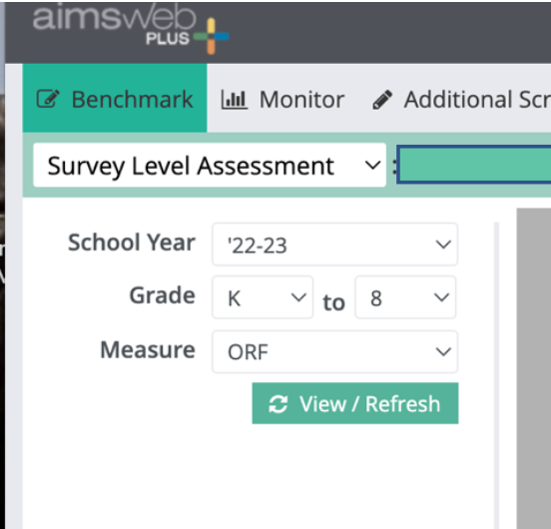
Survey Level Assessments
Notes:
Tammy’s last slide.

Slide 16
Interpreting the data
Notes:
Ashley will do slides 16-28.
Now that we know where to get the data, how do we interpret it?
Students are compared to their peers via the national norms. If Billy, for example, is at the 20th%tile for ORF, that means that 80% of his peers scored higher than him. 20% of his peers scored at/below Billy’s score. This is something to keep in mind when sharing the data with parents.

Slide 17
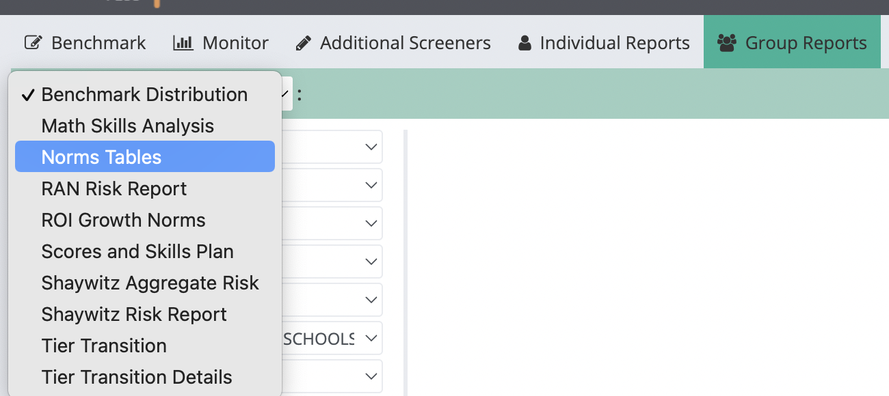
Norms Tables
Notes:
You can generate norms tables by navigating to the group reports tab and choosing norms tables from the drop down menu.

Slide 18
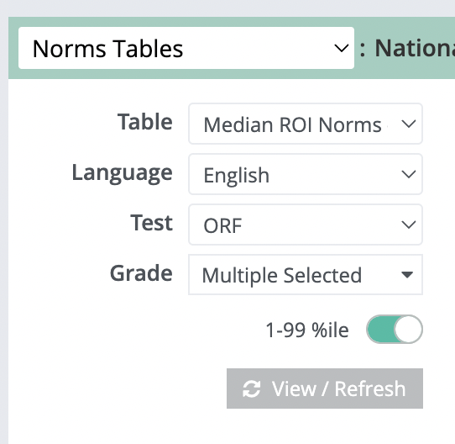
Norms Tables
Notes:
You select any test battery that you’d like norms for…Oral Reading Fluency, Number Sense Fluency, Letter Word Sounds, etc… You select one or more grade levels to export. The toggle switch will allow you to see the norms from the 1st-99th %tiles. This is not a requirement, just a more detailed option.

Slide 19
Norms Tables
Notes:
Here’s an example of 2nd grade norms for ORF. Scores for Fall, Winter, and Spring are located on the norms tables. Following each benchmark you can see how your students are growing in comparison to their peers. You can see the scores the students need to make for each percentile band. For example, if a student has a score of 50 in the Fall, he/she is in the average range.

Slide 20
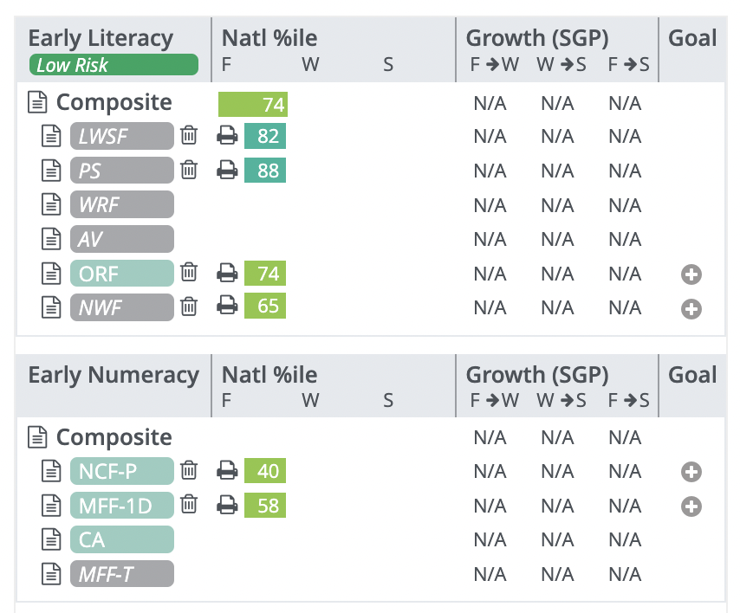
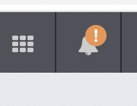
Generate Reports via the Printer Icon
Notes:
As a reminder, the student profile page can be located by clicking the paper icon next to a student’s name from the Benchmark Comparison screen. You’ll click the paper icon, then select Student Profile. (You’ll see an image similar to this one.) Early literacy measures, early numeracy measures, and ORF will show a printer icon next to each percentile. Click the printer icon and “ok.” In the upper tool bar next to your name, you’ll see a bell icon. Wait for the orange exclamation to appear next to the bell. (Reports may take some time to generate or export.) Once you see the orange exclamation point, the reports you’ve requested will be listed. Click the paperclip next to the report you want to download. The following slides will show you what the results will look like.

Slide 21
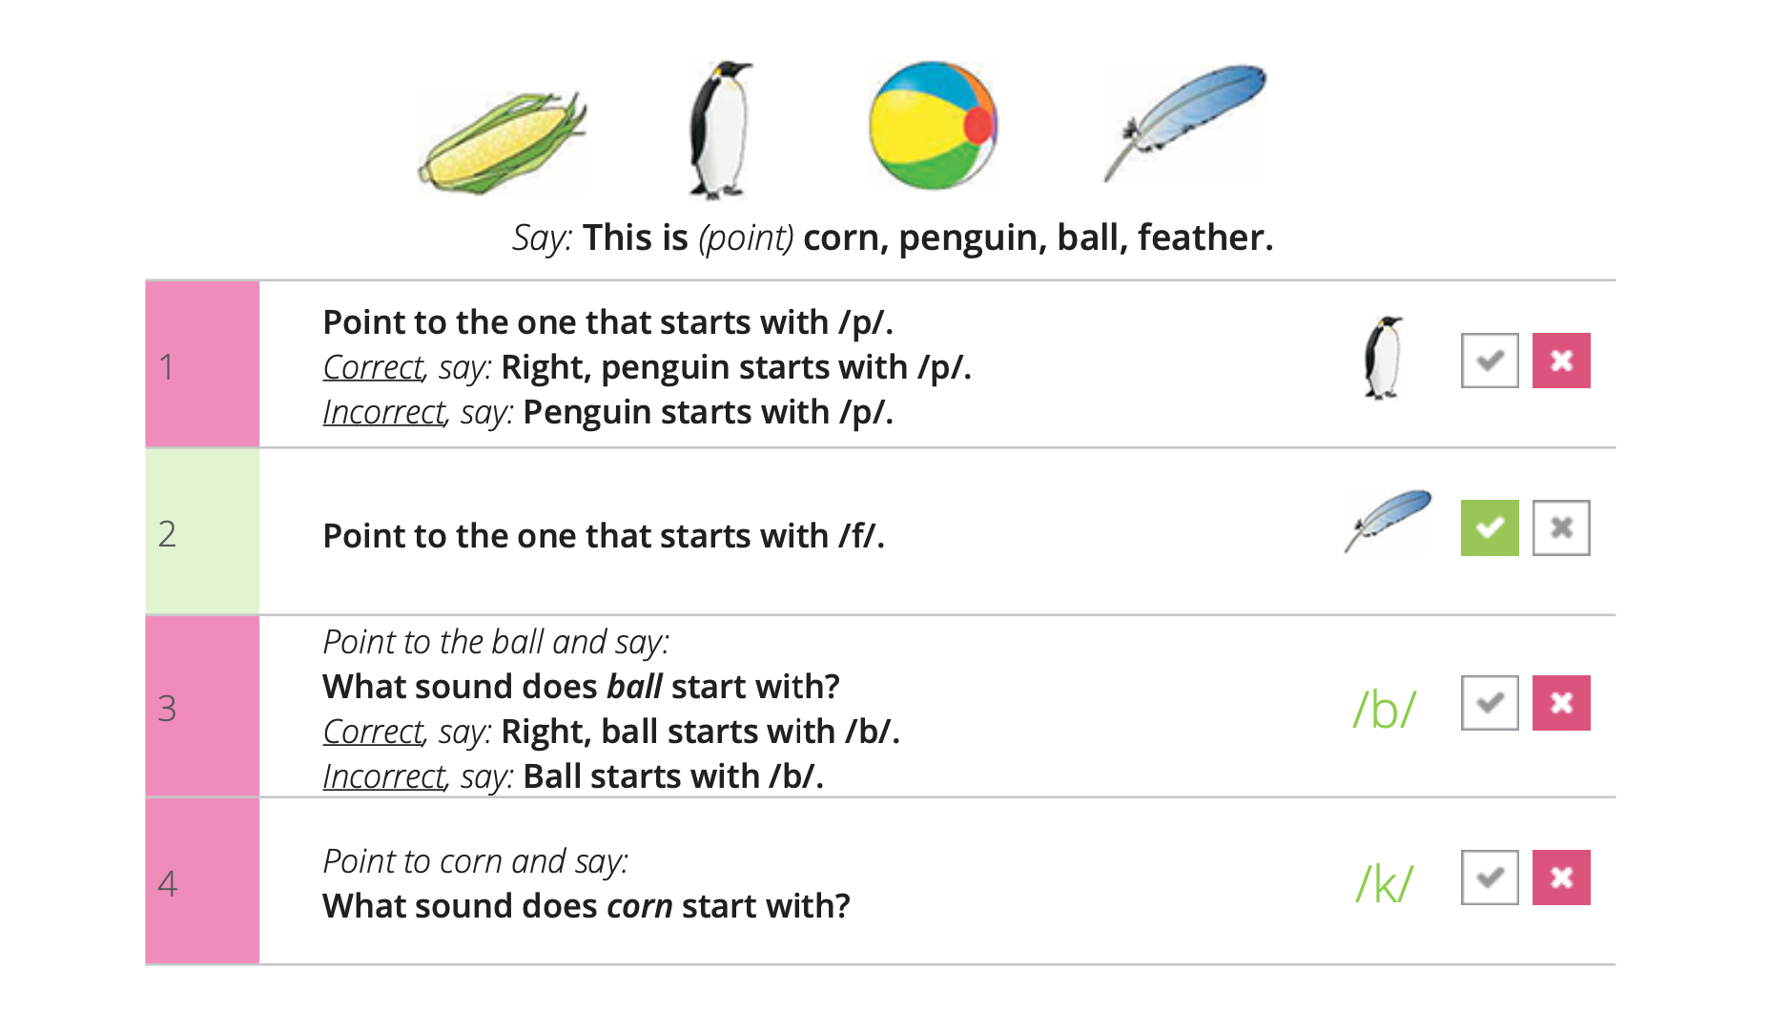
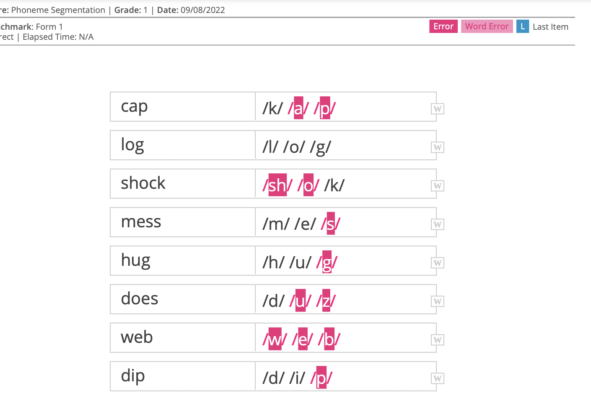
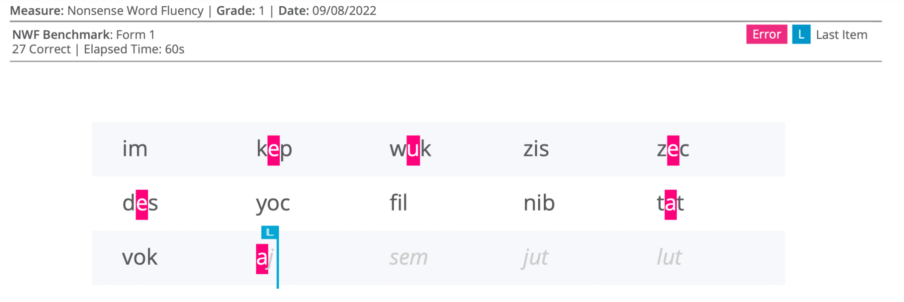
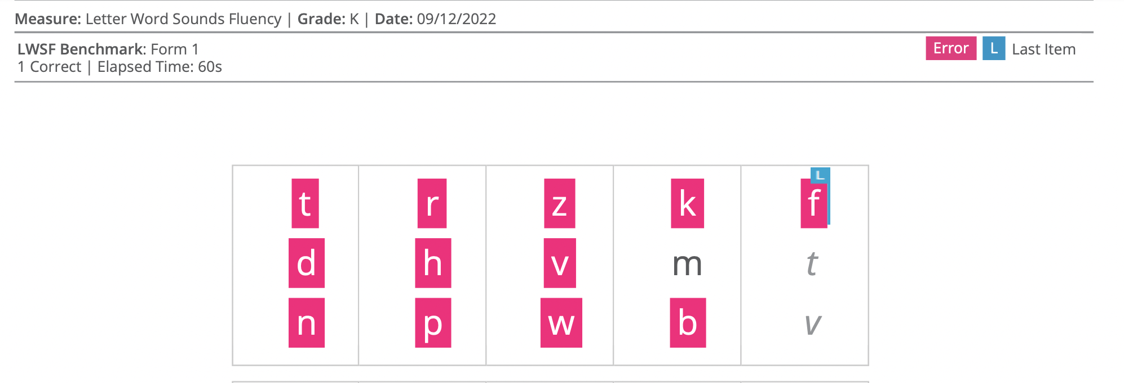
Early Literacy Measures
Notes:
Here are some example of the early literacy measures and the results that can be exported. For example, initial sounds, phoneme segmentation, nonsense words, letter naming, and letter word sounds fluency. You can see specific errors made by students. You can see how far they were able to get during the allotted time. This information may be useful when thinking about foundational skill gaps that you could address during small groups instruction.

Slide 22
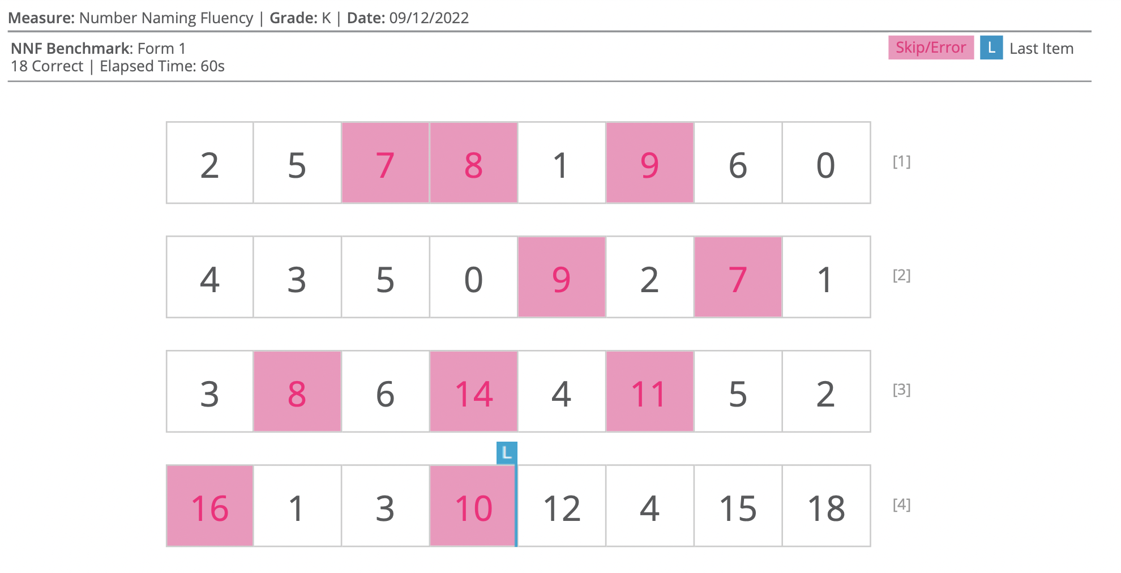
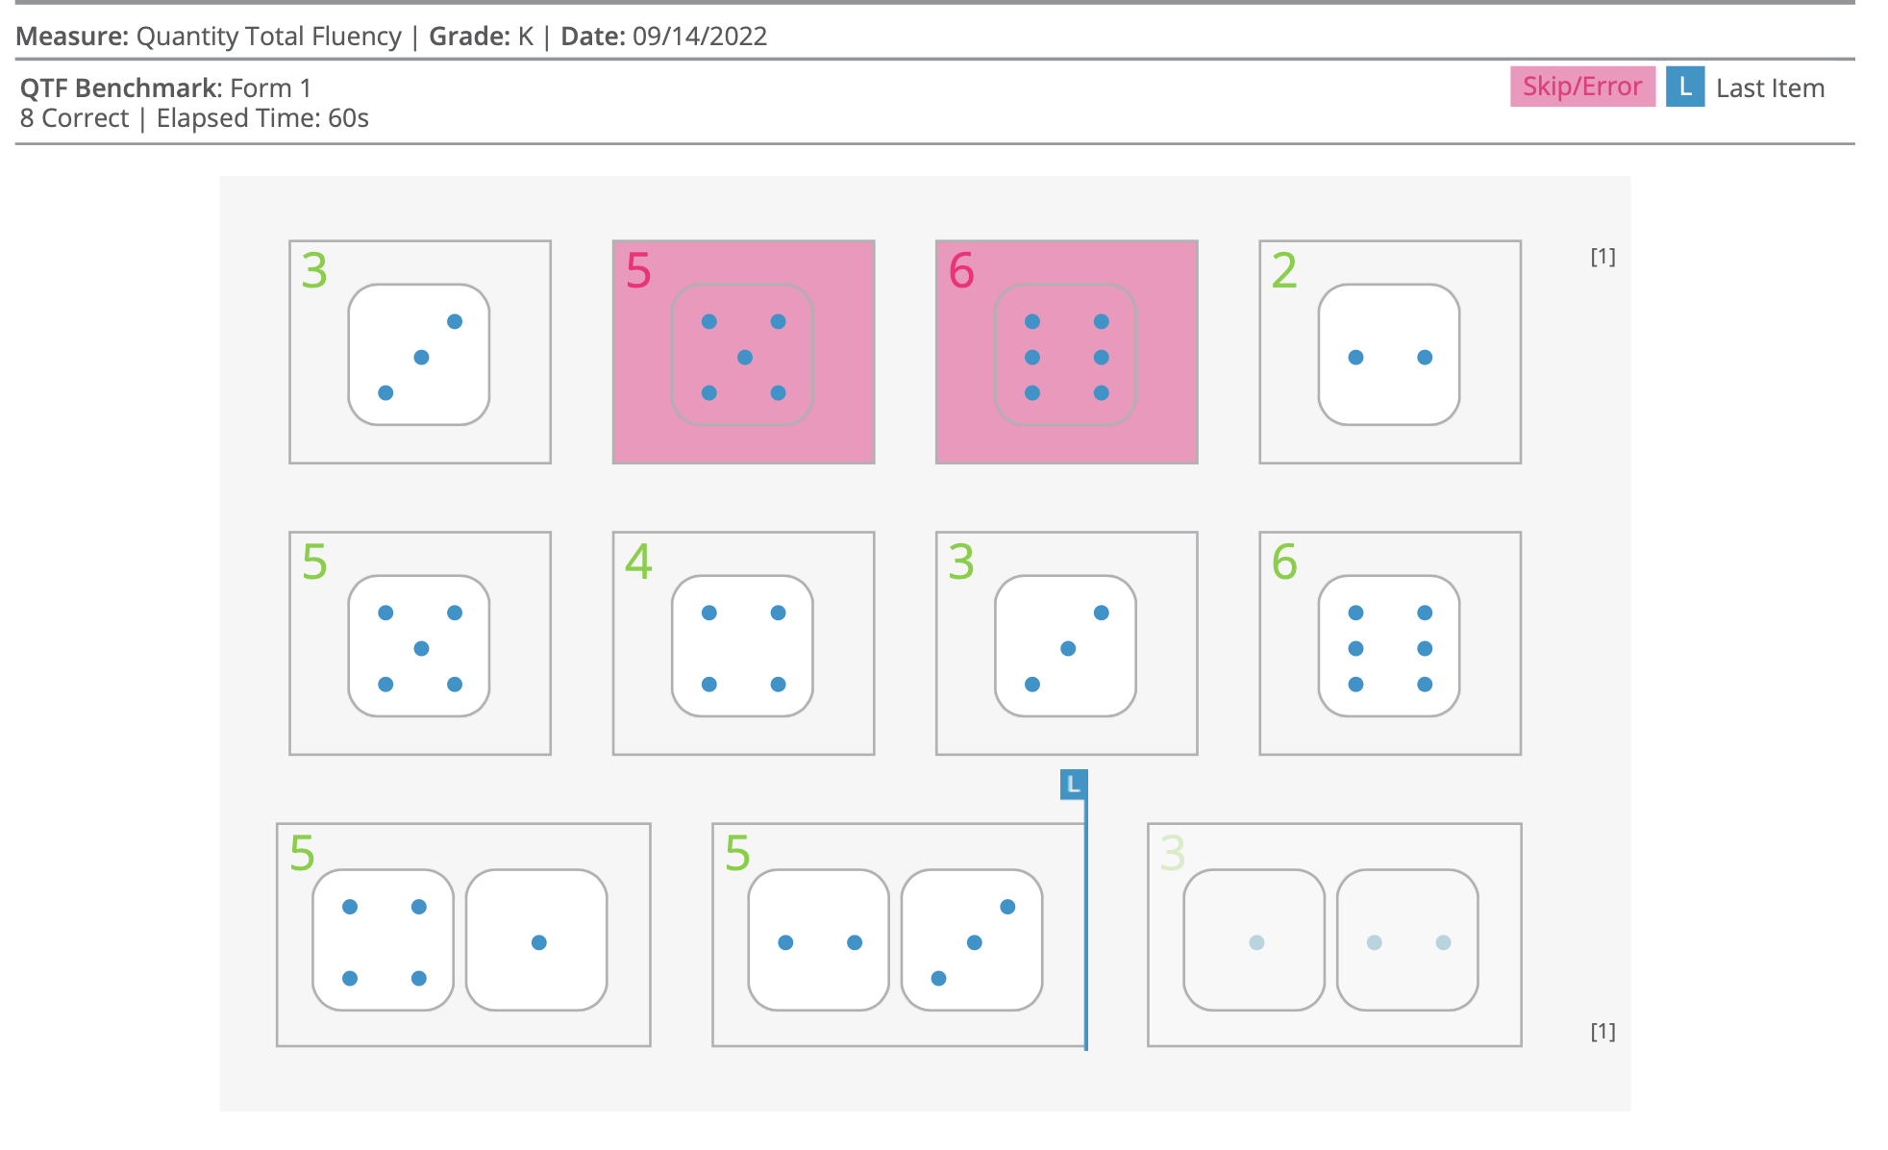
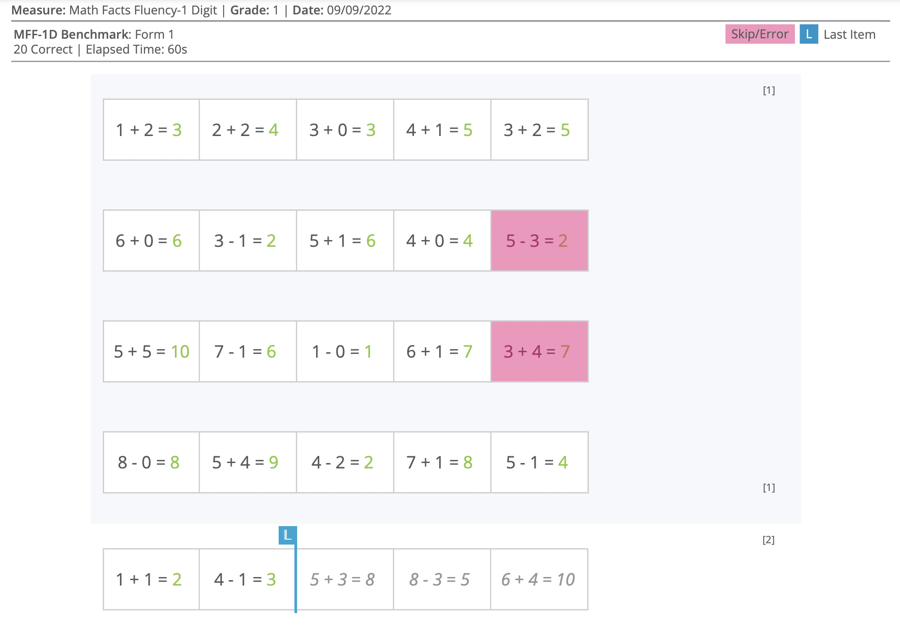
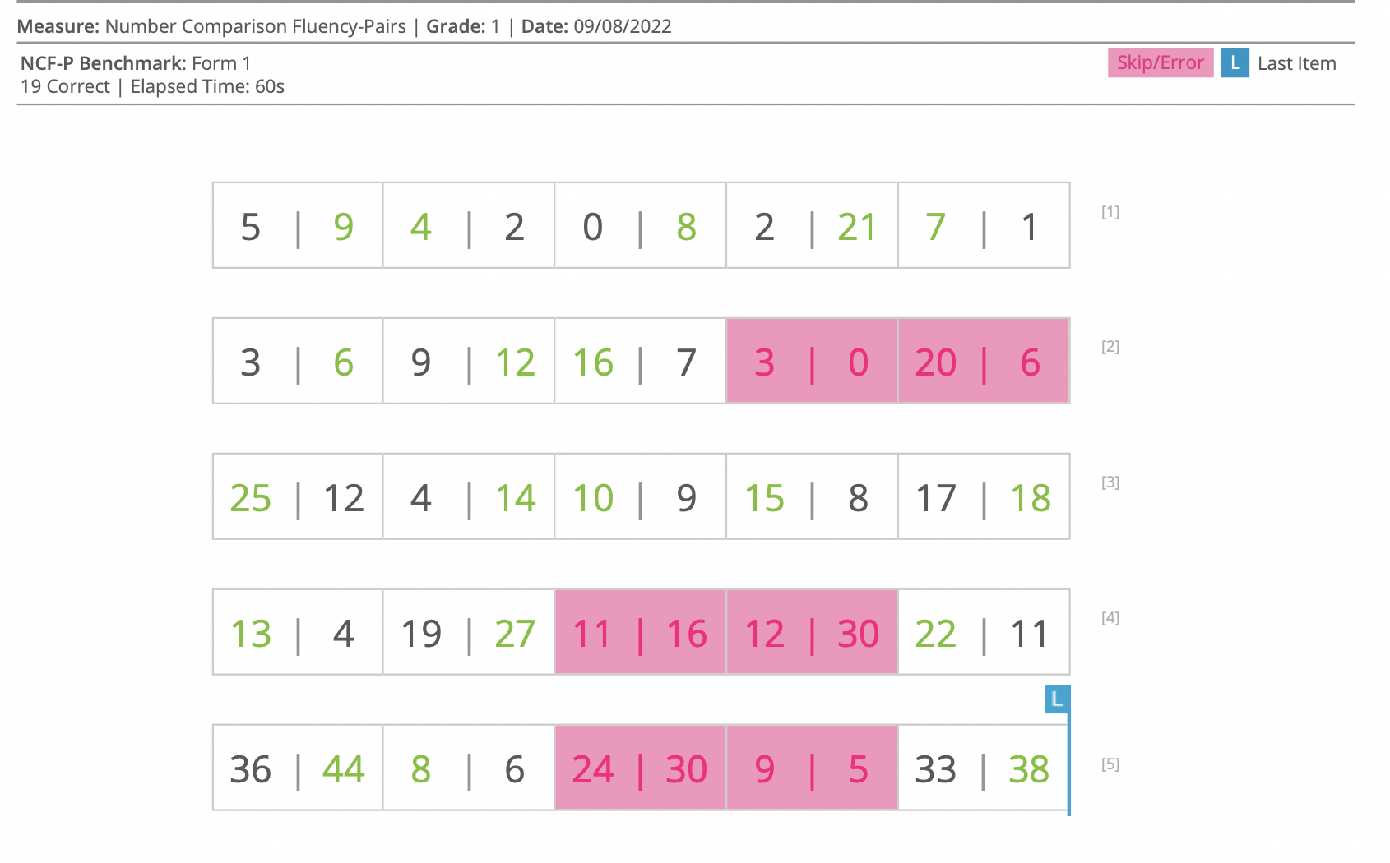
Early Numeracy Measures
Notes:
Here are some example of the early numeracy measures and the results that can be exported. For example, number naming fluency, quantity total fluency, math facts fluency, and number comparison fluency. You can see specific errors made by students. You can see how far they were able to get during the allotted time. This information may be useful when thinking about skill gaps that you could address during small groups instruction. For example, the number naming results from above show this student needs support with 7, 8, 9, and double digit numbers.

Slide 23
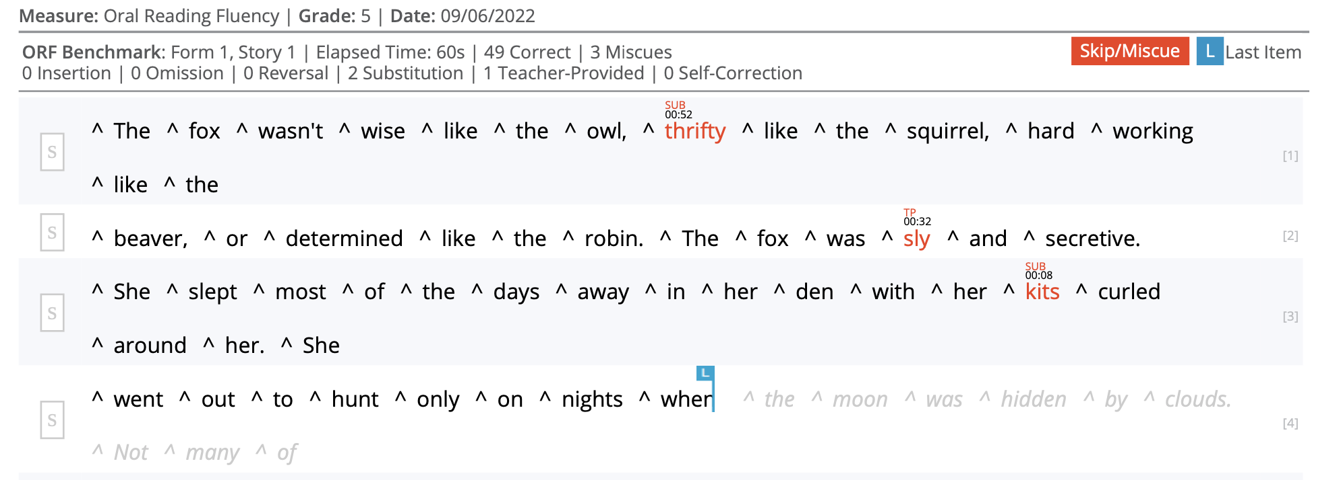
Oral Reading Fluency
Notes:
A detailed report can also be generated for ORF. You’ll see the passage, along with errors made by the student. For example, this student had 2 substitutions and 1 teacher-provided answer. You would also be able to see insertions, omissions, reversals, or self-corrections. The blue line indicated the last word read. There is also a “record” feature in aimswebPlus, if you so choose. This would allow you to listen back for expression, prosody, etc.

Slide 24
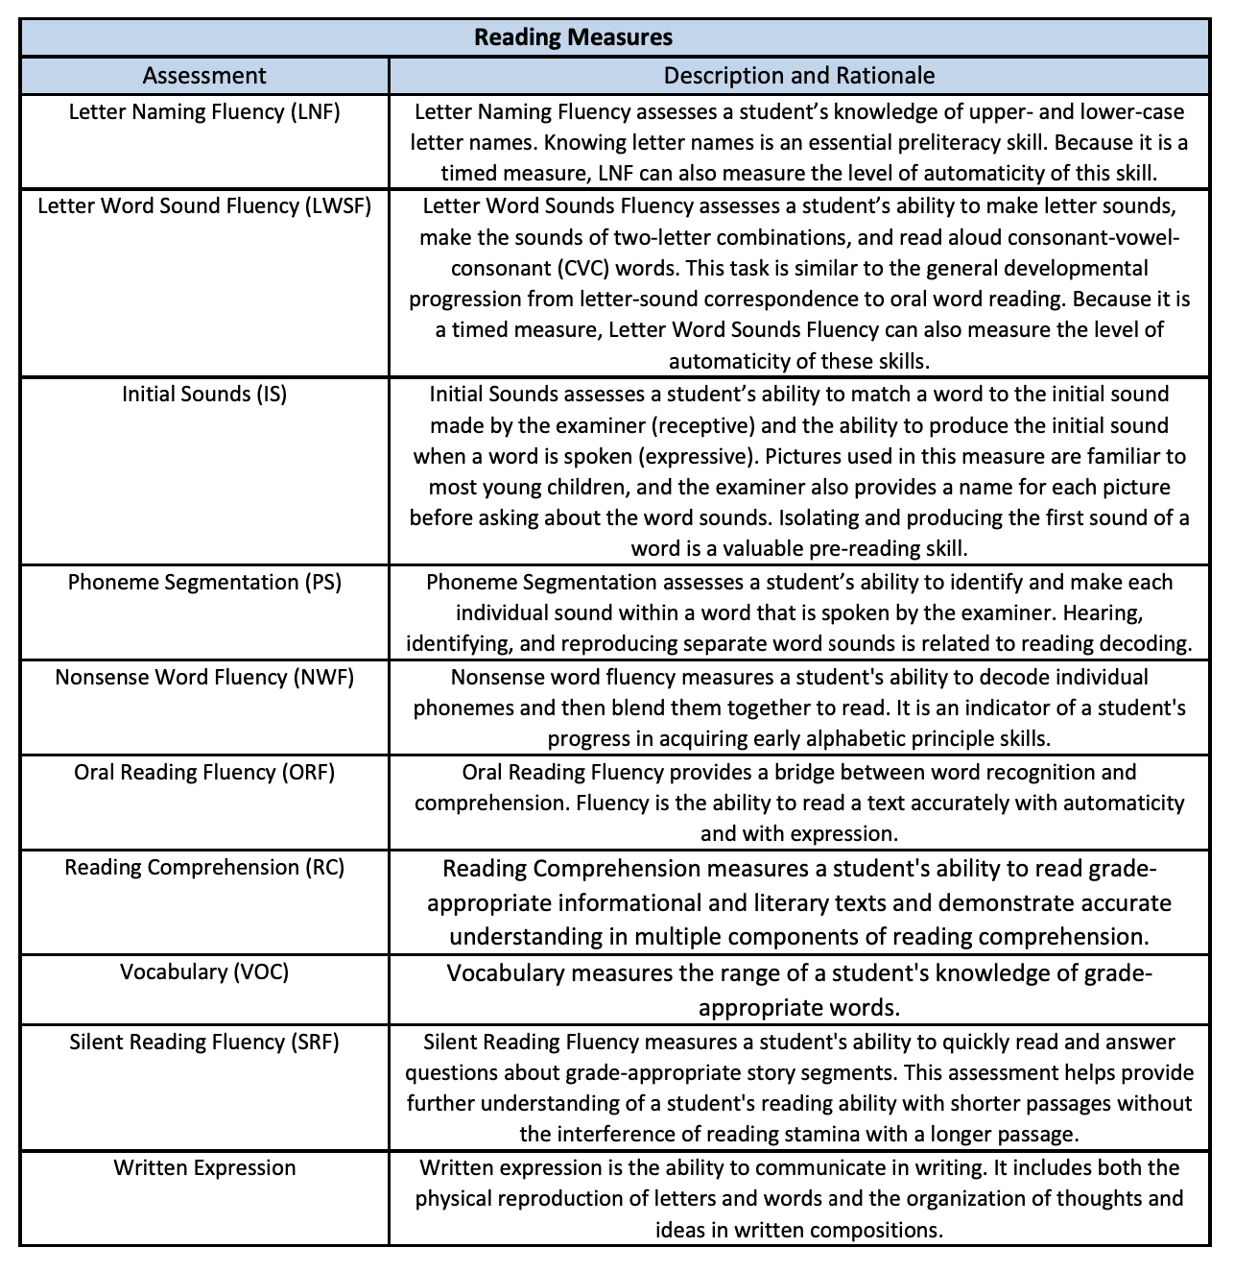
Reading Explanations
Notes:
Here, you’ll see an explanation of the Reading measures that are given throughout the year. If parents have questions about the specifics of a certain battery, these explanations may be helpful to share. We’ll show you in a moment where to find this information on the RTI2 department website.

Slide 25
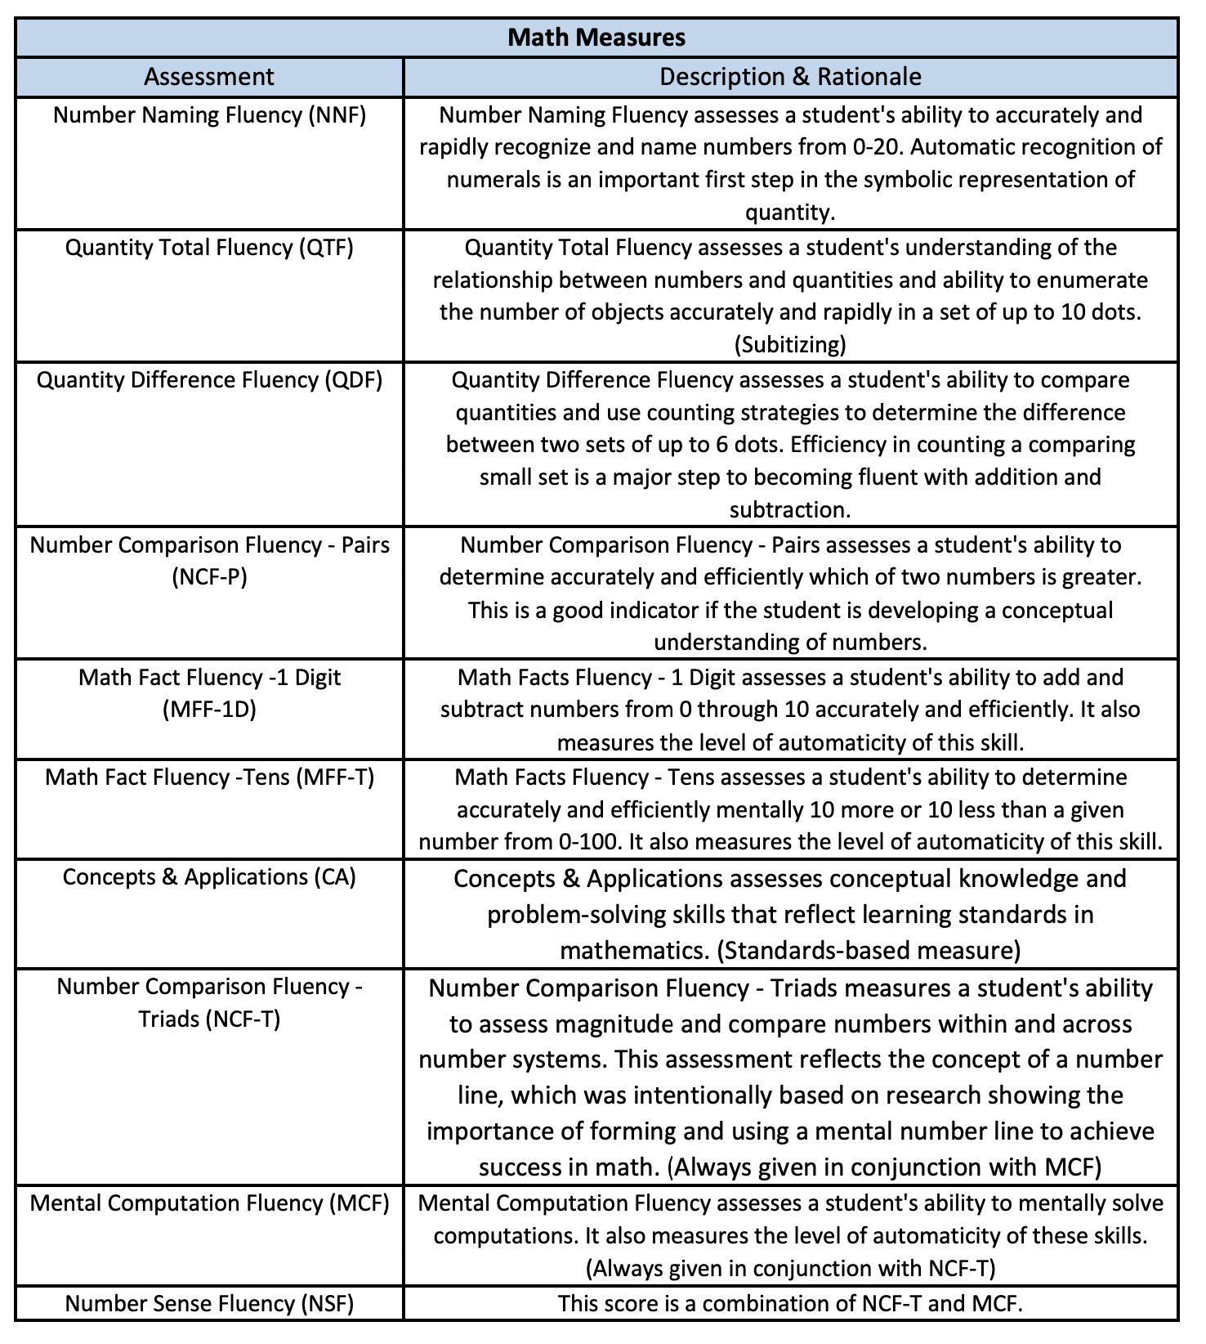
Math Explanations
Notes:
We also have explanations for the Math assessments. Again, this may be helpful when speaking with parents. This document is also housed on our website.

Slide 26
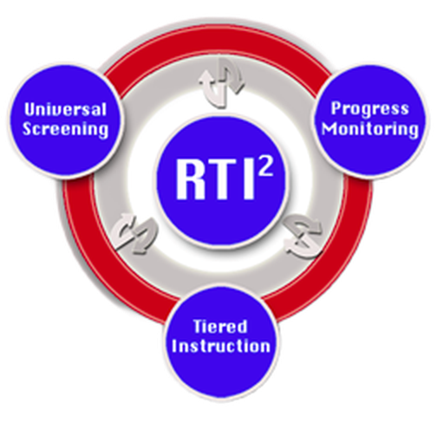
KCS Website~ RTI² Department Page
•RTI² Website https://www.knoxschools.org/Page/10052
Notes:
This link will direct you to the RTI2 department page on the KCS website. Be sure to login to your account. If not, you’ll miss out on resources only available to staff. Several of our resources are made available to the general public, but some items are kept private for staff only.

Slide 27
Notes:
What questions might you have about what we’ve covered so far?

Slide 28
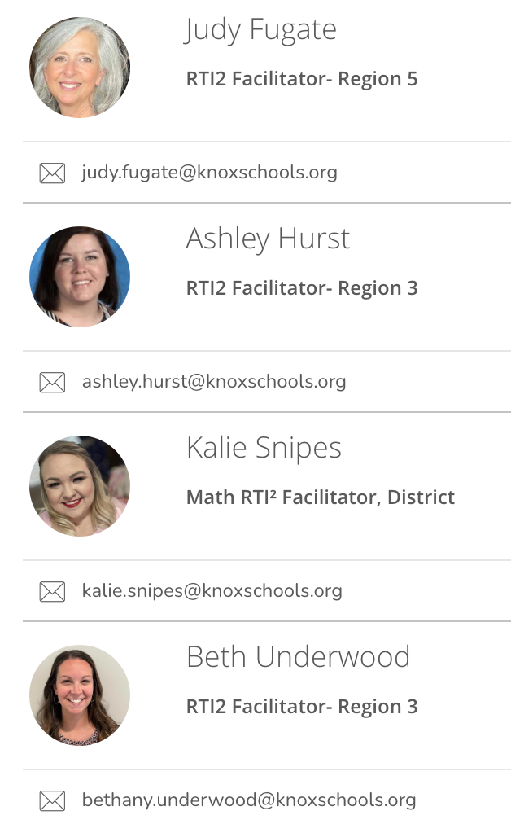
RTI2 Facilitators
Notes:
Ashley’s last slide.
Please reach out to your RTI2 facilitator if you have additional questions/concerns.

Slide 29
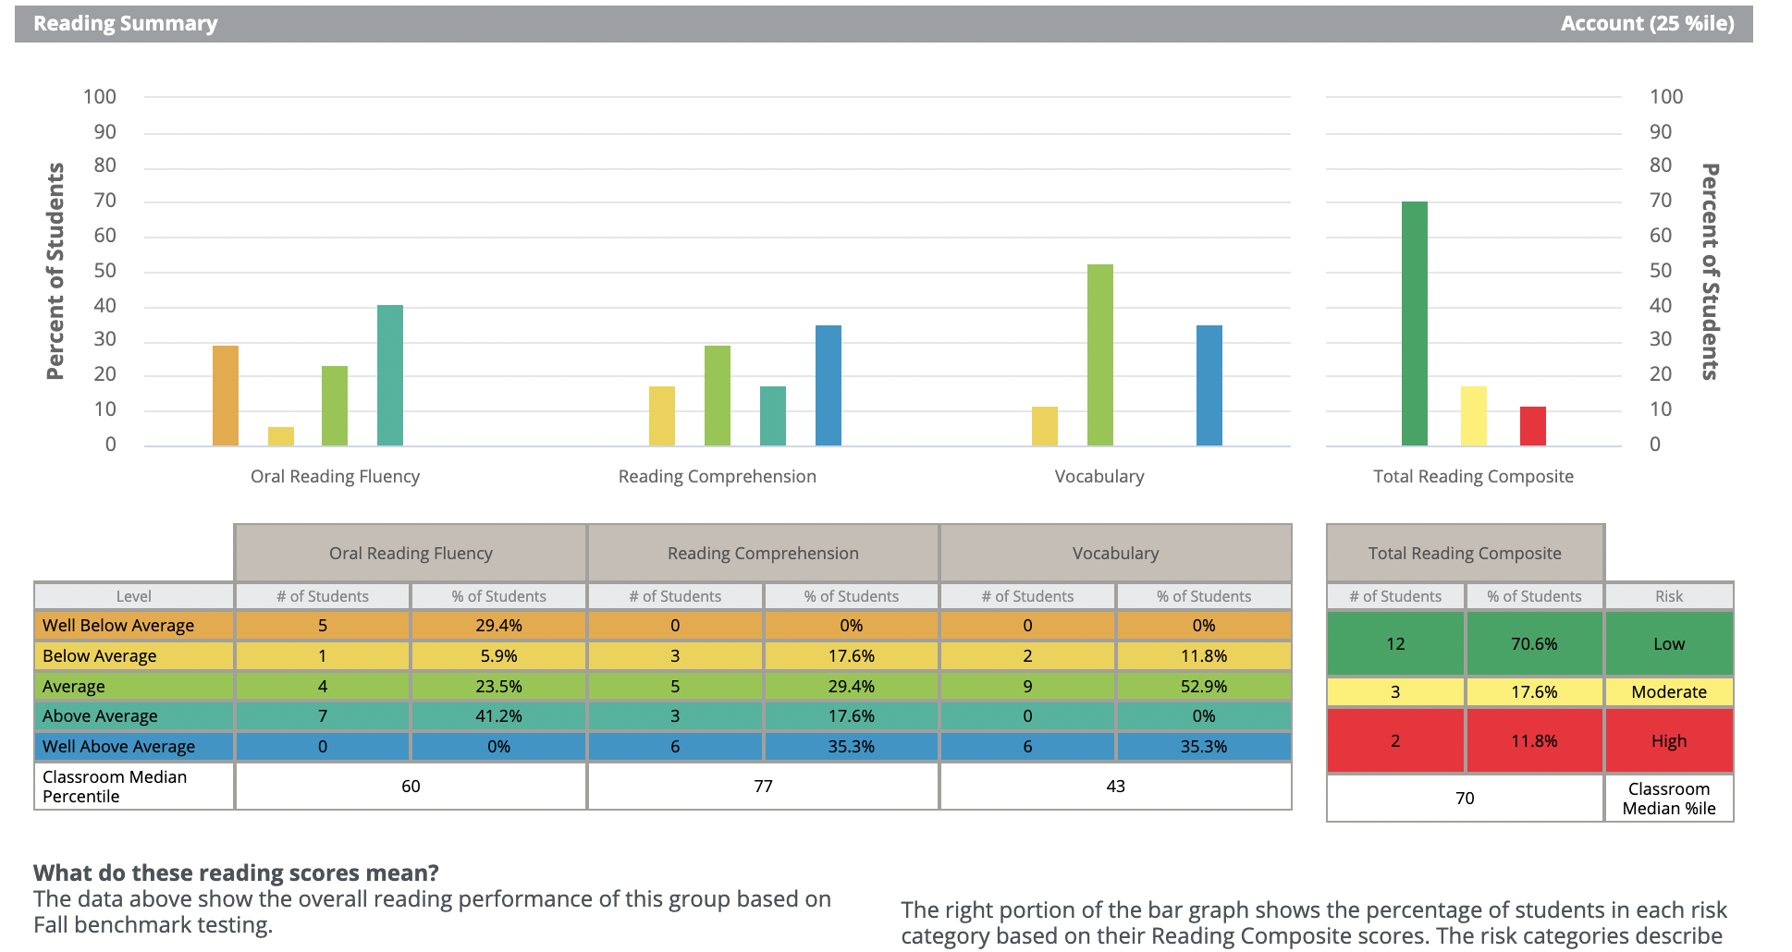
Group Reports~ Scores & Skills Plan
Notes:
Tammy will do slides 29-31.
If time allows…share more detailed reports at this point.

Slide 30
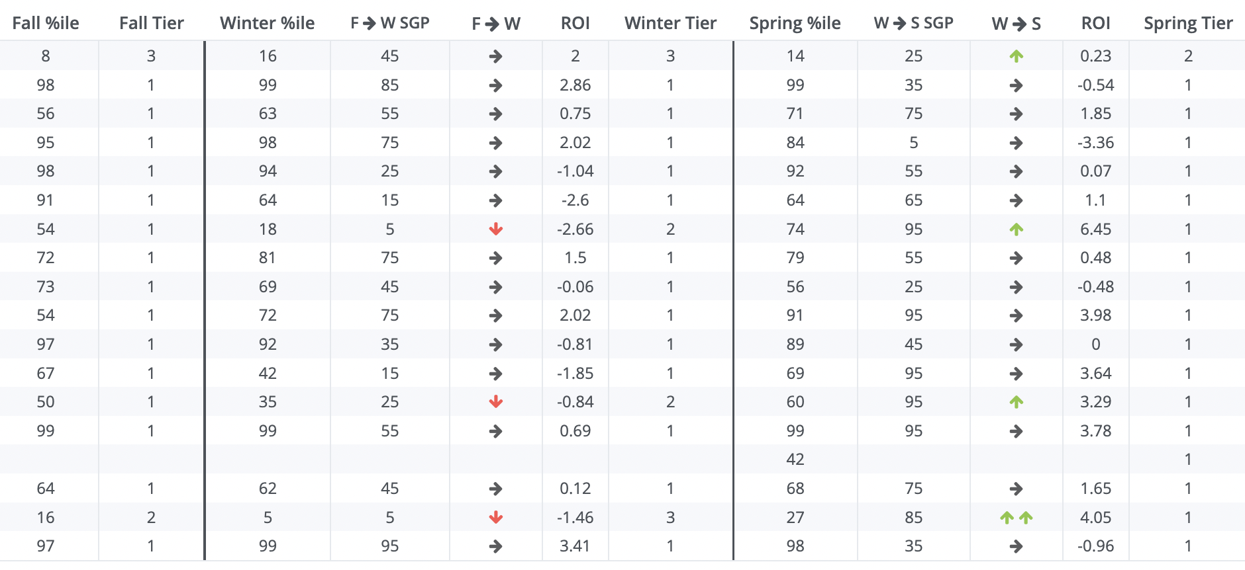
Group Report~ Tier Transition Report

Slide 31
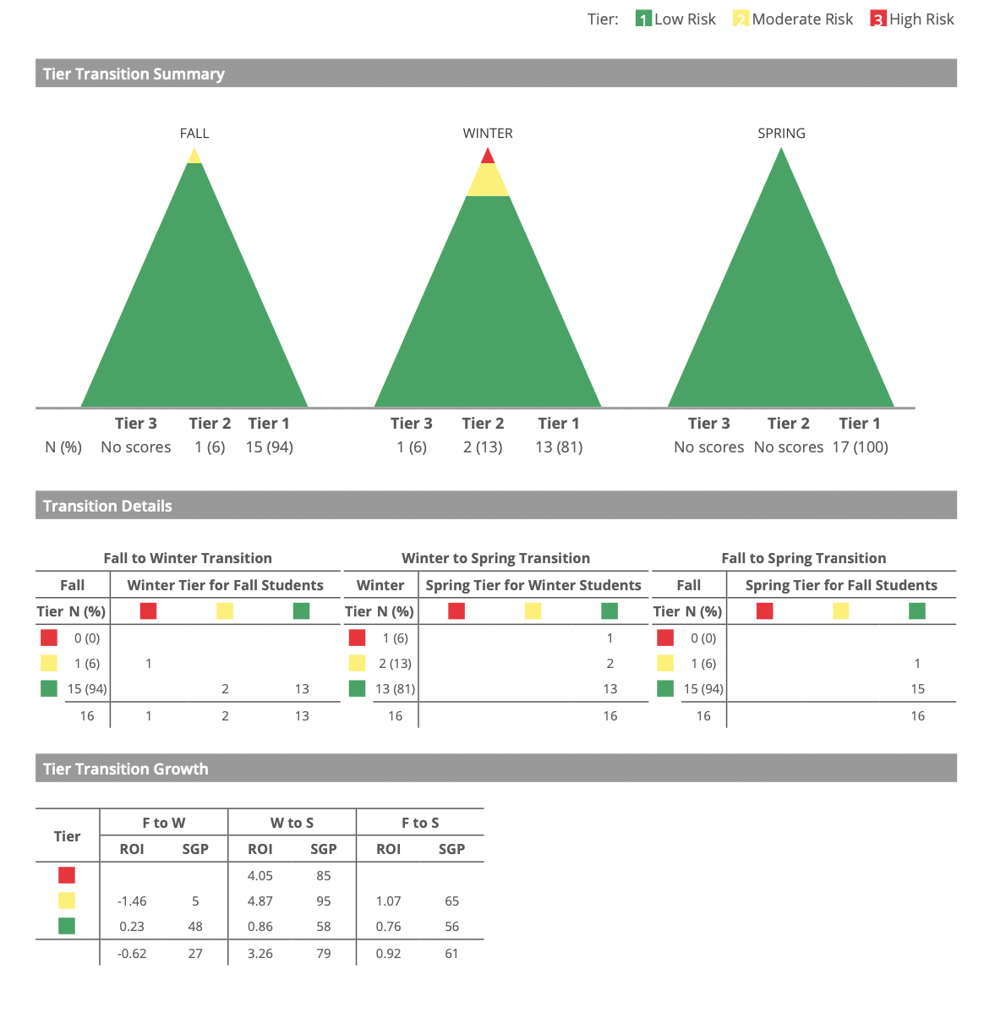
Group Report~ Tier Transition

