Slide 1
Welcome to Farragut Middle School

Slide 2
What will we cover in this video?
This video is to help you to enter related arts course requests ONLY.
This will help you navigate the Aspen system to make your Course requests for the 23-24 School year.
We will also share information about our Counselors at FMS and how to go about contacting them with questions.
** For questions regarding the academic courses being recommended for your child, you should visit the website link for Rising 6th Grade Information or 2023-2024 Student Registration Information for information and follow the process outlined.**

Slide 3
If any student is unable to log in to Aspen and a password reset does not work, they must contact the KCS Help Desk at 865-594-1830 or helpdesk@knoxschools.org.

Slide 4
How are my Academic Classes Chosen?
Academic courses cannot be altered by the student. They are recommended for Standard or Honors Classes in English (ELA), Math, Science and Social Studies.
Academic course recommendations are based on multiple data points; standardized test scores, benchmark testing, course grade, etc.
Teachers also provide recommendations for student courses
Parents can have their student’s placement reviewed by filling out an Academic Release form. You can access directions and this form on our school website.

Slide 5
How can I have my Academic Placement reviewed?
This process has multiple steps. If you would like your child's recommendation(s) reviewed for a different placement, a Parent Request for Academic Release will need to be completed and submitted.
Student recommendations should be in the final stages of review and entry during the month of May. If you would like to submit a Parent Request for Academic Release, you can locate the form on the School Counseling page or download if from the link found on the school website. From the FMS home page, click the link for Rising 6th Grade or 2023-2024 Scheduling Information and you will be able to locate the form and directions . The completed form should be submitted to the FMS main office in the designated basket or may be emailed to the grade level school counselor or Mrs. Schult.
6th Grade - brooke.partin@knoxschools.org
7th Grade - linda.treadwell@knoxschools.org
8th Grade - melissa.wright2@knoxschools.org
Curriculum Principal - marie.schult@knoxschools.org

Slide 6
What Related Arts Can I Take?
Each Student takes TWO Related Arts Classes each day. You will choose one of each of the following.
Fine Arts - You will choose Band, Chorus, Orchestra or Gen Music. If you choose General Music you will have all of the other Related Arts classes and extra PE classes
Rotation - Each student can rank preference for PE, Health, Art, Exploratory Spanish, STEM - Tech, STEM - Career

Slide 7
When do I request Related Arts Classes?
The window to make your requests for the 23-24 School year are as follows
Current 6th and 7th graders - February 21-March 3
Current 5th Graders for 6th grade year expected window March 27-April 6
You can adjust your choices until the Window closes.

Slide 8
What do I do if I am a current band student and am interested in changing to a different music class?
If you are currently in Band, then you have been recommended for a band class for the next school year. If you want to make a change in your fine arts class, please make a note to your school counselor at the bottom of the page.

Slide 9
How do I make Requests for Related Arts Classes?
The following slides will walk you through how to access the request page in Aspen.
Please remember that you can adjust your requests until the window closes. At that time, your requests will become final unless you fill out an Parent Request for Academic Release form to have your class choice reviewed.

Slide 10
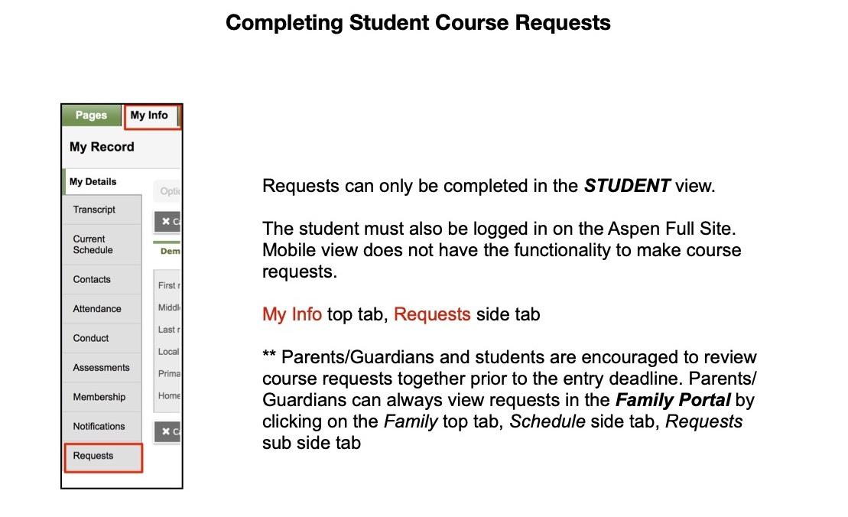

Slide 11
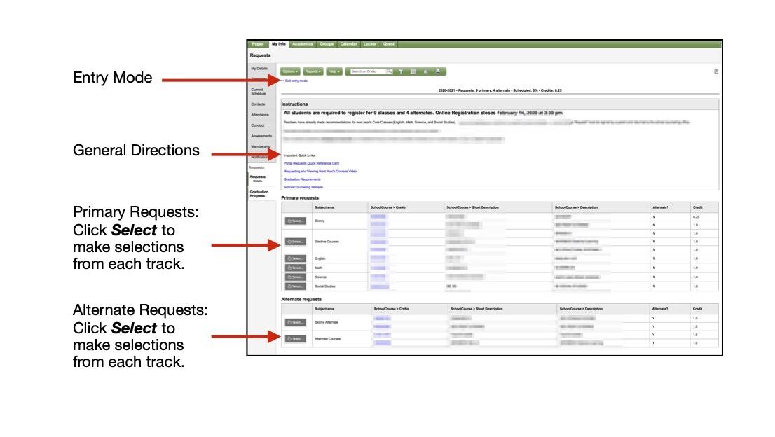

Slide 12
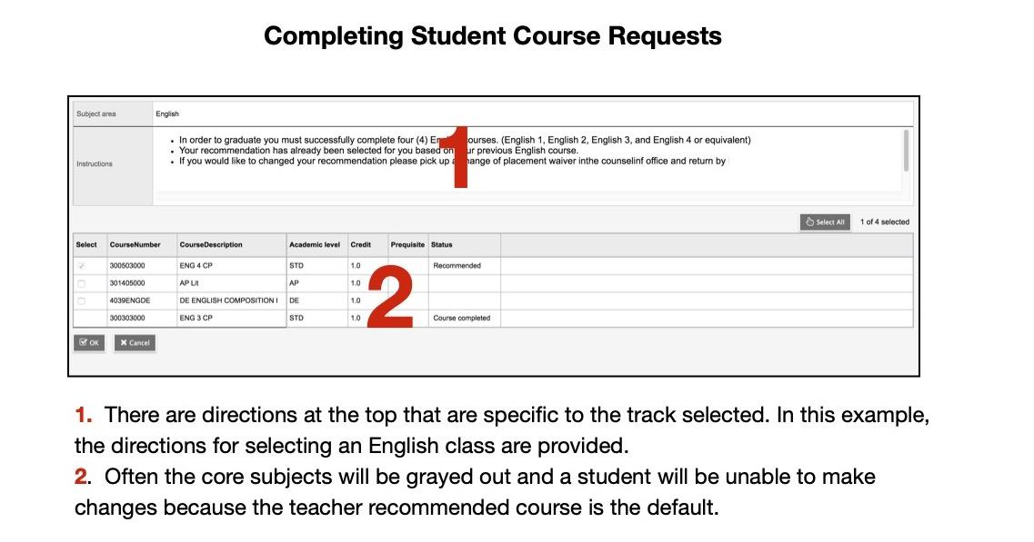

Slide 13
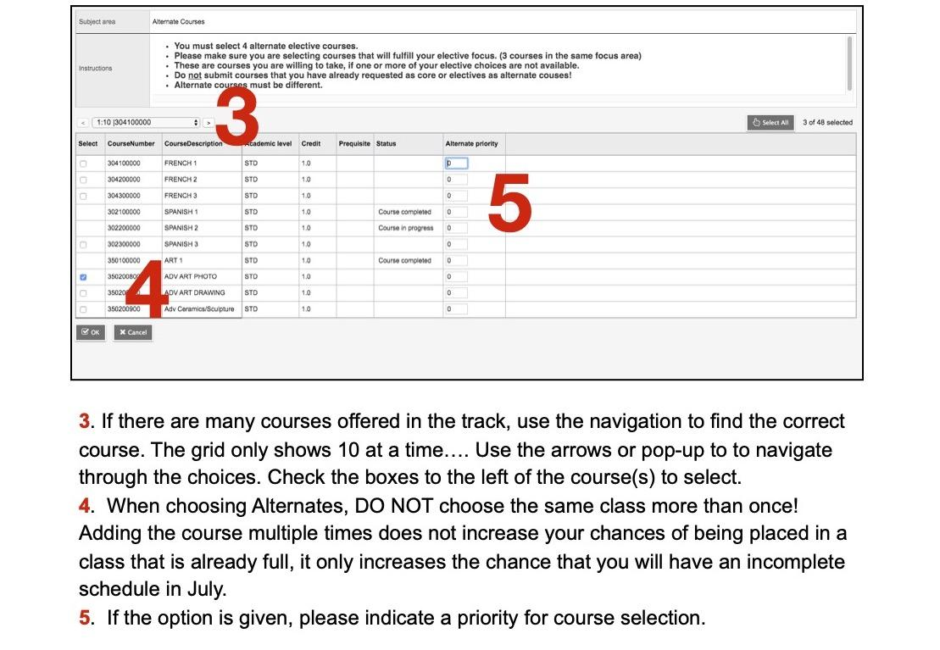

Slide 14
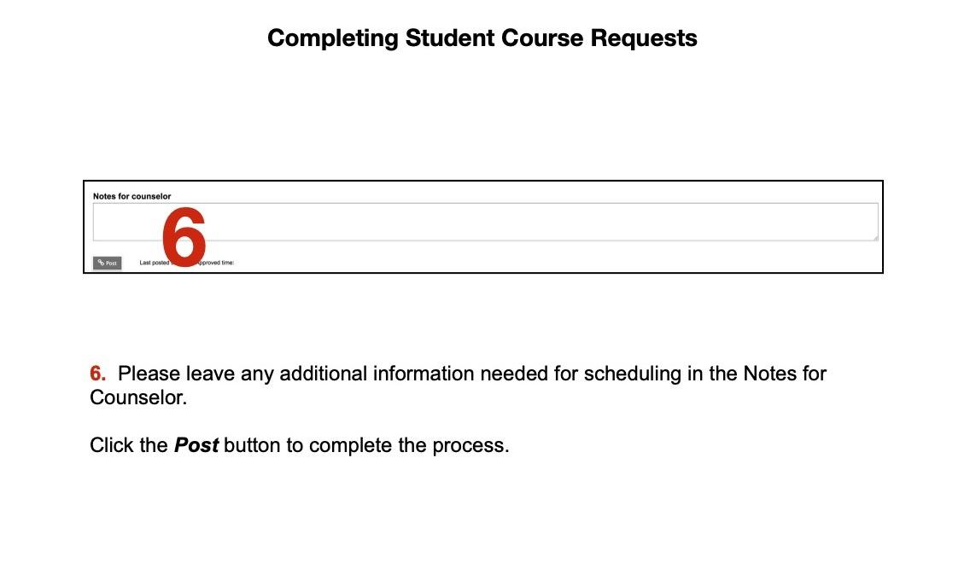

Slide 15
Where do I find more information?
You may visit the FMS website at any time to see information about the upcoming 2023-24 school year and the course selection Process.
https://www.knoxschools.org/Domain/61
You may also contact the grade level counselor:
6th - Brooke Partin - brooke.partin@knoxschools.org
7th - Dr. Linda Treadwell - linda.treadwell@knoxschools.org
8th - Melissa Wright - melissa.wright2@knoxschools.org

