Slide 1
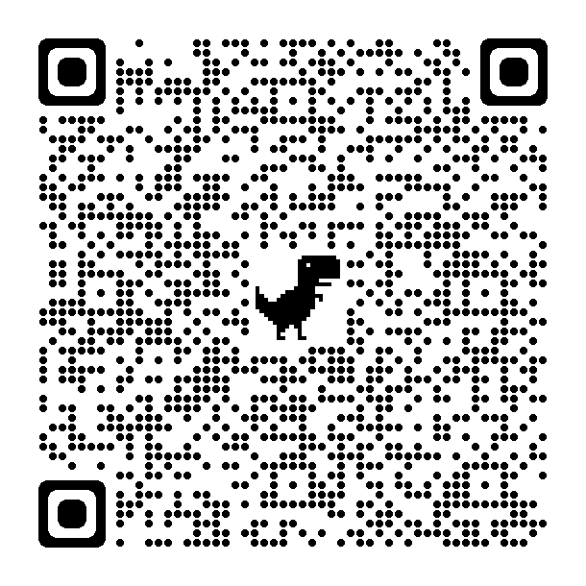
Paying for College
Notes:
This is the THEC/TSAC Paying for college presentation; we will be talking to you guys about the different types of federal and state aid and the financial aid process…
A brief history about our state agency…THEC/TSAC was Created by the General Assembly in 1967 & 1974 to serve as the coordinating body for all public higher education entities and the administration of state financial aid.
Our Mission:
We are Relentlessly focused on increasing the number of Tennesseans with a postsecondary credential
Our Focus:
The Prosperity of Tennessee Families
The Workforce for Tennessee Employers
The Success of Tennessee Students
A few of the state programs we administer:
Tennessee Education Lottery scholarships (aka TELS)
Hope Scholarship
TSAA
GAMS –General Assembly Merit Scholarship
TNPromise
DEG
Wilder N
Ned McWherter

Slide 2
Financial Aid Terms
COA – cost of attendance; varies by institution
Program of Study –(CPoS) Only classes required for your Program of Study are eligible for financial aid funding.
Institutional aid - means aid from a college or career school (from the school’s own funds)
EFC – expected family contribution; number derived from the FAFSA and used to determine need based aid eligibility
FAFSA – Free Application for Federal Student Aid
FSA ID – usernames/passwords created by student AND parent to electronically sign the FAFSA
SAR – student aid report; summary of FAFSA information
Verification – random “audit” of FAFSA
Grant – free money based on need
Loan – money borrowed that must be paid back with interest
Scholarship – free money awarded on the basis of merit, skill, or unique characteristic
Work study – money received from on campus employment
Notes:
Starting with a few terms to help provide greater clarity and understanding of the Financial Aid process and Key terms you’ll see on your financial aid offers across all colleges and universities.
COA- The school’s budget
Program of Study or Course Program of Study -once in college receiving aid, only coursework that counts towards your degree is eligible for such aid.
Originally, CPoS only applied to federal aid, but now it also applies to students receiving state aid (e.g. TSAA, HOPE, Naifeh, and Promise).
EFC-The student's estimated financial need is the difference between the cost of attending college and you and your family's contribution or the EFC. Financial need is partially or fully met in a form of grants, loans, scholarships, and/or student jobs.

Slide 3
Senior Year Checklist
Fall Semester
Take and retake the ACT/SAT
Apply to several colleges (admissions, institutional aid, etc.) and utilize their net price calculators
Complete TN Promise application by November 1, 2021
Complete 2022-23 FAFSA by February 1, 2022
Spring Semester
Complete local/private scholarship applications
Review college acceptances, compare financial aid packages, ask questions, and follow up as needed
Notes:
Here is a checklist for a Class of 2022 student. As s/he returns to high school in August, the student should plan to…
Take the ACT/SAT multiple times in order to achieve a best score for admissions/scholarship purposes;
Apply to several colleges from an admissions perspective and also research and complete each college’s scholarship process. Moreover, schedule an in-person visit at each college.
Complete the 2022-23 FAFSA available October 1 at www.fafsa.gov. Most high school seniors and students, in general, until they reach the age of 24, will need their parents’ information year after year to submit the FAFSA.
Following winter break, students will complete applications for local scholarships. Colleges which have accepted the student for admissions purposes will communicate financial aid package. These packages should be reviewed and any questions should be asked of the college

Slide 4
Federal Aid
The U.S. Department of Education's office of Federal Student Aid provides more than $120 billion in financial aid to help pay for college or career school each year.
Notes:
The FAFSA- Free Application for Federal Student Aid… is aid that comes from the federal government – specifically, the U.S. Department of Education. It's money that helps a student pay for education expenses at a postsecondary school (e.g., college, vocational school, graduate school). Federal student aid covers such expenses as tuition and fees, room and board, books and supplies, and transportation.
Even if you are not sure what school you are gong to attend, you still want to make sure you complete the FAFSA as early as possible.
You can pick multiple schools to send your FAFSA information to and if afterwards you decide on a school that you did not include to send your information to you can include it later.
Colleges will use your FAFSA information to determine the types and amounts of financial aid you’re eligible to receive.

Slide 5
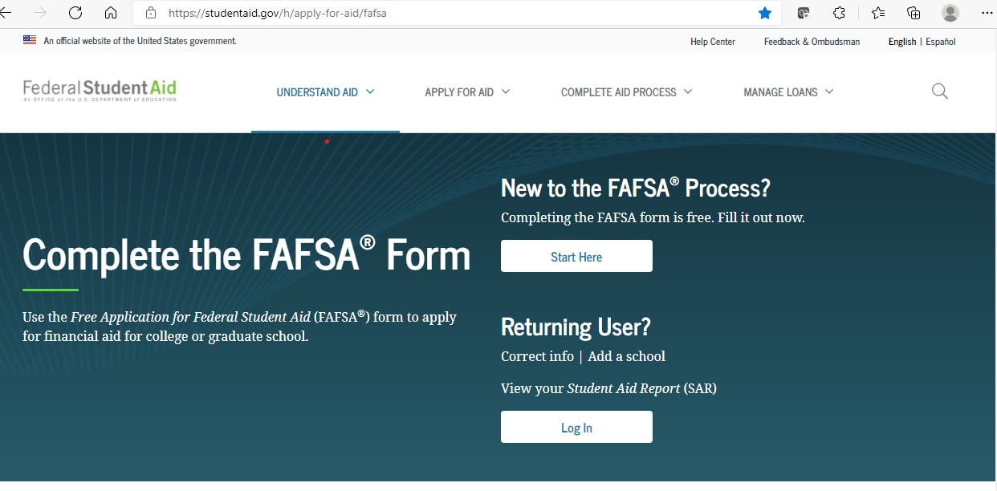
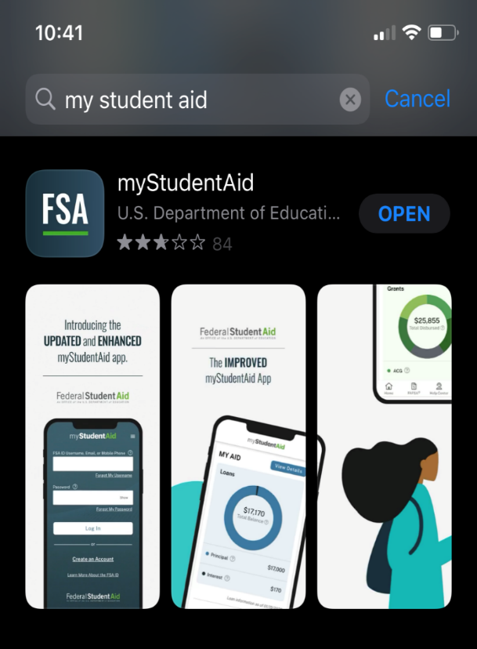
2022-23 FAFSA
Available October 1, 2021
www.fafsa.gov or mobile app
2020 income/ tax information
Notes:
The FAFSA will be available October 1 of your senior year or approximately a year before you enter college-
By filling out the FAFSA you will be considered for eligibility for the federal financial aid programs. You’ll also be considered for some state and private grants and institutional aid the college may offer. Some private colleges may have more private grant money available than state colleges.
Remember most colleges will also ask you to complete school specific forms that ask for more detailed financial information.
It’s also important to remember, you will need to complete the FAFSA each year in which you wish to be considered for financial aid.
The FAFSA asks you questions about your personal financial situation such as your family income, assets, family size and number of family members attending college. The goal of the FAFSA is to determine how much financial aid you need and whether you are eligible to receive federal aid.
The primary reason people do not file the FAFSA is that they assume they will not be eligible to receive any aid. This is a costly mistake.
If you have already done the FAFSA4CASTER then this will be easy for you. It takes an average of 20 minutes to complete.

Slide 6
FAFSA 2-step
FSA ID username/password creation
Student AND parent will create separate FSA IDs (studentaid.gov) to use IRS DRT and sign electronically
FAFSA application – 3 sections
Student demographic information
Parent demographic and financial information
Student financial information

Slide 7
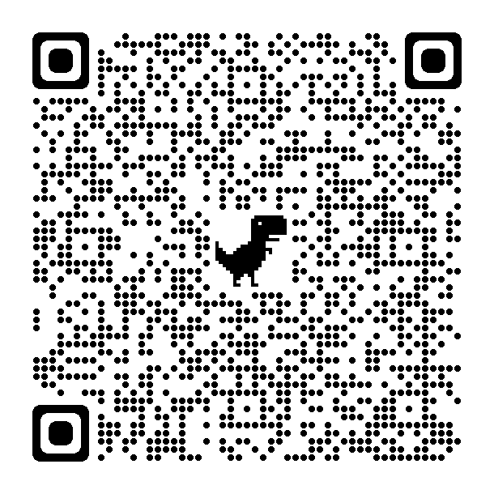
FAFSA Checklist
Student’s Social Security number
Parent(s)’ Social Security number(s)
If a parent does not have a Social Security Number, enter 000-00-0000
Student’s driver’s license number if you have one
2020 tax information (including 2020 W-2, Schedule 1, and Schedule K-1 forms) for student and parent(s)
Records of your untaxed income, such as child support
Checking and savings (e.g. Money Market, CDs, etc.) account balances

Slide 8
FAFSA Dependency
24 or older?
Married?
Master’s or Doctorate?
U.S. Armed Forces?
Veteran?
Children/dependent receiving ½ their support from you?
Since you turned 13, were both parents deceased, foster care, or ward of the court?
Emancipated?
Legal guardianship?
Unaccompanied youth who was homeless?

Slide 9
Four Parts of the EFC
Parent Income
Student Income
Parent Assets
Student Assets

Slide 10
Need Based Aid
Expected Family Contribution (EFC)
0 – 5486 calculation
Pell Grant
Work-Study
SEOG
Subsidized Direct Loan
Notes:
There are several federal financial aid programs. It is important to note a couple of things: (1) some are based on demonstrated need, but others are available even if you do not demonstrate need, and (2) you must file a FAFSA to be considered for all these programs.

Slide 11
Federal Loans
Subsidized Student
3.73% fixed (2021-22)
Interest does not accrue initially
Unsubsidized Student
5.28% fixed (2021-22)
Interest does accrue
Parent PLUS
6.28% fixed (2021-22)
Interest does accrue

Slide 12
Student Loan Limits
Notes:
There are annual borrowing limits – depending on whether you are a dependent student (must provide parent information on your FAFSA) or independent student and your year in college.

Slide 13
Reasons for FAFSA
HOPE Scholarship
Student & PLUS loans
Institutional aid/Colleges require it

Slide 15
State Aid
The Tennessee Higher Education Commission & Student Assistance Corporation is relentlessly focused on increasing the number of Tennesseans with a post secondary credential

Slide 16
Tennessee College of Applied Technology
Diploma/certificate programs
Notes:
Colleges of Applied Technology
They are the state of Tennessee's premier providers of state-of-the-art technical training for students to obtain the technical skills and professional training necessary for advancement in today’s competitive job market.

Slide 17
TN Colleges of Applied Technology (TCAT)
27 TCAT main campuses plus satellite campuses
Diploma/certificate programs
Notes:
27 TCAT main campuses plus satellite campuses
Diploma/certificate programs

Slide 18
TCAT
Wilder- Naifeh
$667 per trimester
TSAA
$333 per trimester
TN Promise
Award amount varies
Pell Grant
$2,165 per trim’ster max (2021-22)
0 – 5846 EFC Need based (2021-22)
0 –4500 EFC February 1
Certificate/ Diploma TCAT
Last dollar to offset tuition
Need
Merit
Notes:
What does financial aid look like at a TCAT?

Slide 19
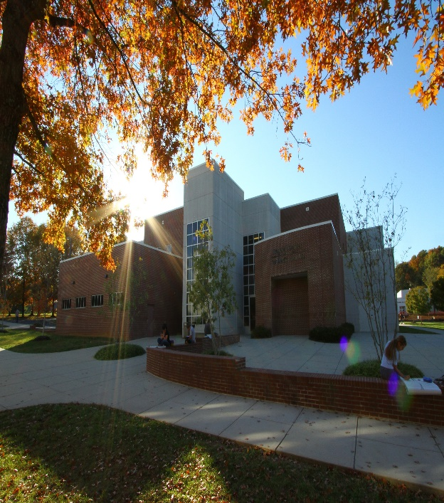
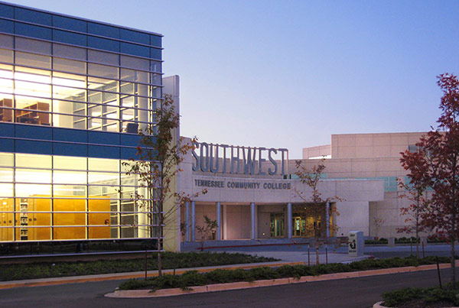
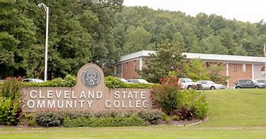
Tennessee Community College
Associate and Associate of Applied science degrees
Notes:
Offers associate degree and certificate programs that focus on preparing you for a certain career. Also, offers two-year associate degrees that prepare you to transfer to a four-year college to earn a bachelor's degree.

Slide 20
TN Community Colleges
13 community colleges plus satellite campuses
Associate degree/certificate programs
Notes:
Red fill – program is need-based (i.e. income based). No fill – program is neither need-based nor merit-based.

Slide 21
TN Community College
HOPE Scholarship
$1,500 per semester
TN Promise
TSAA
$650 per semester
Award amount varies
Pell Grant
$3,247 per semester max (2021-22)
0 – 5846 EFC Need based (2021-22)
0 – 4500EFC February 1
21 ACT/SAT or 3.0 GPA*
Last dollar to offset tuition
Need
*All courses calculated on a 4.0 scale
per the Uniform Grading Policy
Merit
Notes:
What does financial aid look like at a Community college?
Pell and TSAA is based on FAFSA every year-
Hope, allows in theory “16 month rule” (December grad a little different) 16 months to enroll in a Tennessee eligible school or one of the regionally SACS(6) accredited institution (you wont be eligible for state aid but will still be eligible for Hope if the student comes back and enrolls in a Tennessee school (clock starts with graduation date).
Terminating event – 5 years or Bachelor degree
Pell grant results will be shown on confirmation page after the student has applied for FAFSA.

Slide 22
TN Promise Checklist
Apply to the Tennessee Promise program at www.tnpromise.gov by November 1, 2021
Complete 2022-23 FAFSA at www.fafsa.gov by February 1, 2022
Attend spring mandatory meeting as coordinated by partnering organization
Complete 8 hours of community service by July 1, 2022 (coordinated by partnering organization)
Notes:
Tuition Freedom (Emphasis the difference between Hope and Promise)
In 2014, Tennessee created the Tennessee Promise program for students graduating from Tennessee high schools. Through this innovative program, graduating seniors in our state can qualify for a last-dollar scholarship to cover all mandatory tuition and fees at any community or technical college for up to two years.
Here is a checklist for a Class of 2022 student. As s/he returns to high school in August, the student should plan to…

Slide 23
TN Promise Examples
COA
Student responsibilities: Books, food, online fees, other fees, gas, etc.
TSAA $650
Pell $3,247
Tuition
$2,250
TN Promise $750
TN Promise
$2,250
HOPE $1,500
1
2
EFC 6000
GPA 3.25
3
EFC 8000 ACT 19/GPA 2.9
EFC 0
Need
Merit

Slide 24
TN Promise (Semester)
Examples | A | B | C
Tuition | $2,250 | $2,250 | $2,250
HOPE/Pell/TSAA | -$3,250 | -$1,500 | $0
Gap | $0 | $750 | $2,250
TN Promise | $0
Tuition | $0
$750
$0
$2,250
$0

Slide 25
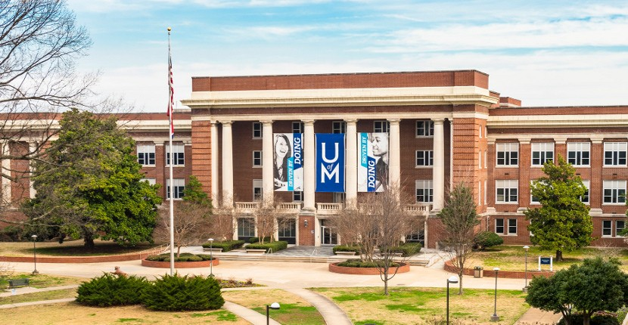
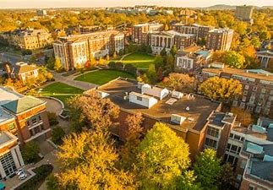
TN 4-yr Public & Private
Bachelor’s degree and higher
Notes:
A 4-year college program is an undergraduate degree program that leads to a bachelor's degree in a specific area of study. Students pursue a bachelor's degree to prepare for a profession, graduate study or both.
Financial Aid at a TN 4yr Public or Private
Federal Aid
Pell Grant
State Aid
Hope Scholarship
TSAA

Slide 26
TN 4-yr Public & Private
Austin Peay State University
UT Martin
Tennessee State University
Tennessee Tech University
UT Knoxville
Middle Tennessee State University
University of Memphis
UT Health Science Center
UT Chattanooga
Notes:
What does financial aid look like at MTSU or Vanderbilt?

Slide 27
TN 4-yr Public & Private
HOPE Scholarship
$1,750/$2,250 per semester
TSAA
$1,000+ per semester
Pell Grant
$3,247 per semester max (2021-22)
0 – 5846 EFC Need based (2021-22)
0 – 4500 EFC February 1
21 ACT/SAT or 3.0 GPA*
*All courses calculated on a 4.0 scale
per the Uniform Grading Policy
Need
Merit
Notes:
Red fill – program is need-based (i.e. income based). Blue fill – program is merit-based (ACT or GPA).
You can be a eligible citizen and non citizen ( Visa T, human trafficking, and battered immigrant status) page 41 on next guide

Slide 28
HOPE Supplements
GAMS
Aspire Award
$250/$750 per semester
$500 per semester
29 ACT/SAT & 3.75 GPA*
Parents AGI ≤$36,000
*All courses calculated on a 4.0 scale
per the Uniform Grading Policy
Need
Merit
Notes:
Red fill – program is need-based (i.e. income based). Blue fill – program is merit-based.
GAMS -$500 no matter where you attend college.

Slide 29
Other State Aid
HOPE Foster Child Tuition Grant
STEP UP Scholarship
Dependent Children Scholarship
Ned McWherter Scholarship

Slide 30
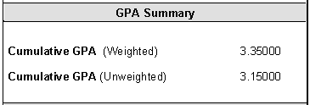
HOPE/GAMS GPA
HOPE GPA (4.0 scale) = most districts’ unweighted GPA
Notes:
Ask school before if they have multiple GPA’s (if yes, use slide).
Example of uniformed grading policy:
A=4 pts
B=3 pts
Depending on your college.. The college may use your weighted GPA but the state of TN does not as it pertains to State Aid

Slide 31
Cost Example (Semester)
Fall Sem. | 4y Public
Tuition | $5,000
Housing | $4,500
Books | $750
Est. Cost | $10,250
HOPE | -$1,750
Bal. owed | $8,500

Slide 32
Out-of-state
Pell Grant
$3,247 per semester max (2021-22)
0 – 5846 EFC Need based (2021-22)
Need
Notes:
Red fill – program is need-based (i.e. income based).

Slide 33
Cost Example (Semester)
Fall Sem. | Out-of-St
Tuition | $15,125
Housing | $6,875
Books | $800
Est. Cost | $22,800
FAFSA | -$0
Bal. owed | $22,800

Slide 34
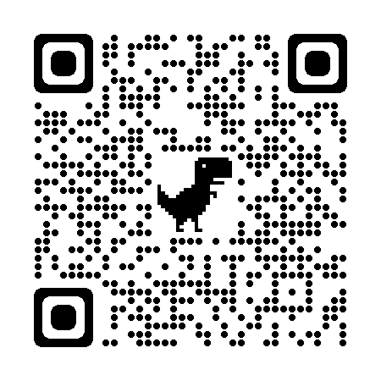
Dual Enrollment Grant (DEG)
Talk with your school counselor to determine your best dual enrollment option.
11th & 12th graders
Beginning January, the first four DEGs will cover tuition and mandatory fees at community college/TCAT.
Fall application deadline is September 15
www.tn.gov/tsacstudentportal

Slide 35
Adult Students
TN Reconnect* Checklist
Complete the TN Reconnect application at www.tnreconnect.gov.
Apply to community college, TCAT, or eligible TN Reconnect institution.
Submit the appropriate FAFSA at www.fafsa.gov (deadline varies).
Enroll in a degree or certificate program at least part-time (6+ hours).
*Must be independent student per FAFSA

Slide 36
Need Help?
FAFSA.Help@tn.gov
Recordings & Infographics:
www.collegefortn.org

Slide 37
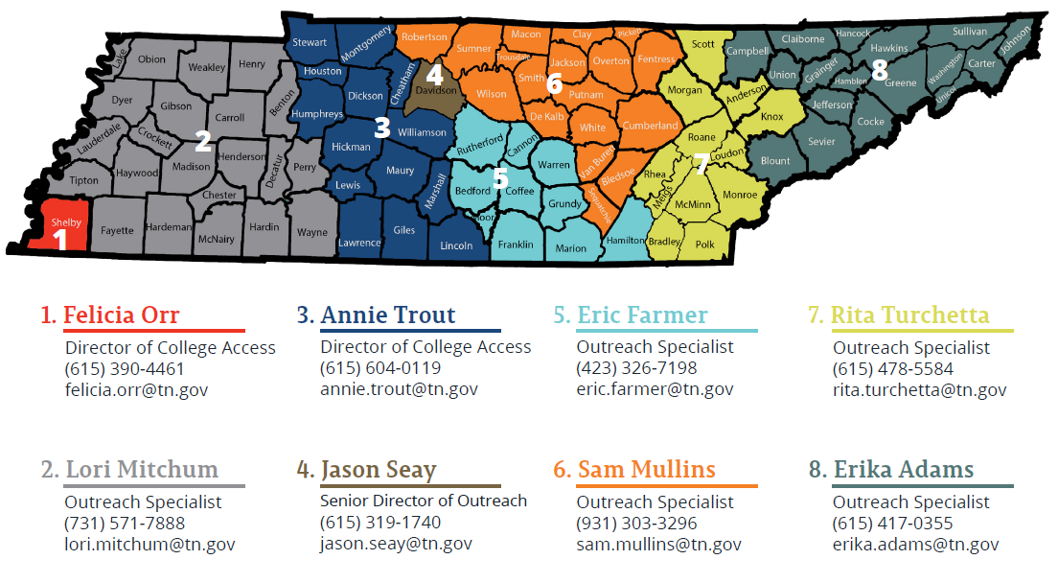
Outreach Division
Notes:
Red fill – program is need-based (i.e. income based).

Slide 38
Thank you!
Rita.turchetta@tn.gov
tnpromise
collegefortn.org

Slide 39
Federal Loans
Subsidized Student
3.73% fixed (2021-22)
Interest does not accrue initially
Unsubsidized Student
5.28% fixed (2021-22)
Interest does accrue
Parent PLUS
6.28% fixed (2021-22)
Interest does accrue

Slide 40
Student Loan Limits

Slide 41
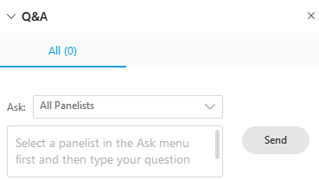
The webinar will begin at 6:00 CDT. _____ If you are unable to hear, click communicate and select call me or use computer audio from audio connection. _____ Please chat questions by using the chat bubble or Q&A.

Slide 42
The webinar will begin at 6:00 CDT. _____ If you are unable to hear, click communicate and select call me or use computer audio from audio connection. _____ Please chat questions by using the chat bubble or Q&A.
Notes:
Hi Everybody, Its great to be here with you tonight.. This is my colleague Felica Orr and my name is Rita Turchetta and we work for the state agency that administers the state Grant and Scholarship programs; THEC-Tennessee Higher Education Commission and TSAC-Tennessee Student Assistance Corporation.
A little bit of housekeeping before we begin.. If you have questions, please use the chat button or the Q & A button and make sure you address your questions to either all attendees or all panelist.
Also, a pdf version of this presentation will be emailed to you some time tomorrow.

