Slide 1

The IEP Olympics
Going for the Gold in KCS

Slide 2

What Do You Want To Be When You Grow Up??

Slide 3
Transition Plans
WHAT DO WE ALWAYS HEAR??
A Rapper or Musician
A Professional Athlete
A Doctor or a Lawyer
A Video Game Designer/Tester
I have no idea!!!!!
These are amazing options and goals we will never discourage, but having alternate options or secondary plans are wise for anyone!! And sometimes, kids just aren't sure what they want!

Slide 4
Activity
Secondary Plans
If Plan A for a student is to be a musician, what could we help them think about as some additional career options?
  Sound Technician
  Stage Hand
  Work in a theatre/music venue
  Work in a music store
  Work at a radio station
  Write about music (Students with a passion for writing)
  Attend a University Music Program

Slide 5
Activity
Secondary Pathways
Group A
  Professional athlete
Group B
  Medical Professional (doctor, vet, etc…)
Group C
  Video Game Designer
Group D
  Politician

Slide 6
How Do We Help Them Get There?
Take what a student is passionate about and guide them
Listen
Write effective transition plans
Make meaningful connections
Help the student GROW with their plan!

Slide 7
Strong Predictors of Post-Secondary Success
1. Access to the general education curriculum
2. High expectations for students
3. Friendships and supportive peer relationships
4. Youth leadership in educational and transition planning
5. Self-determination skills and opportunities
6. Early career development and paid and/or unpaid work experiences
7. Extracurricular and volunteer involvement
8. Collaboration and systems linkages
9. Parent and family involvement
10. Caring teachers and mentors
11. Natural supports and partners in the community
TDOE Special Education Framework – pg. 133

Slide 8
Objectives
Teachers will be able to develop student-specific Transition Plans that assist students in achieving measurable post-secondary goals and improving outcomes after high school
Teachers will be able to use the Transition Checklist to develop student-centered, compliant Transition Plans as a part of the IEP

Slide 9
What is Post-Secondary Transition Planning?
Team approach to planning designed to help students prepare for and manage the many changes they encounter following graduation, including:
  College (Community or 4-year), technical school, vocational school, or programs such as Futures at UT, Next Steps at Vanderbilt, TigerLife at the University of Memphis, etc…
  Ways to find work, fill out job applications learn job skills, etc…
  Living and life skills – Finding housing, budgeting, living alone or with others (family or friends), cleaning, self care, mobility in the community, etc...

Slide 10
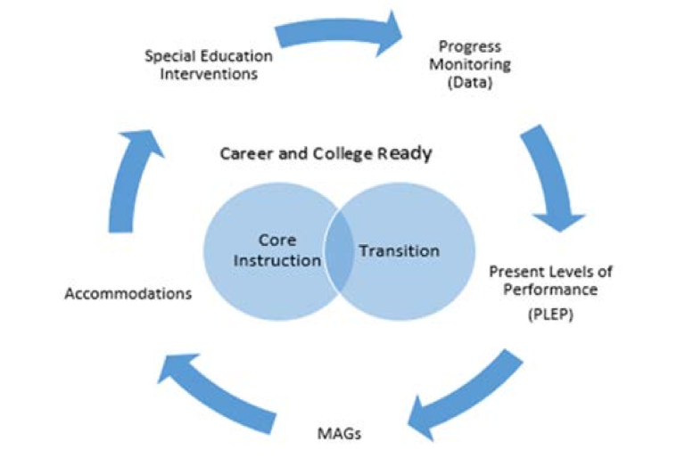
Chart from: TDOE Special Education Framework – pg. 132

Slide 11
Transition Checklist
TRANSITION PLAN CHECKLIST
The following questions should be used as guidelines when developing individual transition plans.
1.___Is there evidence the student was invited to the IEP meeting where transition services will be discussed?
2.___Is there evidence the measurable post-secondary goals were based on age appropriate transition assessments?
3.___Is there an appropriate measurable post-secondary goal that covers education, training, employment and as needed, independent living?
4.___Do the transition services include a course of study that will reasonably enable the student to meet his/her post-secondary goals?
5.___Are there transition services in the IEP that will reasonably enable the student to meet his/her post-secondary goals?
6.___If appropriate, is there evidence that a representative of any participating agency was invited to the IEP meeting with prior consent of the parent or student who has reached the age of majority?
7.___Is at least one IEP goal related to the student’s transition services needs?

Slide 12
Transition Defined
A coordinated set of activities designed within a results-oriented process that improves the academic and functional skills of the student in order to facilitate the student's movement from school to post-school activities such as postsecondary education, vocational education, Integrated employment (including supported employment), continuing and adult education, adult services, independent living or community participation,
based on the individual student's needs, taking into account his or her strengths, preferences and interests, and
includes instruction, related services, community experiences, the development of employment and other post-school adult living objectives and, when appropriate, the acquisition of daily living skills and a functional vocational evaluation.
34 C.F.R. §300.43.
TDOE Special Education Framework – pg. 132

Slide 13
TRANSITION IEP REQUIREMENTS
Step 1: Assessment (Prior to the meeting)
You must complete at least two assessments for transition
One must address SKILLS (interpersonal, daily living, academic readiness, self-advocacy and vocational skills)
One must address INTERESTS & PREFERENCES (recreational, educational and career)
* Summarize each transition assessment & list individually in the present levels of performance on the IEP
Step 2: Draft Measurable Post Secondary Goals/IEP Goals (Prior to the meeting)
*Based on the information obtained from the assessment, develop drafted measurable postsecondary goals
*Develop a Plan of Study or Alternate Plan of Study as appropriate
*Complete transition services (must be completed for students 16 years or older/turning 16 during this IEP year)
* Draft at least one IEP goal that is directly related to the transition services
Step 3: IEP Meeting
* Must obtain “Consent to Invite Outside Agency” prior to inviting outside provider to an IEP meeting (ie. Voc Rehab, DIDD.)
* Must invite student to the IEP meeting and write his/her name on the notice form

Slide 14
Age Appropriate Transition Assessments
Age-Appropriate Transition Assessments
Strengths
Needs
Interests
Preferences

Slide 15
Transition Assessments
The purpose of transition assessment is to identify student strengths, abilities, deficits, interests, and preferences. These assessments are a portion of the present levels of performance (PLEP) and inform transition planning including measurable annual goals.
Transition assessment is an individualized, ongoing process that includes meaningful participation by the student and family. Age-appropriate transition assessments must include information about the academic achievement and functional performance of the student.
Previous pre-vocational assessment data can also be reviewed as a part of this assessment process to inform current assessment.
TDOE Special Education Framework – pg. 135 (2014)

Slide 16
Transition Assessments
Assessments should be based on the skills the students will need to be successful in all life roles, and the supports they will need before, during and after the transition to adult life, and include these areas:
  Functional Academics
  Learning Styles
  Vocational Aptitudes
  Manual Dexterity
  Vocational Interests
  Daily Living Skills
TDOE Special Education Framework – pg. 135 (2014)

Slide 17
Transition Assessments
Where do I find assessment options??
  knoxschools.org> Departments> Special Education> Programs and Services> Secondary Transition
  TN Department of Education website> Special Ed> Secondary Transition>Topics of Interest>Age Appropriate Transition Assessment Toolkit
  transitionta.org (NTACT)
  TN Career Information and Delivery Systems (TCIDS)

Slide 18
Transition Assessments
How do we use the assessments??
The results of age-appropriate transition assessments should be added with present levels of educational performance(PLEPS) on the IEP
Use the PLEP(s) to drive the transition plan and goal(s) that relate to the students post-secondary transition plans. Address skills and preferences separately
Keep past assessments in a working file so that the IEP team can continue to use them as the student progresses through the transition plan

Slide 19
TRANSITION IEP REQUIREMENTS
Step 1: Assessment (Prior to the meeting)
You must complete at least two assessments for transition
One must address SKILLS (interpersonal, daily living, academic readiness, self-advocacy and vocational skills)
One must address INTERESTS & PREFERENCES (recreational, educational and career)
* Summarize each transition assessment & list individually in the present levels of performance on the IEP
Step 2: Draft Measurable Post Secondary Goals/IEP Goals (Prior to the meeting)
*Based on the information obtained from the assessment, develop drafted measurable postsecondary goals
*Develop a Plan of Study or Alternate Plan of Study as appropriate
*Complete transition services (must be completed for students 16 years or older/turning 16 during this IEP year)
* Draft at least one IEP goal that is directly related to the transition services
Step 3: IEP Meeting
* Must obtain “Consent to Invite Outside Agency” prior to inviting outside provider to an IEP meeting (ie. Voc Rehab, DIDD.)
* Must invite student to the IEP meeting and write his/her name on the notice form

Slide 20
Measurable Post-Secondary Goals
The transition plan, beginning with the IEP during which the student will turn 14, must include measurable post-secondary goals in the two required areas of Education/Training and Employment.
These are goals the student is expected to meet within 5 years of graduation or exit from the high school. Some students may have MPSGs in the optional areas of Independent Living Skills and/or Community Involvement depending on their needs and the preference of the IEP team. Transition services are designed to support the student in achieving these goals
TDOE Special Education Framework – pg. 136 (2014)

Slide 21
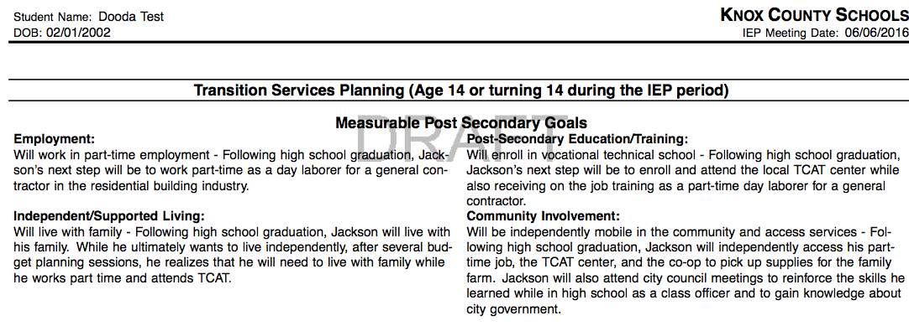
Measurable Post-Secondary Goals
Ex from - TDOE Division of Special Population: Instructional Programming – Summer Training

Slide 22
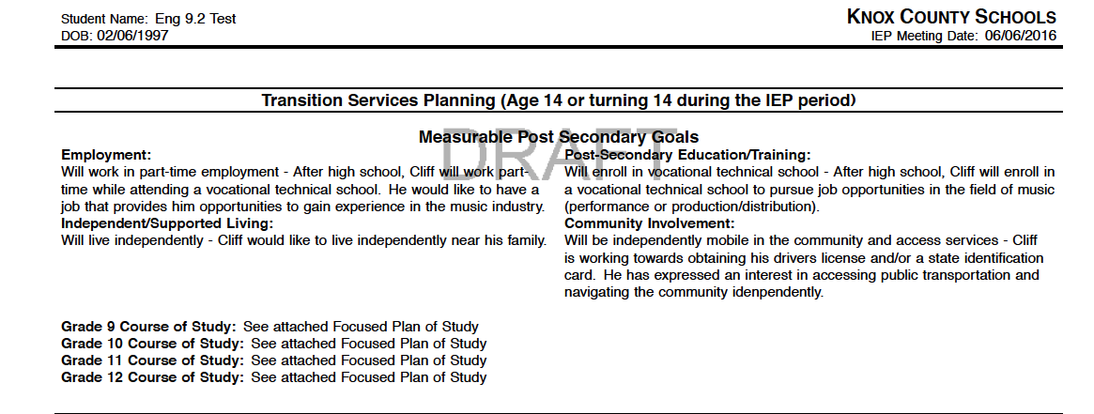
Measurable Post-Secondary Goals

Slide 23
Plans of Study
Focused Plan of Study
  IEP team(including school counselor) determines what instruction and educational experiences will assist the student to prepare for the transition from secondary education to post-secondary life
  How the educational program can be planned and relate directly to the student’s goals beyond secondary education
  Show how those courses are linked to those goals
  Promotes the concept that the high school program focuses on post-school results
  Help students and family select courses of study that are meaningful and motivate students to complete their education
Alternate Plan of Study
  The plan for educational experiences that will be taught to the student who is determined to be appropriate for the alternate assessment. This individual may have a combination of courses and activity-based curriculum as he/she starts high school, then progress to more community-based and Work-Based Learning experiences as the student moves through the high school career
  Often used for students participating in activity based programming

Slide 24
Focused Plan of Study

Slide 25
Alternate Plan of Study

Slide 26
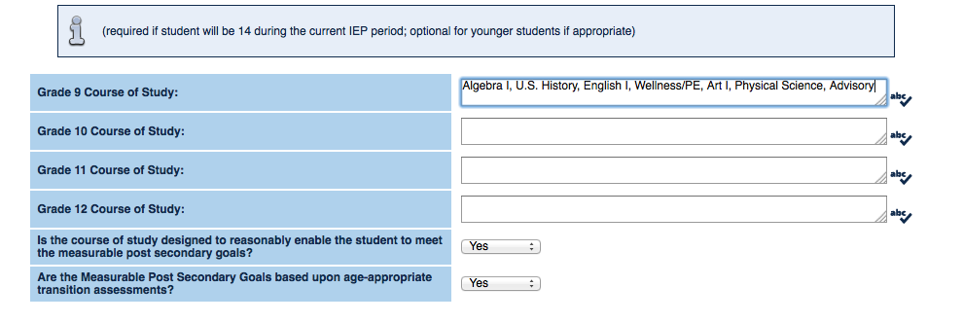
Plans of Study
Example A

Slide 27
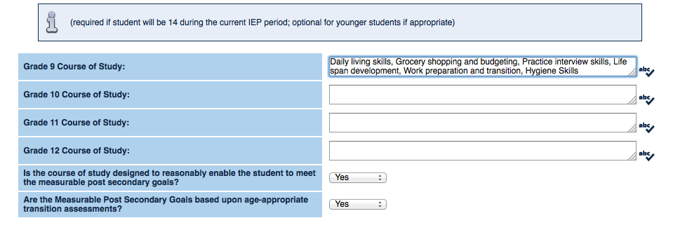
Plans of Study
Example B

Slide 28
Activity
Write a plan of study for a student you have currently:
  Think about diploma path
  Think about state and local graduation requirements
  Detailed and Purposeful

Slide 29
 | Occurs while still in high school | List Courses (academic) | List Courses/Skills (non-academic)
No – Example | Attend community college | -CDC -TBD -General Education Courses | -Life Skills -Career related electives -Electives
Yes – Example | Courses and experiences to occur while student is still in high school (English I, Daily living skills, etc.) | Algebra I, U.S. History, English I Personalized Math, personalized ELA, Wellness/PE | Daily living skills, Grocery shopping and budgeting, Practice interview skills, Life span development, Work preparation and transition

Slide 30
Transition Services
Must be completed for students 16 years or older/turning 16 during this IEP year
A set of coordinated activities that should enhance the process to achieve post-secondary goals
Results-oriented process
Includes a variety of people/agencies- especially the individual!!

Slide 31
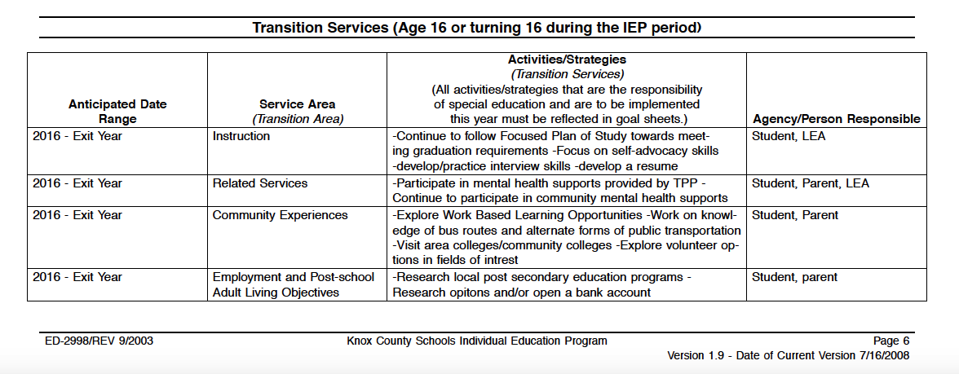
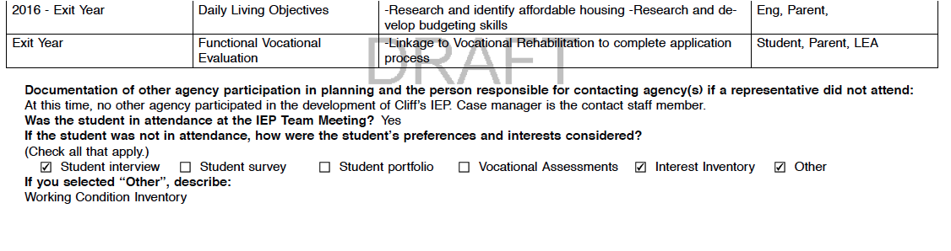
Transition Services

Slide 32
Measurable Annual Goals
Triangulated Annual Goals
Postsecondary Goal
Skill Deficit
Industry Standards
Annual goals that will help the
student make reasonable
progress toward achieving
their goals

Slide 33
Develop Instructionally Appropriate Goals for Transition
An annual goal must be established for each identified exceptional area. The goal must describe what the student can reasonably be expected to accomplish in each area during a school year as a result of the provision of special education and related services and should be measurable
All high school students should have a goal focusing on transition
Use the present level of educational performance to drive the development of the IEP goal

Slide 34
Annual IEP Goals - Transition
Examples from the Special Education Framework (2014)
  Given simulation or work-based activities for at least 5 different careers, Delia will develop skills necessary to hold a part-time job at a level of “proficient” as measured on the work experience rubric by teacher observation and data collection in 80% of the work experience settings.
  Given instructional lectures and activities, Piper will remain on task 75% of the time as measured by a time on task probe randomly occurring each week for 4 consecutive weeks.
  When frustrated, embarrassed, or increasing in anxiety, Cam will use his coping skills to regulate and maintain his behavior as measured by participation on his behavior log at a rate of 90% per week for 3 consecutive weeks.
TDOE Special Education Framework – pg. 141 (2014)

Slide 35
Annual IEP Goals - Transition
Examples from your peers:
  Given access to professionals with military experience and internet access, the student will research requirements for entrance into the Navy or Army at the entry level and officer level and be able to describe 5 requirements for entrance for each level (ex: graduation requirements, skills sets, experience needed ) as measured by student work product and/or teacher grade book in 2 out of 2 assignments.
  Given 3 desired careers of interest the student will research the educational requirements for all 3 jobs in 3/3 trials with 100% accuracy as measured by teacher observation and work samples.
  Given various simulated, real word scenarios, the student will independently demonstrate self-advocacy skills by using appropriate communication skills, asking for assistance/clarification, and identifying needed accommodations in a variety of settings, 3 out of 5 opportunities as measured by teacher made data collection tool.
  Given instruction in a self-advocacy/self determination curriculum, the student will understand his basic rights under IDEA and ADA, and his individual civic responsibilities with 100% accuracy on 8 of 10 opportunities as measured through data collection and teacher observation.

Slide 36
TRANSITION IEP REQUIREMENTS
Step 1: Assessment (Prior to the meeting)
You must complete at least two assessments for transition
One must address SKILLS (interpersonal, daily living, academic readiness, self-advocacy and vocational skills)
One must address INTERESTS & PREFERENCES (recreational, educational and career)
* Summarize each transition assessment & list individually in the present levels of performance on the IEP
Step 2: Draft Measurable Post Secondary Goals/IEP Goals (Prior to the meeting)
*Based on the information obtained from the assessment, develop drafted measurable postsecondary goals
*Develop a Plan of Study or Alternate Plan of Study as appropriate
*Complete transition services (must be completed for students 16 years or older/turning 16 during this IEP year)
* Draft at least one IEP goal that is directly related to the transition services
Step 3: IEP Meeting
* Must obtain “Consent to Invite Outside Agency” prior to inviting outside provider to an IEP meeting (ie. Voc Rehab, DIDD.)
* Must invite student to the IEP meeting and write his/her name on the notice form

Slide 37
Consent to Invite Outside Agencies
Must obtain “Consent to Invite Outside Agency” prior to inviting outside provider to an IEP meeting (ie. Voc Rehab, DIDD.)
Found on the front page of EdPlan/Easy IEP under Documents

Slide 38
The IEP Team Meeting
Review all transitionally relevant portions of the IEP and the current and past transition assessments (as needed) with the team
Ask for input from all IEP team members to help provide insight into post-secondary goals
Push the student to be an advocate for themselves and understand the IEP process
Self Advocacy
  Training
  Student knowledge of strengths and areas to grow
  Student participation in the development of the IEP
  Student participation in the team meeting and ownership of their IEP and transition plan

Slide 39
Transition Checklist
TRANSITION PLAN CHECKLIST
The following questions should be used as guidelines when developing individual transition plans.
1.___Is the evidence the student was invited to the IEP meeting where transition services will be discussed?
2.___Is there evidence the measurable post-secondary goals were based on AGE APPROPRIATE TRANSITION ASSESSMENTS?
3.___Is there an appropriate measurable post-secondary goal that covers education, training, employment and as needed, independent living?
4.___Do the transition services include COURSES OF STUDY that will reasonably enable the student to meet his/her post-secondary goals?
5.___Are there TRANSITION SERVICES in the IEP that will reasonably enable the student to meet his/her post-secondary goals?
6.___If appropriate, is there evidence that a representative of any participating agency was invited to the IEP meeting with prior consent of the parent or student who has reached the age of majority?
7.___Is at least one IEP goal related to the student’s transition services needs?

Slide 40
Other Post-Secondary Transition Considerations
Diploma Type:
  General Education, Occupational, SPED
Work-Based Learning
  KCS Work Programming
  Community Job
College/Post-secondary educational options
Linkage to Vocational Rehabilitation

Slide 41
Activity
For this activity:
  Return to your groups
  Review the transition information provided in the questionnaire
  Develop one annual goal, and work through the portions of the transition services section for the student you have
  Present to the group
I will gather the results for each student and create an example summary of each so you have an snapshot for a few different types of students and transition ideas.
Notes:
Potentially out

Slide 42
Secondary Transition Coordinator
Michelle Pittman: michelle.pittman@knoxschools.org
Phone: 594-1490
Fax: 594-1712
School Mail: A.J. 5th Floor

Slide 43
References
Pittman, Michelle. "Transition Planning Process." Lecture/Presentation
Labor &Industries (L&I), Washington State. “Kids and teens share their dream jobs – Video 3” Youtube. Youtube, LLC, 23 June 2016.
"Special Education Secondary Transition." - TN.Gov. N.p., n.d. Web. 21 June 2016.
United States. Tennessee Department of Education. Special Education. Special Education Frameworks. Nashville: Tennessee Department of Education, 2014. Print.

