Slide 1
TNCompass
TNCompass
Instructional Guide on Licensure Advancement
All educator licensure transactions are completed electronically in TNCompass. This step-by-step guide is specifically for licensure advancement for Out of State, Practitioner and Apprentice
Practitioner Teacher to Professional Teacher
The Practitioner License may be advanced to the Professional License if advancement expectations are met. In addition to completing an approved educator preparation program and submitting passing scores on required content and literacy assessments, educators must meet the following criteria:
Three years of experience, AND
The recommendation of the Director of Schools -OR- Documentation of 30 Professional Development Points (PDPs)
This instructional packet details advancing your license with the recommendation of the Director of Schools/Superintendent.

Slide 2
Licensure Advancement
TNCompass
Experience Requirements for Licensure Advancement
To advance from an initial license (transitional, apprentice, practitioner) to the professional license, teachers and school service personnel must demonstrate 3 years of experience working in an appropriate pre-K-12 instructional setting.
Three Years of Experience: To meet the criteria for advancement, the educator must present documentation of three years of education work experience. The burden of proof rests with the educator. In total, the experience must be no less than twenty-five months of full-time work of which at least one year (10 months) must have been within a Tennessee public or approved non-public school. An educator must have held a valid license during the period when the experience was accrued. Substitute experience cannot be used for license advancement. Candidates who successfully complete a full school year internship clinical practice and hold a practitioner license shall receive credit for a year of teaching experience. These candidates must submit an experience verification form signed by both their Educator Preparation Provider, and the school system in which they completed their internship.
Out-of-State Experience: To receive credit for education work experience outside of Tennessee, the educator must have held a valid license while teaching in the state or country where the experience was accrued. Other types of experience may be used for the purposes of salary ratings. For example, a local education agency may elect to give an engineer credit for the years spent working in that field prior to becoming a teacher. However, that type of work experience is not counted for purpose of advancing to a professional license.

Slide 3
TNCompass
TNCompass

Slide 4
How to Start a License Advancement Transaction
TNCompass
Click on “My Educator Profile”.
Under the Transaction tab click on “Start a new transaction”

Slide 5
TNCompass
Select the type of change you are requesting (Advance an Active License).

Slide 6
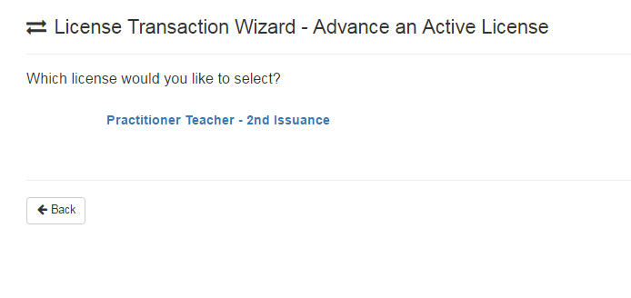
TNCompass
Click on the blue Practitioner Teacher link. If you have an apprentice license, below it will read Apprentice.

Slide 7
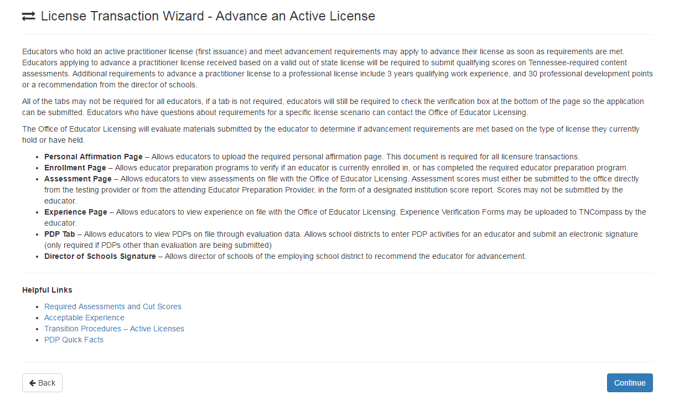
TNCompass
The next screen confirms the transaction being requested and provides helpful information regarding the transaction type.
Click “Continue” and the system will guide you to the end.

Slide 8
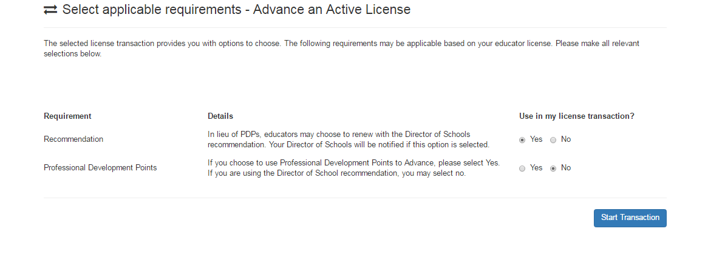
TNCompass
You will need to select the method of advancement, select “Yes” for Recommendation and “No” for Professional Development Points. Both must be selected in order to start the transaction.
Click on “Start Transaction” and the system will guide you to the end.

Slide 9
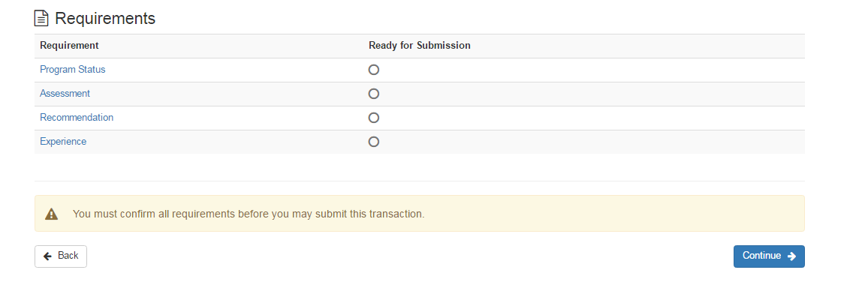
TNCompass
Overview page, click “Continue” to the next tab.
Some educators may only have Recommendation and Experience listed.

Slide 10
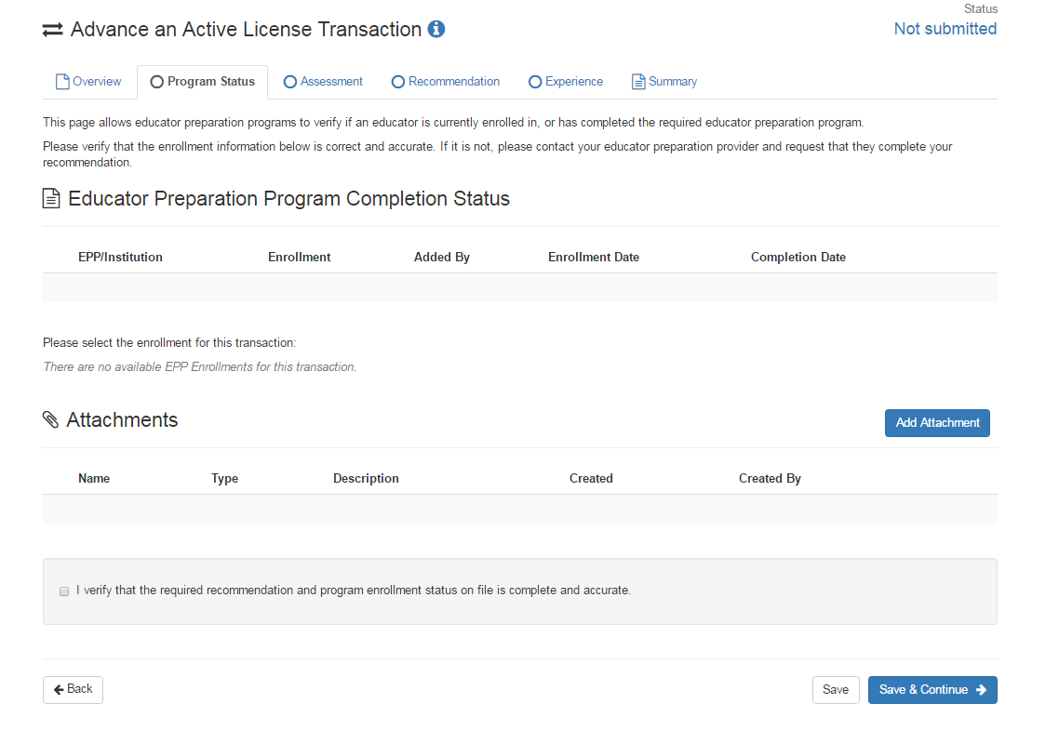
TNCompass
Program Status page, check the verify box and click “Save & Continue”.
The program status section would be completed by the college or university where the educator completed their education preparation program; however if the educator renewed an apprentice or out of state teacher license to the Practitioner 2nd issuance then this portion of the application will not need to be completed since the information would be located in state’s old database.

Slide 11
TNCompass
Assessment page
Check box to verify and click “Save & Continue” to the next tab.

Slide 12
Recommendation Page
STOP HERE UNTIL THE SUPERINTENDENT OR HIS DESIGNEE HAS COMPLETED THE RECOMMENDATION! This should take a day or two so the educator will need to log in to complete the transaction.

Slide 13
Recommendation Page
Once the superintendent or his design has completed the recommendation, the educator must add a checkmark verifying the statement below under the Recommendation tab and click continue.

Slide 14
TNCompass
Experience Page
Verify all teaching experience listed is accurate.
If any of your teaching experience including this current year is not listed under the Experience tab, click on the “Add Attachment” link and upload your experience form that was provided to you.
Check box to verify and click “Save & Continue” to the next tab.

Slide 15
TNCompass
Summary Page
The Summary page indicates what you have completed. If any of the requirements do not have a checkmark in the circle, you will need to complete it before you can submit your transaction. Click Save & Continue if your requirements are ready for submission.

Slide 16
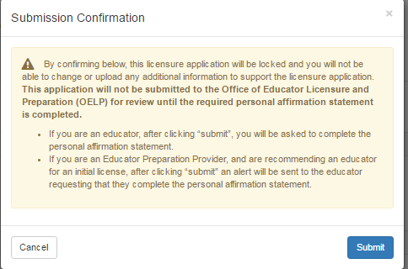
TNCompass
Read and confirm by clicking on the “Submit” button below.

Slide 17
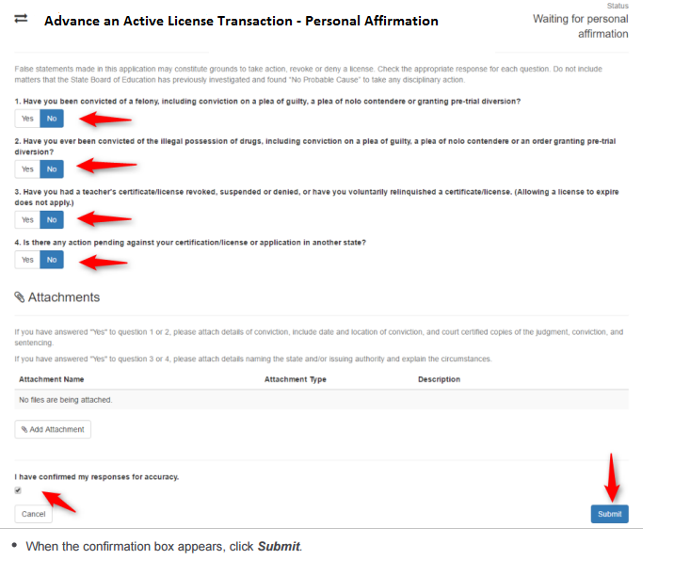
TNCompass
Complete the Personal Affirmation page and click “Submit”.

Slide 18
TNCompass
Once you have completed your licensure advancement transaction, your status will show Pending OELP review until approved by the Office of Educator Licensing. You will receive an email notification from TNCompass once your professional license has been approved.
If you have a question regarding your licensure advancement, please contact christine.wolf@knoxschools.org or 594-1912. If you wish to contact the Office of Educator Licensing, you may contact them at 615-532-1448.

